Slide 1
1st Look at the New But For Standard in Massachusetts Torts
Vincent N. DePalo
Smith Duggan Buell & Rufo LLP
Stesha A. Emmanuel
McCarter & English
Robert L. Boston
Smith Duggan Buell & Rufo LLP
Barrie Duchesneau
Lubin & Meyer, P.C.

Slide 2
Contact Info:
Vincent N. DePalo
Smith Duggan Buell & Rufo LLP
vincent.depalo@smithduggan.com
Stesha A. Emmanuel
McCarter & English
semmanuel@mccarter.com
Robert L. Boston
Smith Duggan Buell & Rufo LLP
robert.boston@smithduggan.com
Barrie Duchesneau
Lubin & Meyer, P.C.
bduchesneau@lubinandmeyer.com

Slide 3
LET’S TAKE THE CONCEPT OF CAUSATION BACK TO THE BEGINNING……
The Pillars of Negligence:
Duty
Breach of Duty
Causation (actual/factual causation and proximate cause/foreseeability)
Damages

Slide 4
The Rise of the Substantial Contributing Factor Standard to Determine Factual Causation
Which of the fires will ultimately lead to a very bad day for the dog trying to enjoy his coffee? If the fires all started at the same time but in different areas of the room, is there a way to distinguish liability?
See Anderson v. Minneapolis, St. Paul & Sault Ste. Marie Ry. Co., 179 N.W. 45 (Minn. 1920).
B
C
A
D

Slide 5
Restatement (First) of the Law of Torts (1934)
and Restatement (Second) of the Law of Torts (1965)
While substantial factor initially appears in the First Restatement, most citations rely on the Second Restatement for guidance on how to employ the substantial factor analysis. In fact, substantial factor appears in the definition of actual/factual cause: “[i]f two forces are actively operating, one because of the actor's negligence, the other not because of any misconduct on his part, and each of itself is sufficient to bring about harm to another, the actor's negligence may be found to be a substantial factor in bringing it about.” Section 432(2).

Slide 6
Application of the Substantial Contributing Factor Standard
Prior to the Doull decision, the Commonwealth accepted that substantial contributing factor standard was appropriate in matters where there exists multiple causes or tortfeasors.

Slide 7
Application of the Substantial Contributing Factor Standard
Matsuyama v. Birnbaum, 452 Mass. 1, 30, 890 N.E.2d 819 (2008):
“The ‘substantial contributing factor’ test is useful in cases in which damage has multiple causes, including but not limited to cases with multiple tortfeasors in which it may be impossible to say for certain that any individual defendant's conduct was a but-for cause of the harm, even though it can be shown that the defendants, in the aggregate, caused the harm.”

Slide 8
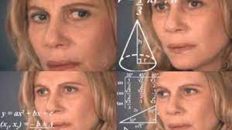

Slide 9
SO WHAT HAPPENED???

Slide 10
Change in Course With The Elimination of “Substantial Contributing Factor” Language
First, with the Restatement
The Restatement (Third) of Torts § 26, Reporter's Note to comment j, at 367, recommended the elimination of the “substantial factor” language from the causation instruction except where there are multiple sufficient causes: “To the extent that substantial factor is employed instead of the but-for test, it is undesirably vague. As such, it may lure the factfinder into thinking that a substantial factor means something less than a but-for cause or, conversely, may suggest that the factfinder distinguish among factual causes, determining that some are and some are not ‘substantial factors.’ Thus, use of substantial factor may unfairly permit proof of causation on less than a showing that the tortious conduct was a but-for cause of harm or may unfairly require some proof greater than the existence of but-for causation.”

Slide 11
Restatement (Third) of Torts: Liability for Physical and Emotion Harm, §§26, 27 (2010)
Under Section 26, the Restatement concludes that “[t]ortious conduct must be a factual cause of harm for liability to be imposed. Conduct is a factual cause of harm when the harm would not have occurred absent the conduct. Tortious conduct may also be a cause of harm under § 27.”
Under Section 27, the Restatement, when describing the effects of multiple causations, concludes that “[i]f multiple acts occur, each of which under § 26 alone would have been a factual cause of the physical harm at the same time in the absence of the other act(s), each act is regarded as a factual cause of the harm.”

Slide 12
Doull v. Foster, 487 Mass. 1 (2021)
In a medical malpractice matter, the trial judge used but-for causation principles when instructing the jury. On appeal, the Supreme Judicial Court used this opportunity to clarify the two competing causation standards and concluded that:
1. “But For” Causation Analysis Must Be Employed In Multiple Causes Matters; and
2. Eliminated “Substantial Factor” and “Substantial Contributing Factor” Language, with rare exceptions
Moreover, the SJC reasoned that the adopted of the Third Restatement would reduce confusing terminology, ensure that jurors properly separated conduct that had no impact from conduct that caused harm and avoid conflicting jury instructions.

Slide 13
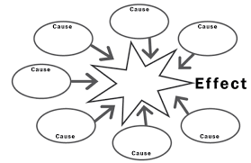
Where Do We Go From Here?

Slide 14
Substantial Contributing Factor vs. But For
A SHIFT IN THE PLAINTIFF’S BURDEN

Slide 15
JURY INSTRUCTIONS HISTORICALLY
SUBSTANTIAL CONTRIBUTING FACTOR
Plaintiffs do not have to prove that the defendant’s negligence was the only or predominant cause of the injury - O’Connor v. Raymark Indus., Inc., 401 Mass. 586, 591-92 (1998).
Did it make a difference in the result?
BUT FOR
The defendant’s conduct was a cause of the plaintiff’s harm if the harm would not have occurred absent the defendant’s negligence. In other words, if the harm would have happened anyway, the defendant is not liable. – Mass Super. Ct. Civil Practice Jury Instructions

Slide 16
THE MEDICAL MALPRACTICE PLAINTIFF’S DILEMMA THE HARM WOULD HAVE OCCURRED ABSENT THE DEFENDANT’S CONDUCT
MULTIPLE DEFENDANTS
If any one defendant is removed from the situation the harm still occurs
“Whether the defendant’s conduct was necessary to brining about the harm.” – Doull v. Foster, 487 Mass. 1, 8 (2021).
MULTIPLE SUFFICIENT CAUSES
Anderson v. Minneapolis, St. Paul & Sault Ste. Marie Ry. Co., 146 Minn. 430 (1920).
Disease process v. defendant’s conduct

Slide 17
DOULL CONCURRENCE
“Only those who meaningfully contribute to a person’s harm should be liable for it.” Wainwright v. Jackson, 291 Mass. 100, 102 (1935)
But-for causation….begins not with what was, but with what might have been.” Doull at 27.
Impending Confusion
How can there be more than one but-for cause?
A TRUE DISSENT

Slide 18
WHAT TO EXPECT Jury Instructions & Verdict Slips
But for the defendant’s conduct would the harm have occurred?
How do we hold more than one tortfeasor liable?
Did the defendant cause the plaintiff’s injury?
How do we hold a defendant liable if his/her duty is to stop an evolving disease or injury process?
Was the defendant a cause of the plaintiff’s injury?
Does this not require an explanation of the long held substantial contributing factor test?

Slide 20
Contacts:
Robert L. Boston
Smith Duggan Buell & Rufo LLP
101 Arch Street, Suite 1950
Boston, Massachusetts 02110
Email: robert.boston@smithduggan.com
Phone: (617) 833 – 1194

Slide 21
Confused?
Factual Cause
But-For Cause
Efficient Cause
Cause in Fact
Legal Cause
Proximate Cause
Scope of Liability
Foreseeability

Slide 22
History of Thought Regarding Causation
Aristotle (384-322 B.C.) – Discussed four separate “causes”:
Material Cause - stone carved into a statute
Formal Cause - shape or form of the statue
Efficient Cause - source of the statute (i.e. the sculptor)
Final Cause - the statue
Sir Francis Bacon (1561-1626)
Discussed “proximate cause” in temporal or spatial terms as the thing or event that is closest to the harm at issue.
Sir Isaac Newton (1642-1727)
Mathematical Principles of Natural Philosophy
An object at rest will remain at rest unless compelled to change by an outside force
This scientific analysis made its way into law through the concept of causal chains (i.e. what action initiates the chain of events that results in the harm)

Slide 23
ROAD MAP
Elements of Medical Malpractice
Types of Medical Malpractice Cases
Causation Instructions
Fact Pattern Analysis

Slide 24
Definition of Medical Malpractice
“‘Medical malpractice’ … is a term commonly used to describe negligence in the provision of medical care and treatment by a doctor, nurse or other healthcare provider.” *
* Massachusetts Superior Court Civil Practice Jury Instructions (MCLE), Vol. I, Chapter 4, Sec. 4.1

Slide 25
ELEMENTS OF MEDICAL MALPRACTICE
DUTY
BREACH
INJURY
CAUSATION

Slide 26
DUTY
Requires a Special Relationship
Physician/Patient
Nurse/Patient
Surgeon/Patient, etc.
Standard of Care
What a reasonably prudent professional in like circumstances would do
Requires expert testimony

Slide 27
Standard of Care
The classic definition:
“the degree of care and skill of the average qualified practitioner, taking into account the advances in the profession.”
-Brune v. Belinkoff, 354 Mass. 102, 109 (1968).
May consider “medical resources available” and ”type of community” of the practitioner. Id.

Slide 28
BREACH
Deviation from the standard of care
Requires expert testimony
Can be both affirmative and negative
May involve supervision or oversight

Slide 29
INJURY
The “easiest” element of a medical malpractice claim
Includes physical and emotional harm
May extend beyond the patient (i.e. consortium claims)
Can include lost chance or lost opportunity for a better outcome

Slide 30
CAUSATION
> Negligence must cause injury for recovery
> Requires expert testimony
> But-For Causation
- Doull standards

Slide 31
TYPES OF MEDICAL MALPRACTICE CASES
Single Cause
Multiple Causes
Multiple Sufficient Cause

Slide 32
CAUSATION INSTRUCTIONS
Lower Court Instructions
Doull Instructions
MCLE Instructions

Slide 33
Lower Court Causation Instructions

Slide 34
Lower Court
With regard to this issue of causation, the Defendant in question’s conduct was a cause of the Plaintiff’s harm . . . if the harm would not have occurred absent, that is but for the Defendant’s negligence. In other words, if the harm would have happened anyway, that Defendant is not liable.

Slide 35
Lower Court
. . . what we mean by cause. I’m going to use the term legal cause here because there can be other causes of things that aren’t necessarily within what the law considers to be legal cause. So I’m going to use that term legal cause.

Slide 36
Lower Court
. . . But I just want to explain to you when I say legal cause what I mean by that word legal cause. That is that the Plaintiffs must have proven that the Defendant in question[‘s] . . . conduct was the cause of . . . Laura Doull’s harm. That is the harm would not have occurred absent the Defendant in question’s negligence.

Slide 37
What the Lower Court Got Right
Focused on but-for causation
Rejected substantial factor causation
Contemplated the possibility of multiple causes

Slide 38
Problems With Lower Court Instructions
The trial judge’s instructions illustrate one of the main issues addressed by Doull and the Restatement (Third) of Torts: combining the concepts of legal and factual cause – leading to confusion
Legal cause is mentioned approximately a dozen times in the jury instructions
Legal cause was also used on the Special Verdict Slip
Did not make a difference in the outcome

Slide 39
Doull’s Causation Instructions:

Slide 40
Doull:
Single Cause
“in the majority of negligence cases, the jury should be instructed on factual cause using a but-for standard as well as legal causation.” Doull v. Foster, 487 Mass. *1, *9 (2021)(emphasis added).
Legal cause “means that the harm must have been ‘within the scope of the foreseeable risk arising from the negligent conduct.’” Doull, 487 Mass. at *4, citing, Leavitt v. Brockton Hospital, 454 Mass. 37, 45 (2009).

Slide 41
Doull:
Multiple Causes
“we conclude that a but-for standard, rather than a substantial factor standard, is the appropriate standard for factual causation in negligence cases involving multiple alleged causes of the harm.” Doull, at *9 (emphasis added).

Slide 42
Doull: Multiple Sufficient Causes
“In . . . multiple sufficient causes the jury should receive additional instructions on factual causation” beginning with “the illustration from the Restatement (Third) of the twin fires so that the complicated concept can be more easily understood by the jury.” Doull, at *10.
“…‘A defendant whose tortious act was fully capable of causing the plaintiff’s harm should not escape liability merely because of the happenstance of another sufficient cause…, operating at the same time.’ The jury should then be instructed that when ‘there are two or more competing causes, like the twin fires, each of which is sufficient without the other to cause the harm and each of which is in operation at the time of the plaintiff’s harm occurs, the factual causation requirement is satisfied.” Id.

Slide 43
MCLE Causation Instructions:

Slide 44
MCLE Instructions
Prepared on behalf of Massachusetts Continuing Legal Education, Inc.
3rd Edition 2014 with 2016 and 2018 Supplements
Instructions cover various practice areas
Massachusetts has not officially adopted any civil jury instructions
Appropriately separates factual and legal cause

Slide 45
MCLE - Medical Malpractice Instructions
§4.3.4 Causation
If you decide that the defendant was negligent, you must then consider whether the defendant’s negligent conduct [caused/enhanced] the plaintiff’s injuries. Even if you find that the defendant was negligent, the defendant is not liable to the plaintiff unless [his/her] negligence caused the plaintiff’s harm. To meet [his/her] burden, the plaintiff need only show that there was greater likelihood or probability that the harm complained of was due to causes for which the defendant was responsible rather than from any other cause. Causation, like negligence, must be proved by expert medical testimony.

Slide 46
MCLE - Medical Malpractice Instructions
§4.3.4 (a) But-For Causation
The defendant’s conduct was a cause of the plaintiff’s harm if the harm would not have occurred without the defendant’s negligence. In other words, if the harm would have happened anyway, the defendant is not liable.

Slide 47
Counterfactual But-For Causation
Unjustly criticized
Mirrors plaintiffs’ claims which call for jurors to ask “what-if” questions
Suited to the task of evaluating causation
Appropriate tool to test the plaintiffs’ claims

Slide 48
MCLE - Medical Malpractice Instructions
§4.3.4 (b) Multiple Sufficient Causes or Tortfeasors: Substantial Factor Test
There may be more than one cause present to produce an injury, and more than one person legally responsible for an injury. The plaintiff does not have to prove that the defendant’s negligence was the only or even the predominant cause of the injury. If two or more causes operating together contributed to the plaintiff’s injury, so that, in effect, the damages suffered were inseparable, then it is enough for the plaintiff to prove that the defendant’s negligence was a substantial contributing factor in causing the injury.

Slide 49
MCLE - Medical Malpractice Instructions
§ 4.3.4 (b) Substantial Factor Test Continued
By “substantial” I mean that the defendant’s contribution to the harmful result, i.e. the defendant’s negligence, was not an insignificant factor. The defendant’s negligence must contribute along with other factors to the result; it must be a material and important ingredient in causing the harm. If the defendant’s negligence was a substantial factor, then is is considered a cause of the plaintiff’s injury, and the plaintiff is entitled to recover. If it was not a substantial factor, if the negligence was only slight or tangential to causing the harm, then even though you may have found the defendant [it/he/she] cannot be held liable to pay damages to the plaintiff on his claim.

Slide 50
MCLE - Medical Malpractice Instructions
§4.3.4 (c) Limitations on Scope of Liability – Foreseeability Test
Furthermore, to establish causation, the plaintiff must show that the general type of harm was reasonably foreseeable to someone in the defendant’s position at the time of the defendant’s negligence. The plaintiff does not have to establish that the defendant foresaw, or should have foreseen, the precise manner in which the harm occurred; but the plaintiff must show that [his/her] harm was a natural consequence of the defendant’s negligence.
The defendant is liable for those injuries that are a reasonably foreseeable consequence of [his/her/its] negligence. When we say that an injury or injuries [is/are] foreseeable, we mean that it is a predictable consequence of the defendant’s negligent act[s] or omission[s].

Slide 51
MCLE - Medical Malpractice Instructions
§4.3.4 (d) Limitations of Scope of Liability – The Risk Standard
On the causation issue, there is one other consideration you must address. A defendant’s liability is limited to those harms that result from the risks that made the defendant’s conduct negligent. You must decide whether the harm to the plaintiff is within the scope of the defendant’s liability. To do that you must first consider why you found the defendant negligent [or some other basis for tort liability]. You should consider all of the dangers that the defendant should have taken reasonable steps [or other tort obligation] to avoid. The defendant is liable for the plaintiff’s harm if you find that the plaintiff’s harm arose from the same general type of danger that was one of those that the defendant should have taken reasonable steps [or other tort obligation] to avoid. If the plaintiff’s harm, however, did not arise from the same general dangers that the defendant failed to take reasonable steps [or other tort obligation] to avoid, then you must find that the defendant is not liable for the plaintiff’s harm.

Slide 52
What the MCLE Instructions Get Right
Separate factual and legal cause
Provides two possible tests for proximate or legal cause: Foreseeability Test and The Risk Standard
Acknowledges the Restatement (Third) of Torts’ rejection of the prior Restatement’s comingling of factual and legal cause
Follows the Restatement (Third) in purging the term “proximate cause”

Slide 53
CONCLUSIONS
Medical Malpractice remains a battle between the experts
Abandoning substantial factor causation will make it easier for juries
Plaintiffs will seek to apply Doull’s standard for multiple sufficient causes in future cases
Defendants will need to adjust strategies to adjust to plaintiffs’ new focus

Slide 54
Contacts:
Robert L. Boston
Smith Duggan Buell & Rufo LLP
101 Arch Street, Suite 1950
Boston, Massachusetts 02110
Email: robert.boston@smithduggan.com
Phone: (617) 833 – 1194

Slide 55
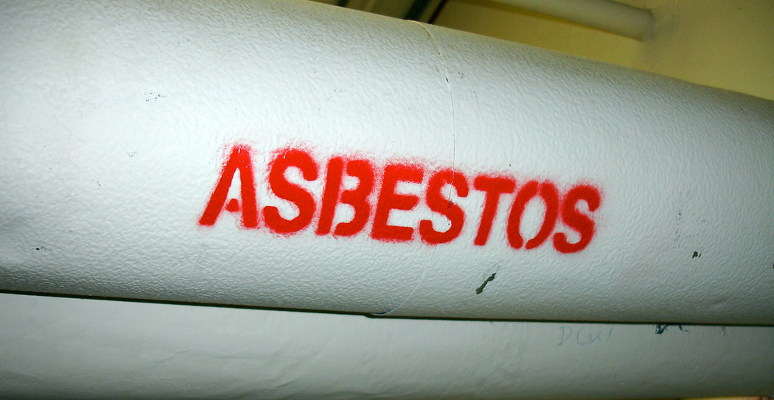
Doull & Toxic Tort Cases

Slide 56
Mass. Asbestos Causation Standard
(1) The defendant’s product contained asbestos (product identification)
(2) The victim was exposed to the asbestos in the defendant’s product (exposure), and
(3) The exposure was a substantial contributing factor in causing harm to the victim (substantial factor).
Morin v. AutoZone Northeast, Inc., 79 Mass. App. Ct. 39, 42 (2011)

Slide 57
Doull v. Foster, 487 Mass. 1 (2021)

Slide 58
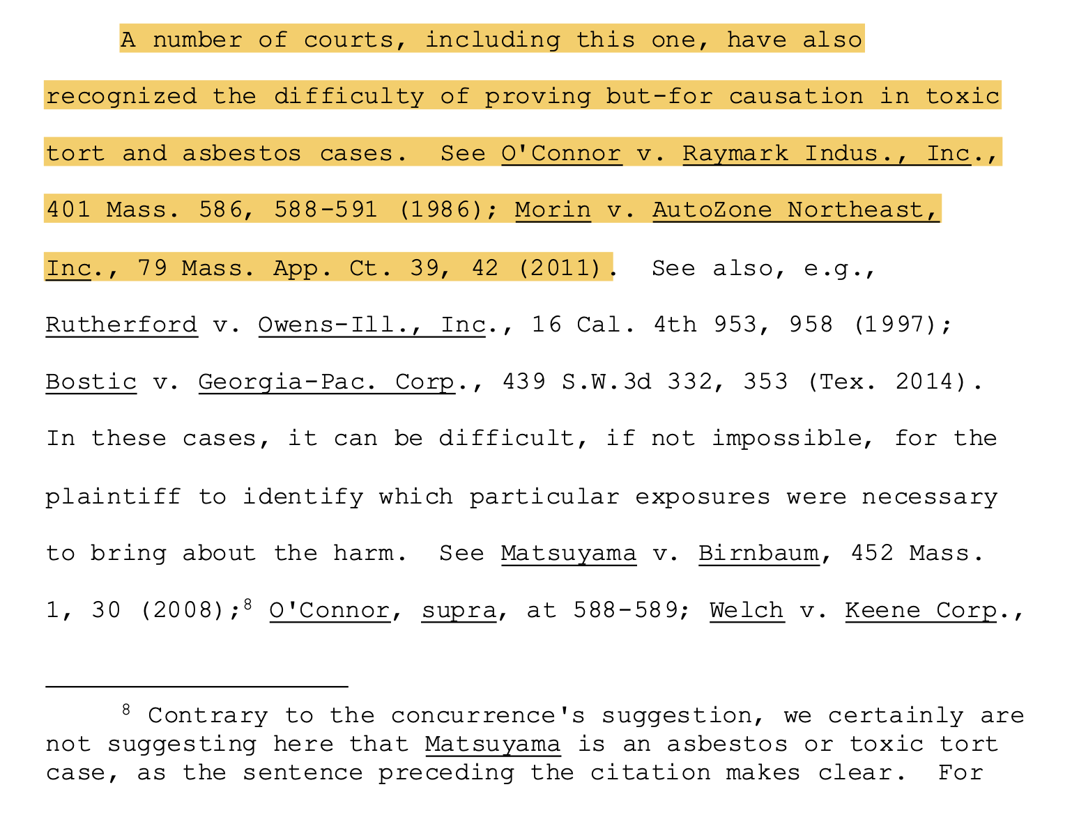
Doull v. Foster, 487 Mass. 1 (2021)

Slide 59
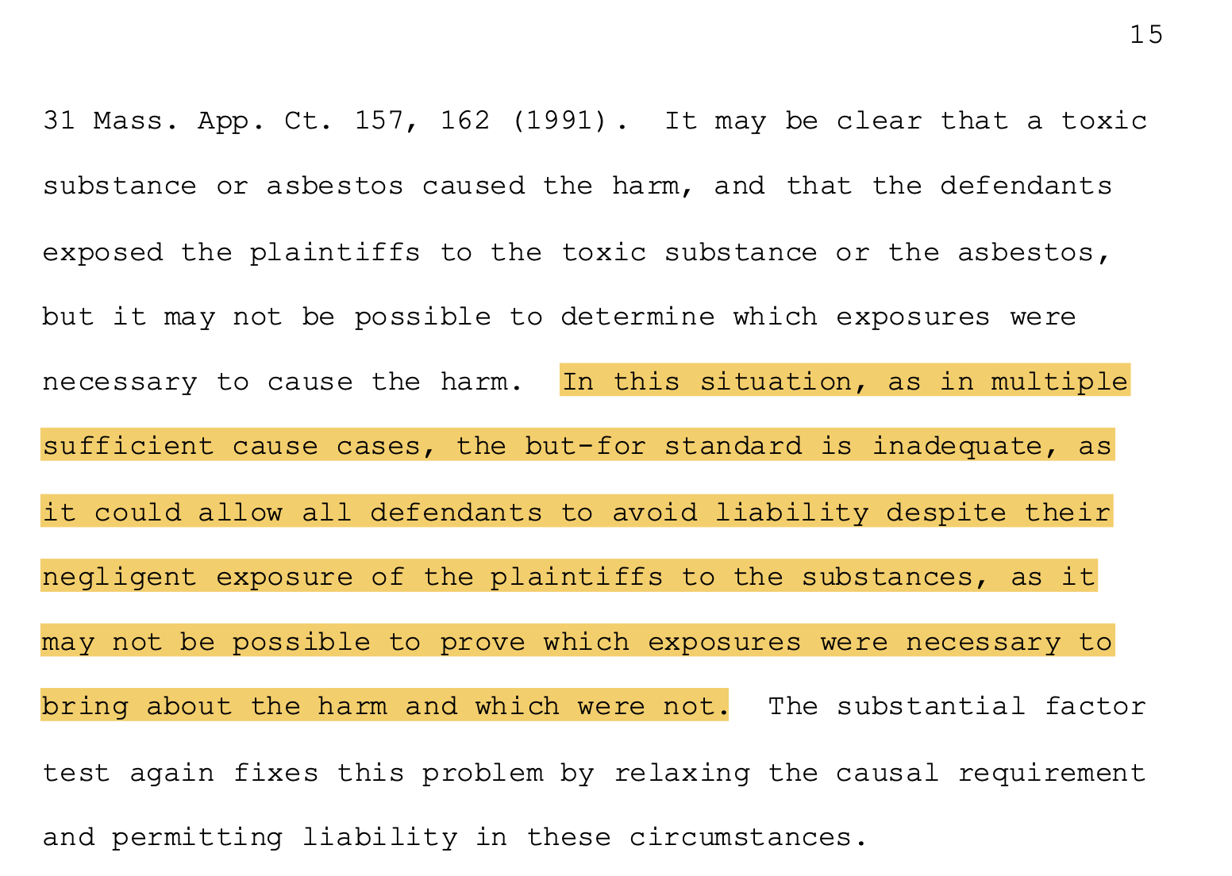
Doull v. Foster, 487 Mass. 1 (2021)

Slide 60
Doull v. Foster, 487 Mass. 1 (2021)

Slide 61
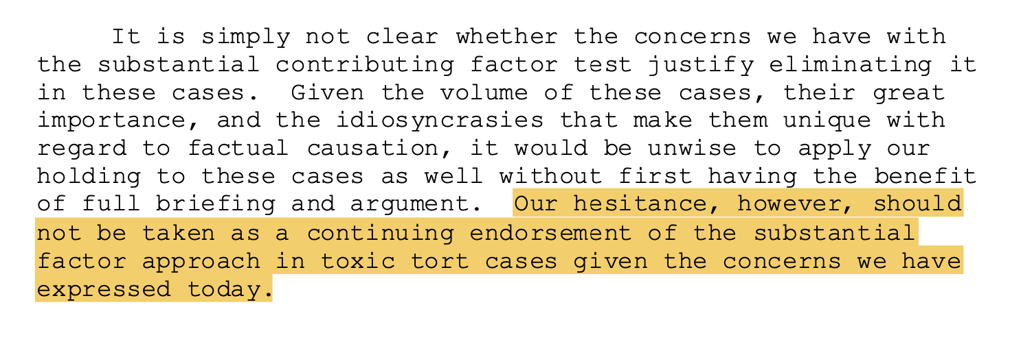
Doull v. Foster, 487 Mass. 1 (2021)

Slide 62
Let’s Go Back to 1988

Slide 63
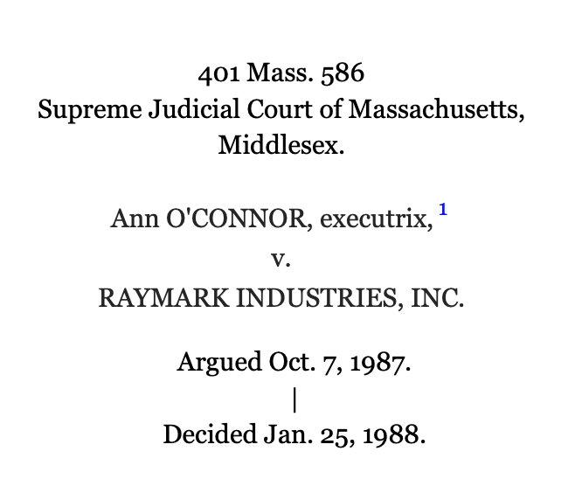
“Did Mr. O’Connor’s exposure to the asbestos contained in those Raybestos-Manhattan products cause, or did it substantially contribute to cause, mesothelioma in him, and did it cause his death?”

Slide 64
“You see the two possibilities are direct cause—but it isn't necessary for the plaintiff to persuade you that the exposure actually caused it.
It's enough if that exposure contributed to cause it in whole or in part, and the reason is very simple:
Raymark is not responsible for Mr. O'Connor's disease and death unless its product was at least in part the cause of the disease and death.
For you to answer ‘yes' to Question Number 2, you have to find that the asbestos contained in this defendant's products was a substantial contributing cause of his illness and death.
It doesn't have to be the only cause, but it has to be a substantial contributing cause.... It means something that makes a difference in the result.

Slide 65
“[W]e agree with the plaintiff that she would be entitled to a new trial if the judge’s instructions, viewed as a whole, might reasonably led the jury to understand that, in order to recover, the plaintiff had to prove “but for” causation…
“We have said before, and we repeat, ‘that if two or more wrongdoers negligently contribute to the personal injury of another by their several acts, which operate concurrently, so that in effect the damages suffered are rendered inseparable, they are jointly and severally liable.”

Slide 66
O’Connor’s Progeny
Welch v. Keene Corp., 31 Mass. App. Ct. 157 (1991)
“We point out that [the plaintiff] is not required to prove that ‘but for’ the particular product of each manufacturer, he would not have been harmed…he need only show… the conduct of the defendant was a substantial factor…”
Morin v. AutoZone Northeast, Inc., 79 Mass. App. Ct. 39 (2011)
“The plaintiff need not produce evidence ‘but for’ causation on the part of the targeted product, but only its contribution to causation of the resulting injury.”
Matsuyama v. Birnbaum, 452 Mass. 1, 31 (2008)
“[T]he ‘substantial-factor’ test[‘s]… primary function was to permit the factfinder to decide that factual cause existed when there were overdetermined causes—each of two separate causal chains sufficient to bring about the plaintiff's harm, thereby rendering neither a but-for cause.”

Slide 67
Why Relaxed Causation Standard in Asbestos Cases?
Morin v. AutoZone Northeast, Inc., 79 Mass. App. Ct. 39 (2011)
Disease’s prolonged latency period
Multiple exposures of the victim
Indistinguishability of contributory exposures

Slide 68
Why Relaxed Causation Standard in Asbestos Cases?
Morin v. AutoZone Northeast, Inc., 79 Mass. App. Ct. 39 (2011)
“Because the resulting injury may not emerge for years or decades the law does not require the plaintiff… to establish the precise brand names of the asbestos-bearing products, the particular occasion of exposure, or the specific allocation of causation among multiple defendants’ products.”
“The plaintiff must produce evidence of a degree of exposure greater than ‘insignificant or de minimis.’”

Slide 69
Asbestos Trial Jury Instructions

Slide 70
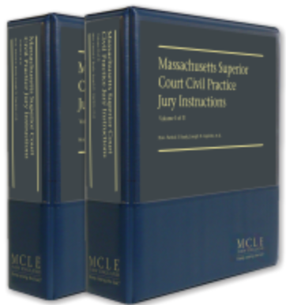
Mass. Super. Ct. Civil Practice Jury Instructions
§ 4.3.4 (b) Substantial Factor Test
“By “substantial” I mean that the defendant’s contribution to the harmful result, i.e. the defendant’s negligence, was not an insignificant factor… it must be a material and important ingredient in causing the harm.”

Slide 71
Two Asbestos Trials in Two Years, Two Different Instructions

Slide 72
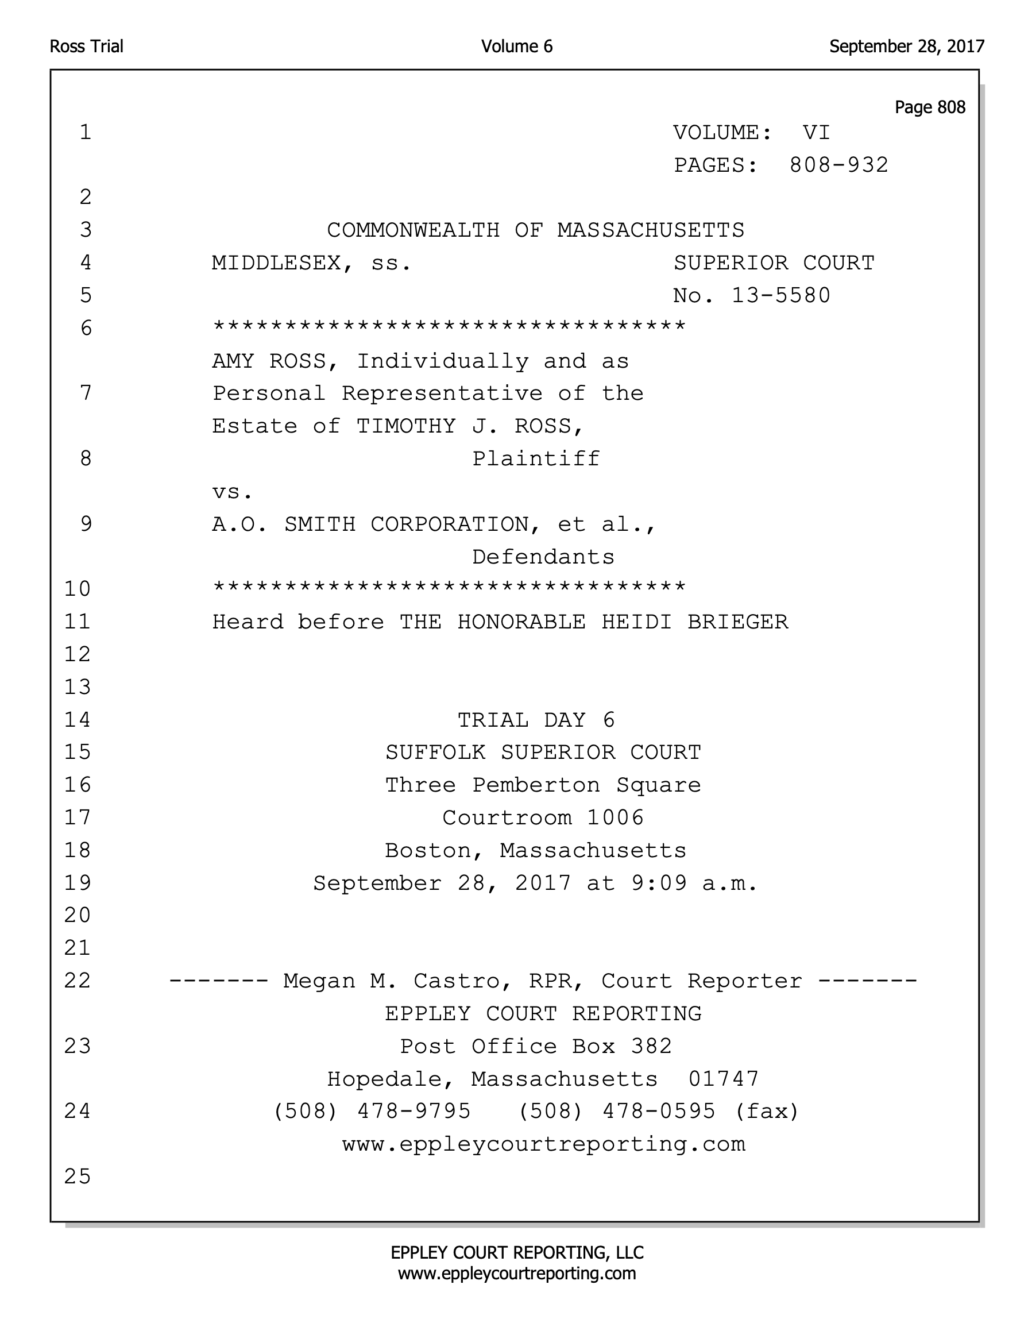
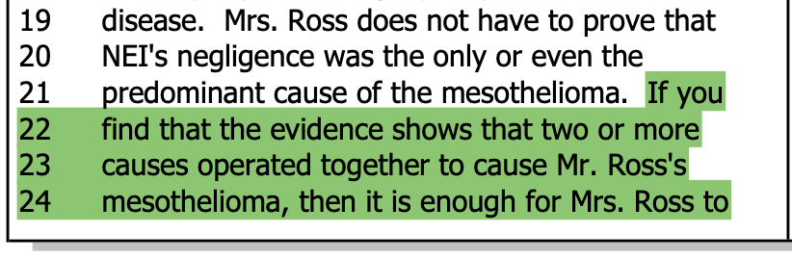
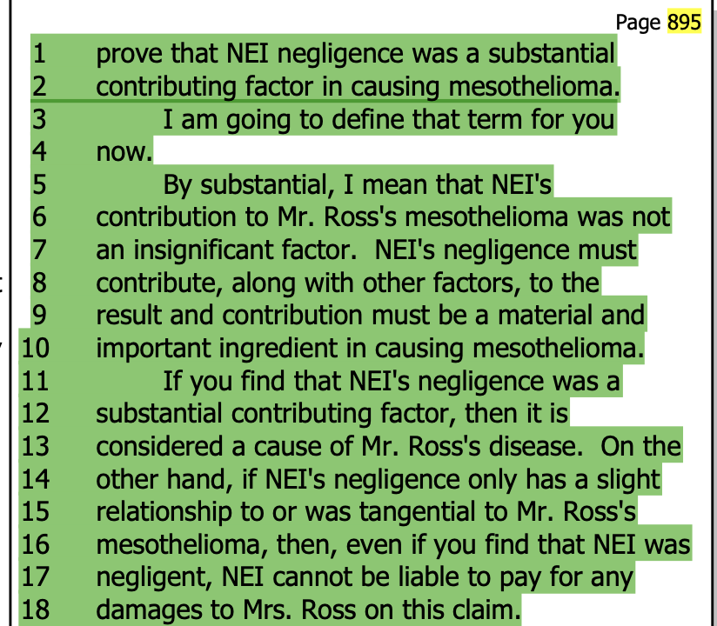
Ross v. A.O. Smith Corp. - Sept. 28, 2017

Slide 73
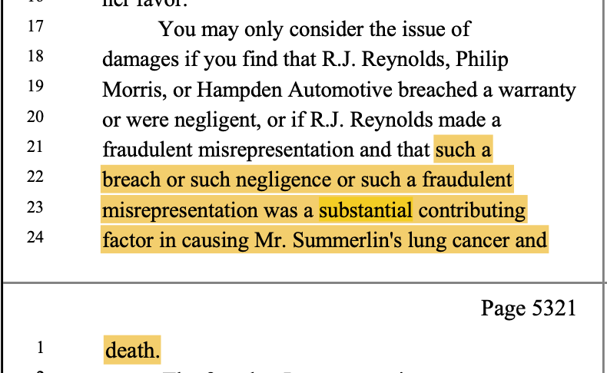
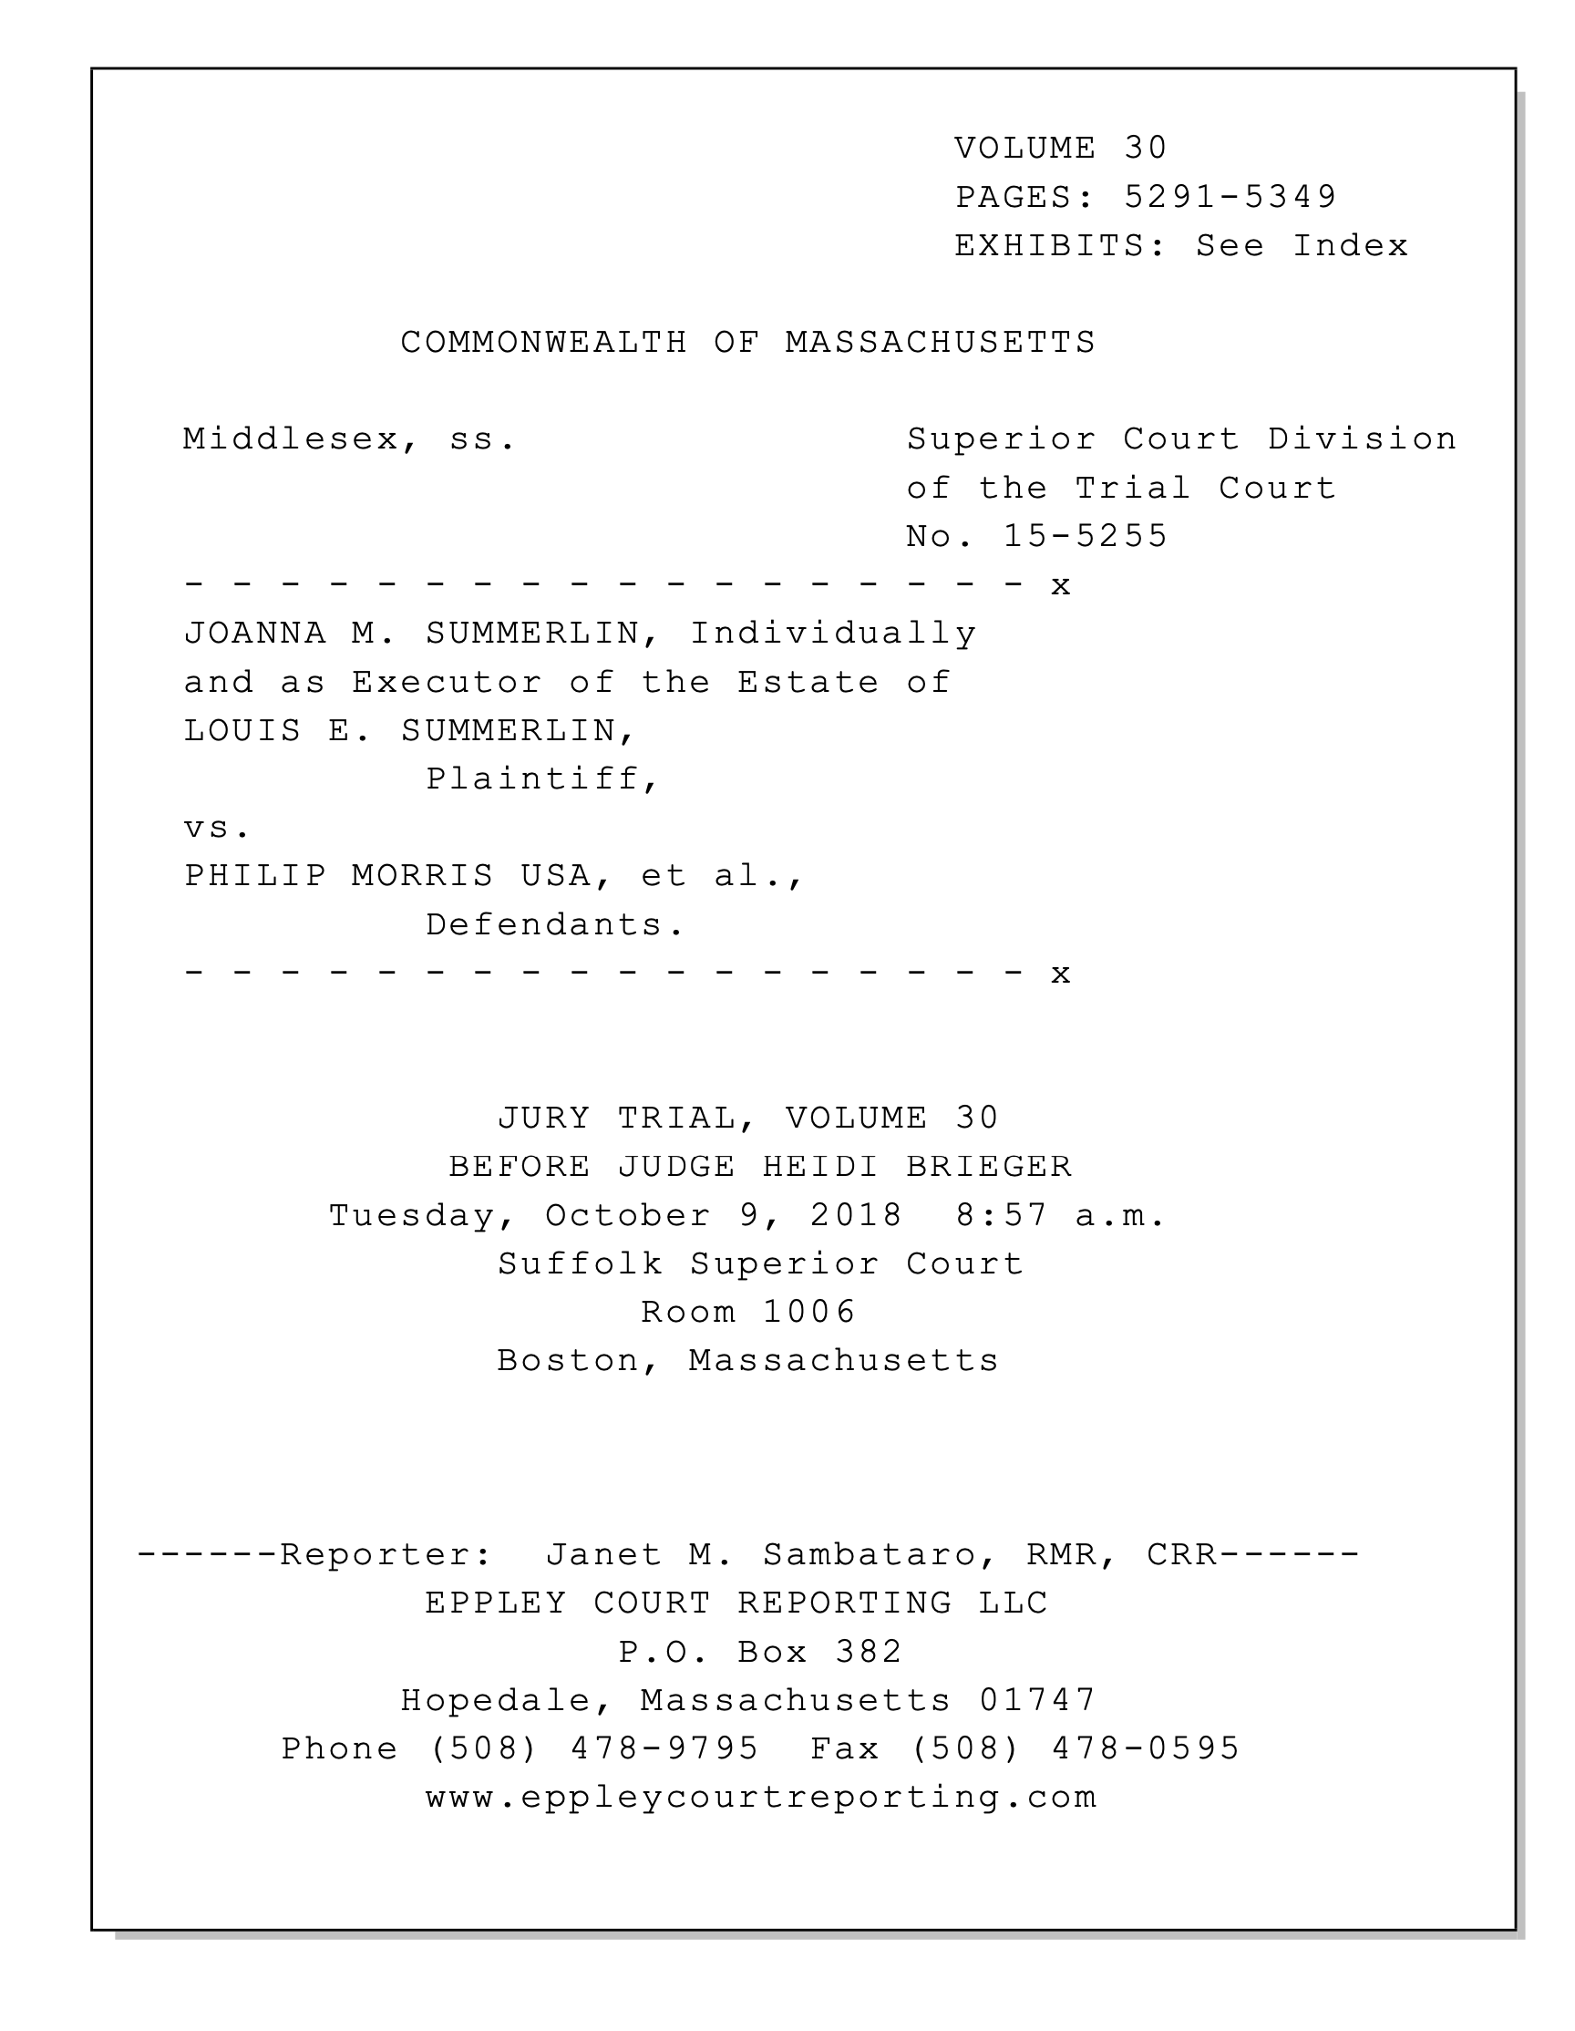
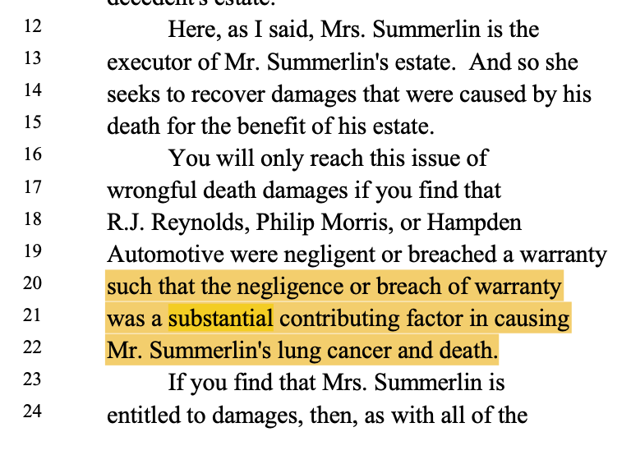
Summerlin v. Philip Morris USA - Oct. 9, 2018

Slide 74
Contact Info:
Vincent N. DePalo
Smith Duggan Buell & Rufo LLP
vincent.depalo@smithduggan.com
Stesha A. Emmanuel
McCarter & English
semmanuel@mccarter.com
Robert L. Boston
Smith Duggan Buell & Rufo LLP
robert.boston@smithduggan.com
Barrie Duchesneau
Lubin & Meyer, P.C.
bduchesneau@lubinandmeyer.com

