Slide 1

Basic Benefits Training:
MassHealth and Health Coverage Programs
Andrew P. Cohen
Director/Lead Attorney, General Legal Practice
Health Law Advocates
MCLE
February 15, 2022

Slide 2
Health Law Advocates
Non-profit, public interest law firm
  Pro bono legal services for low-income Mass. residents (< 300% FPL)
Core issues:
  Legal barriers to care and coverage
  Appeals of coverage or service denials
  Medical debt/collections assistance
  Access to care for immigrants, transgender people, children with mental illness, etc.

Slide 3
MassHealth and Public Coverage Programs
History of Massachusetts Health Care Reform and MassHealth Overview
MassHealth Programs
Other Public Programs Overview
Immigrant Health Access

Slide 4
A (very) brief history of recent Massachusetts health reform
2006: Chapter 58
  Coverage expansion through insurance mandates (individual and employer), insurance subsidies
2010: Affordable Care Act
  Coverage expansion on federal level through Medicaid, insurance market reforms, tax credits
  Implemented fully in 2014
2012: Chapter 224
  Focus on cost and quality
2020-22: MassHealth COVID flexibilities

Slide 5
Public Coverage Programs
MassHealth
  Comprehensive: Standard, Care Plus, CommonHealth, Family Assistance,
  Limited: MassHealth Limited
Health Safety Net (HSN)
CMSP (Children’s Medical Security Program)
Connector Care
  ACA Tax Credits + state subsidies

Slide 6
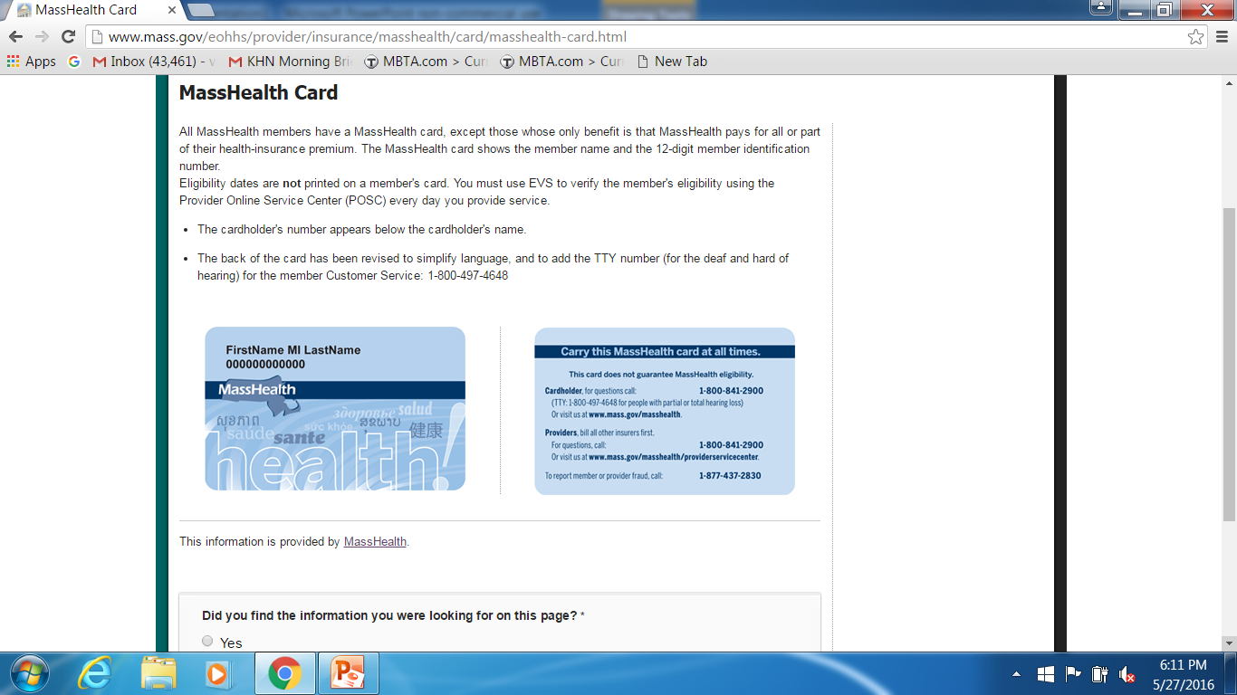
MassHealth by the #s
MassHealth key #s:
~2.14 million members
$8.5 billion = state $s
22% of state spending
Graphic: MassBudget and Policy Center, Issue Brief, Nov. 2021
Notes:
Source: Mass Budget and Policy Center, https://massbudget.org/wp-content/uploads/2021/11/IssueBrief_MassHealth-Cost_SFY2022.pdf

Slide 7
MassHealth Overview
MassHealth = Medicaid + CHIP
  State/Federal program
  Managed care = primary coverage
  Fee-for-service = secondary coverage
Eligibility, generally…
  Children and youth, ages 0-18, <300% FPL
  Young Adults, ages 19-20, <150% FPL
  Adults, ages 21-64, <138% FPL,
  Elderly adults, ages 65+, 100% FPL
  BUT: many eligibility categories based on disability, immigration status, age, etc.

Slide 8
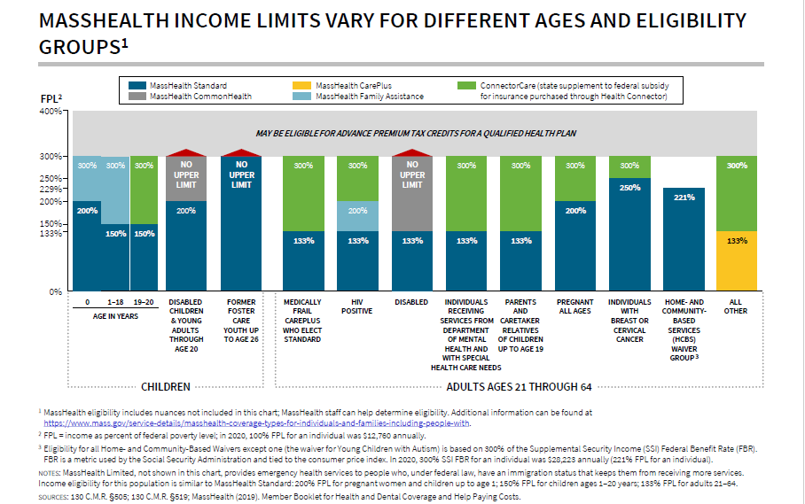
Subsidized Health Coverage
Data from MMPI’s MassHealth: The Basics, October 2020

Slide 9
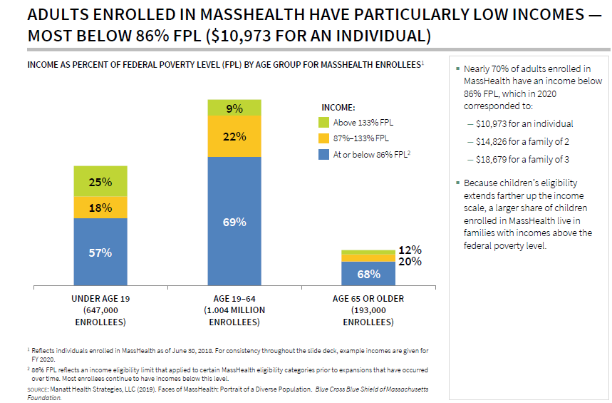
Members by age, income
Data from MMPI’s MassHealth: The Basics, October 2020

Slide 10
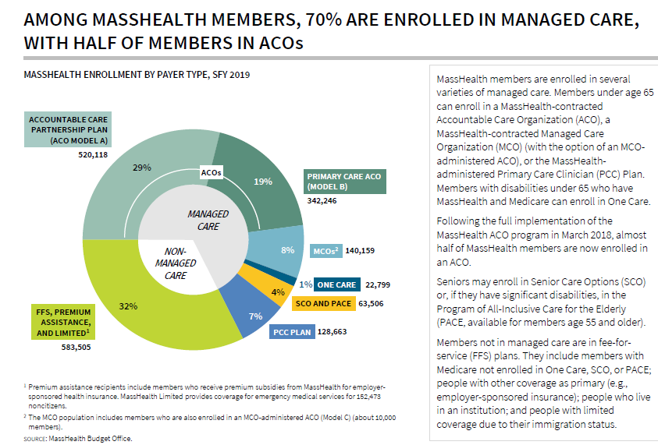
Managed Care
Data from MMPI’s MassHealth: The Basics, October 2020

Slide 11
How Medicaid Operates
States operate within framework under federal law, subject to federal approval
Eligibility: mandatory & optional groups
Benefits: mandatory & optional services
Flexibility for states: delivery systems, rates, amount, duration & scope of covered benefits, premiums & cost sharing, etc.
Federal approval: State plan and waivers approved by CMS
Federal reimbursement: 50% FMAP in MA

Slide 12
Medicaid Laws: Federal
Statute: 42 USC § 1396 et seq.
Regulations: 42 CFR Part 430 et seq.
Federal agency: Centers for Medicare and Medicaid Services (CMS)
Federal website: www.Medicaid.gov

Slide 13
Medicaid Laws: State
Statute: MGL. c. 118E
Regulations: 130 CMR § 501-610
State agency: Executive Office Health and Human Services (EOHHS)
Daily Administration: Office of Medicaid
Long-term services and supports: Dept. of Elder Affairs and Office of Medicaid
Website: www.mass.gov/MassHealth

Slide 14
Waivers: § 1115 & HCBS
42 USC § 1315 (§ 1115 of Soc. Sec. Act)
Secretary of HHS can authorize:
  Fed. reimburse. beyond Medicaid options
  Waiver of Medicaid statutory provisions
MassHealth Waiver: Program has operated under 1115 demonstration for most of under 65 population since 1997
Also, home and community-based services (HCBS) waivers for LTC

Slide 15
Counting income: MAGI
“Modified Adjusted Gross Income”
Applies to almost everyone except:
  MassHealth-eligible seniors based on age
  People eligible for MassHealth based on need for long term care (LTC)
  People for whom MassHealth does not make an income decision e.g. SSI, TAFDC & EAEDC recipients, kids in DCF custody, etc.

Slide 16
More on MAGI
Uses IRS tax rules for:
  Household composition (with exceptions)
  What income counts (with exceptions)
MAGI income disregard: 5% of family FPL, i.e. 138% instead of 133%
Lots more MAGI information in on-line materials
Notes:
Added with exceptions

Slide 17
MassHealth and Public Coverage Programs
History of Massachusetts Health Care Reform and MassHealth Overview
MassHealth Programs
Other Public Programs Overview
Immigrant Health Access

Slide 18
MassHealth Programs
MassHealth Standard
  Comprehensive benefit package
  Preventive care, outpatient medical services, nursing home and PCA services, prescription drugs, hospitalization.
MassHealth Common Health
  Same as Standard; only for disabled people
MassHealth Family Assistance
  Rich, comprehensive benefits incl. 6 mo SNF, but does not cover:
    Most LTSS, e.g. personal care attendant services, but new pathway!
    Non-emergency medical transportation (NEMT)
MassHealth Care Plus
  Childless, low-income, able-bodied adults age 21-64
  Same as Family Assistance (but covers NEMT)
MassHealth Limited – Emergency services ONLY
Notes:
F.A. updated benefits & ** to stand in for path to SF Standard

Slide 19
MassHealth Standard
“Categorical” eligibility
Low-income kids: 150% FPL
Young adults age 19-20: 150% FPL
Parents of minor children: 133% FPL
Pregnant women and infants: 200% FPL
Breast/cervical cancer: 250% FPL
HIV+ adults: 133% FPL
Elder adults (65+): 100% FPL + asset test

Slide 20
MassHealth CommonHealth
Eligibility:
  People with disabilities and higher incomes
  No Upper Income Limit
Premiums for people earning >150% FPL
One-time deductible for adults
  Children under 19 do NOT have deductibles
Working disabled adults program
  Deductible waived if working 40hrs/mo.
  Applies to all adults, including 65+

Slide 21
MassHealth CarePlus
ACA “expansion program” for
  Non-elderly, childless adults
Eligibility:
  Ineligible for MassHealth Standard
  Adults 21-64 with income <133% FPL
  Not on Medicare
Does NOT cover long-term care, but:
  “Medically Frail” or disabled/CommonHealth

Slide 22
MH Family Assistance
Children: 150-300% FPL
  Direct Coverage if uninsured
  Premiums: begin at $12 per child, $36 maximum for 3 or more children, waived if parents pay premium in ConnectorCare
Adults:
  HIV+ Adults: 133% - 200% FPL
  PRUCOL immigrants: up to 300% FPL
  Disabled “lawfully present” imms: 100% FPL
  Certain EAEDC recipients
Premiums: sliding scale above 150% FPL

Slide 23
MassHealth Limited
MA version of federal Emergency Medicaid
Coverage: Emergency services for acute medical issues or prevention of a serious health problem
Eligibility:
  People ineligible for Standard or Care Plus
  Mostly undocumented people and lawfully present immigrants who qualify for Connector Care
  Adults: < 138% FPL
  Kids 1-20: < 150% FPL
  Infants <1: < 200% FPL
Notes:
Includes some ongoing conditions where there is an immediate need for treatment, such as kidney dialysis.
Includes labor and delivery
Emergency ambulance services
Not limited to Emergency Room services
130 CMR 450.105(F) MassHealth Limited.
(1) Covered Services. For MassHealth Limited members
(see 130 CMR 505.006: MassHealth Limited and 519.009:
MassHealth Limited), the MassHealth agency pays only for the
treatment of a medical condition (including labor and delivery) that manifests itself by acute
symptoms of sufficient severity that the absence of immediate medical attention reasonably
could be expected to result in
(a) placing the member’s health in serious jeopardy;
(b) serious impairment to bodily functions; or
(c) serious dysfunction of any bodily organ or part.

Slide 24
MassHealth and Public Coverage Programs
History of Massachusetts Health Care Reform and MassHealth Overview
MassHealth Programs
Other Public Programs Overview
Immigrant Health Access

Slide 25
Children’s Medical Security Plan (CMSP)
Background: Created by statute in the 1990s
  Inspiration for CHIP (esp. tobacco tax)
Coverage: Primary and preventive services
  Limitations: Caps on Rx ($200/yr), DME, dental ($750), and mental health visits (20)
Eligibility: Uninsured children ages 0-18 (i.e. ineligible for MassHealth);
  Mostly undocumented and higher-income kids
Not “insurance” for federal tax purposes

Slide 26
Health Safety Net (HSN)
Background: “Uncompensated Care Pool” created in 1985; became the “HSN” in 2006
Coverage: Pays for care delivered at acute care hospitals and Community Health Centers
  Wraps private insurance as secondary coverage;
  Pays deductibles and co-insurance
Limitations: Not insurance
  Doctors NOT covered, with limited exceptions
  Does not pay for private insurance copayments
Medical Hardship program

Slide 27
Gov. Baker cut coverage for immigrants in 2016
Health Safety Net (HSN) cuts:
Eliminated 6 month retroactive period
  NOW: Retroactive period = 10 days
Introduced $500+ deductibles for people earning 150-200% FPL
Decreased eligibility from 400% FPL to 300% FPL

Slide 28
HCBS Waiver Programs
Home and Community-Based Services (“HCBS”) Waiver programs:
For people who “would be institutionalized”
Higher income limits; asset rules same as NF rules
Programs
  Frail Elder Waiver
  Money Follows the Person (Moving Forward Prog.)
  Traumatic Brain Injury, Acquired Brain Injury waivers
  HCBS Waivers for ppl with Intellectual Disabilities
Related programs:
    Kaileigh Mulligan (disabled kids age <18)
    Program of All-Inclusive Care for the Elderly (PACE)
Notes:
Edits –on income & asset. Moved K.M. & PACE ==not 1915c HCBS

Slide 29
Immigrants & COVID-19
All types of MassHealth cover testing and treatment of COVID-19
This includes MassHealth Limited
No cost-sharing for COVID-related care for MassHealth members
For uninsured and HSN-only COVID patients, providers can seek payment through federal portal:
  https://www.hrsa.gov/CovidUninsuredClaim

Slide 30
MassHealth and Public Coverage Programs
History of Massachusetts Health Care Reform and MassHealth Overview
MassHealth Programs
Other Public Programs Overview
Immigrant Health Access

Slide 31
Immigration/citizenship statuses for health benefits
Citizen (naturalized)
Lawfully Present
  “Qualified” Lawfully Present
  “Qualified Barred” Lawfully Present
  “Non-Qualified” Lawfully Present
PRUCOL (“Person Residing Under Color of Law”)
Undocumented

Slide 32
Immigrant eligibility
Qualified lawfully present
  Coverage like citizens based on income
Nonqualified/barred lawfully present
  Adult < 300% FPL = Connector Care
  Kid/YA < 150% FPL = MH Standard
PRUCOL
  Kids/Adults <300% FPL: MH Fam Asst

Slide 33
Immigrants’ Eligibility for Public Benefits
MCLE Training
April 7, 2022

Slide 34

  Questions?
  Andrew P. Cohen, Esq.
  Director/Lead Attorney, General Legal Practice Team, Health Law Advocates
  617-275-2891, acohen@hla-inc.org
  Health Law Advocates:
  Toll-free: 888-211-6168

