Slide 1
An Investment Banker’s Perspective on How Attorneys Add Value in M&A

Slide 2
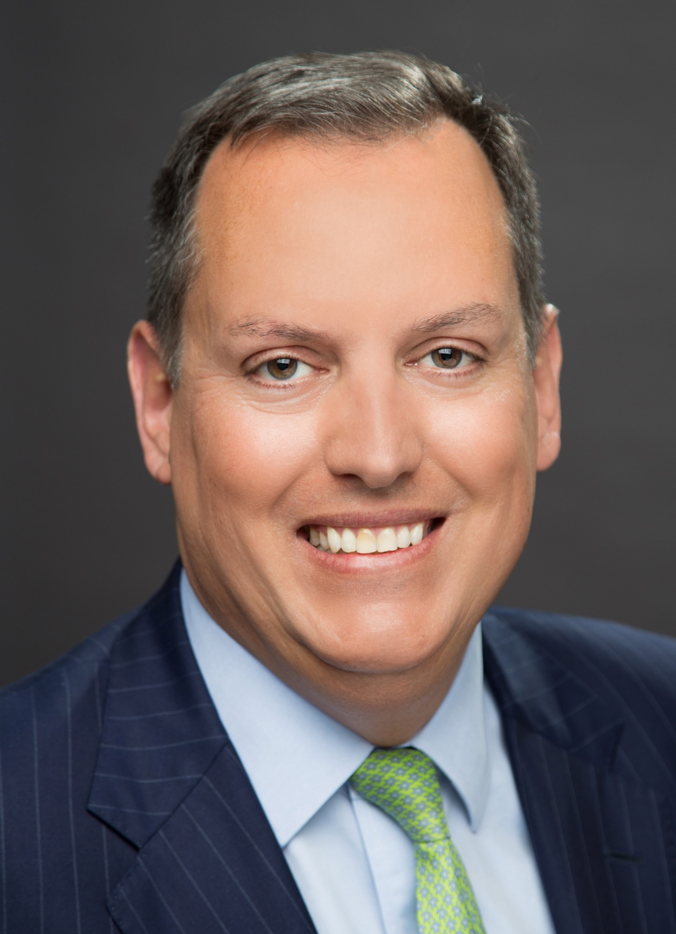
Mirus Capital Advisors
The value of accomplishment
Mirus has been advising middle market companies since 1987
  Professional sell-side, buy-side and capital raising processes and for providing tactical and strategic deal advice for both private and public companies
  Working with middle market companies ranging up to $200 million in revenues and transaction size
Mirus is a FINRA-licensed broker-dealer
Alan Fullerton
Managing Partner, Mirus
An investment banker to middle market firms since 1997, Alan has managed and closed over 50 M&A transactions.
Member of the ACG Boston board of directors.
Registered Securities Principal, holds FINRA Series 7, 24, 63 and 79 licenses.
Seven years experience in the technology industry with The Analytic Sciences Corporation.
MBA, Ecole des Ponts (France) and Sc.M., Electrical Engineering from Brown University.
Sc.B., Mechanical Engineering from MIT.
Manages firm which closes 8-12 sell-side deals per year
Firm talks with hundreds of PE and strategic buyers per year
We see what works and what doesn’t

Slide 3
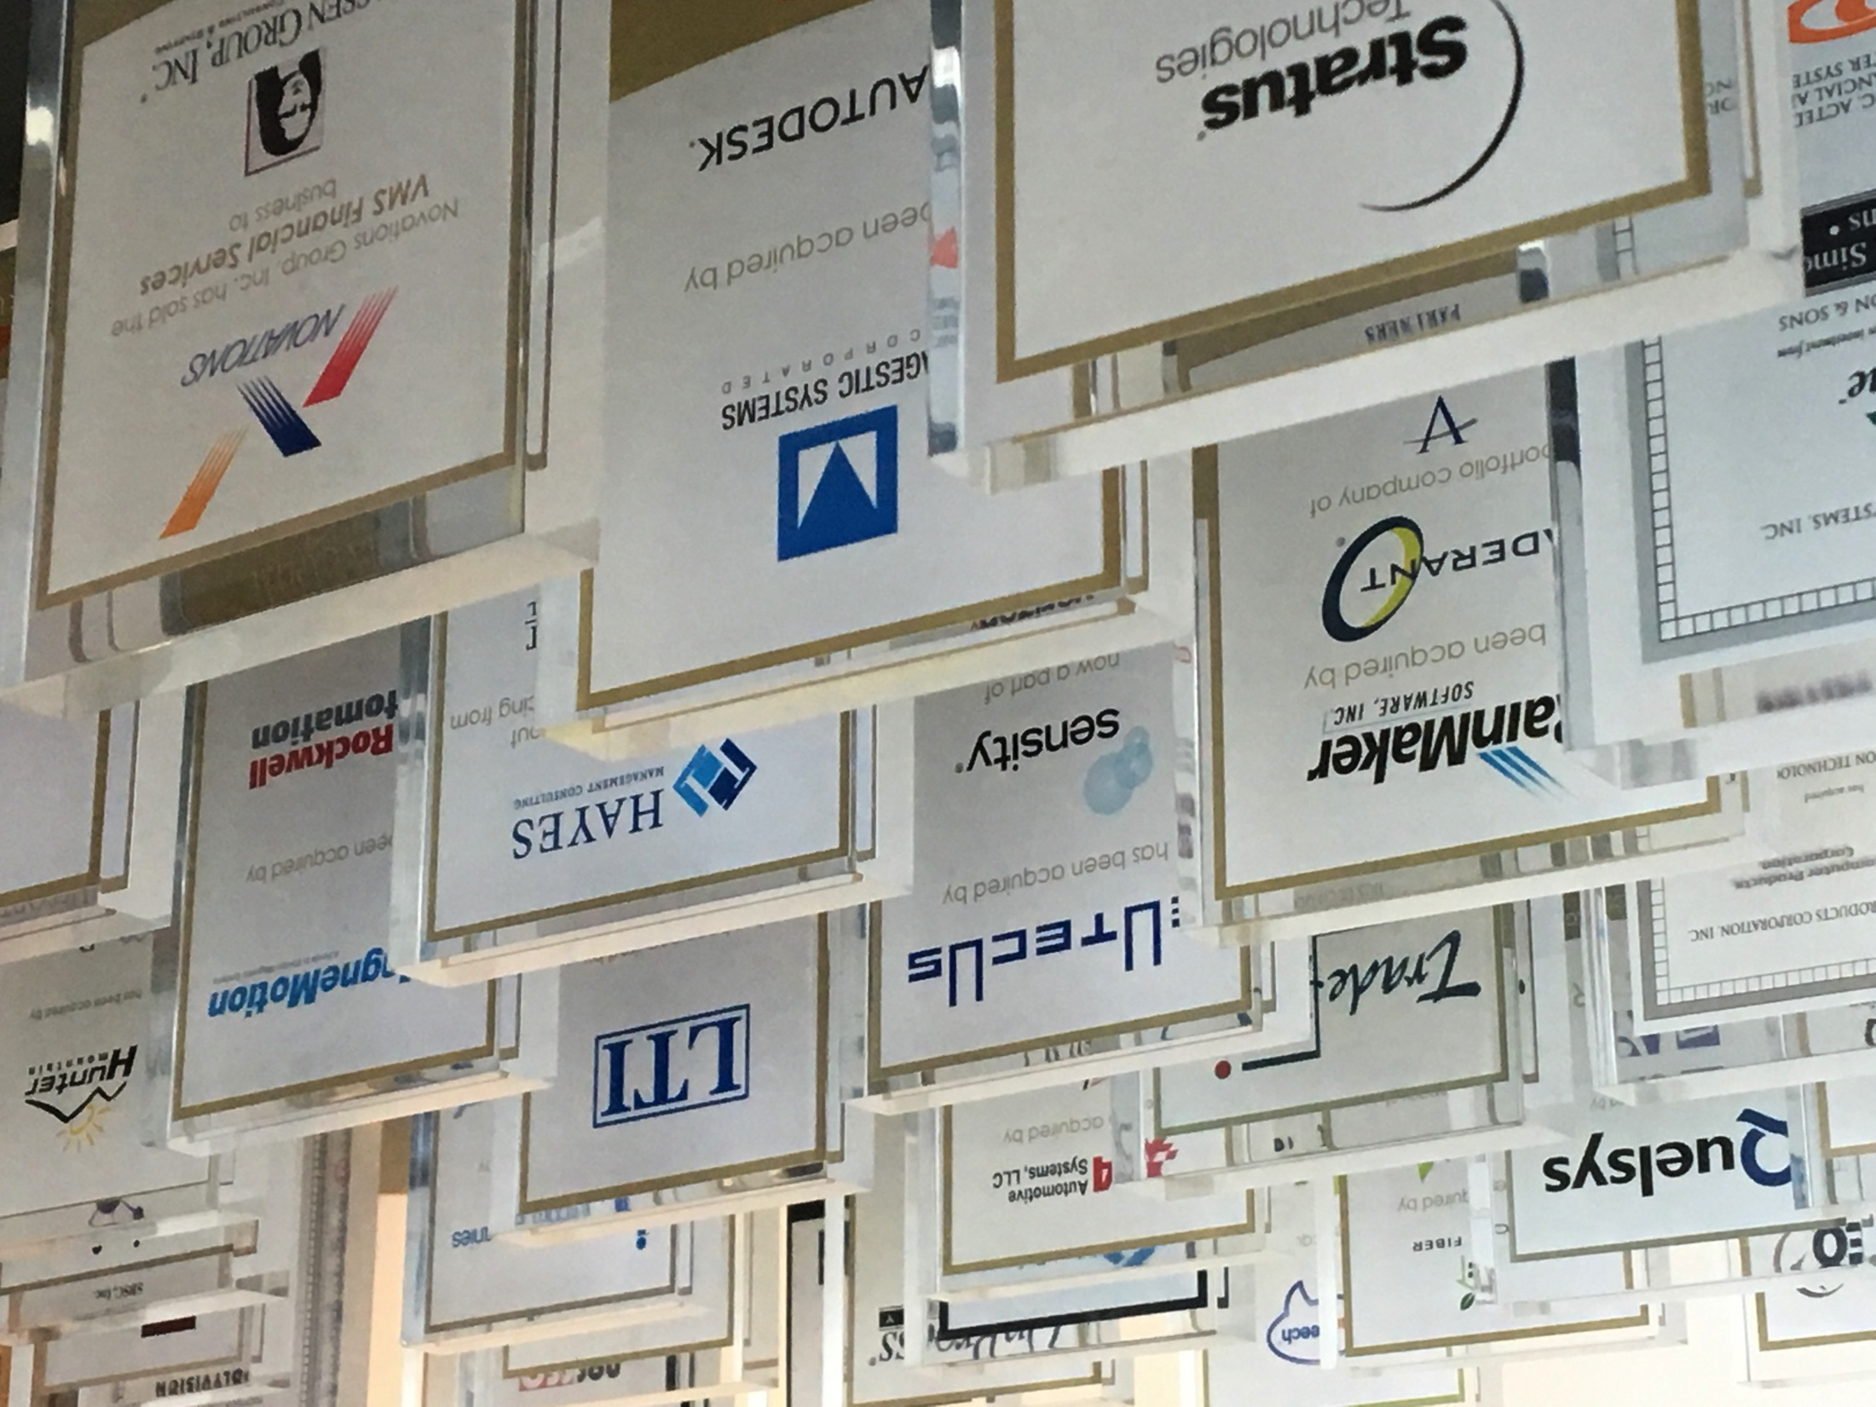

35 YEARS. 350 DEALS.

Slide 4
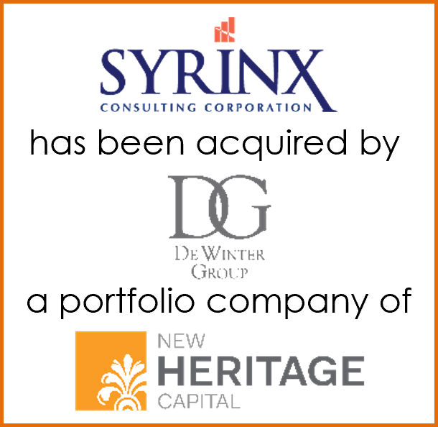

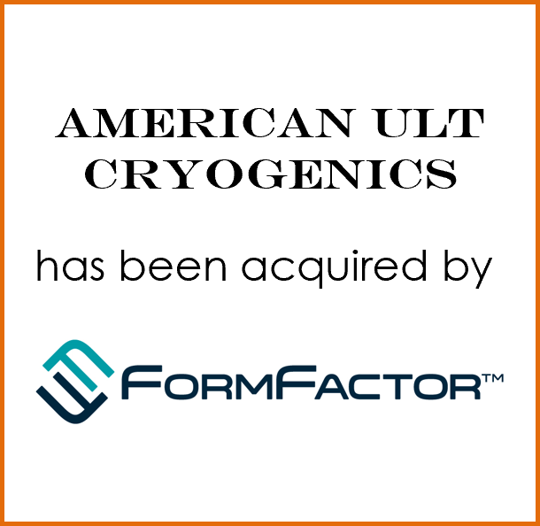
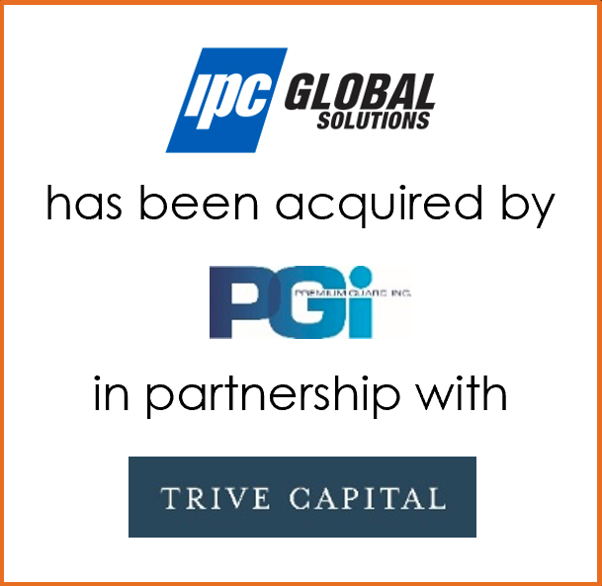
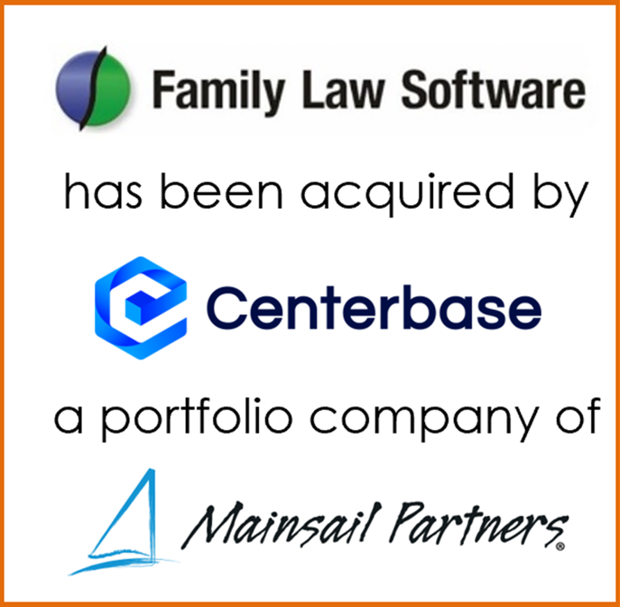
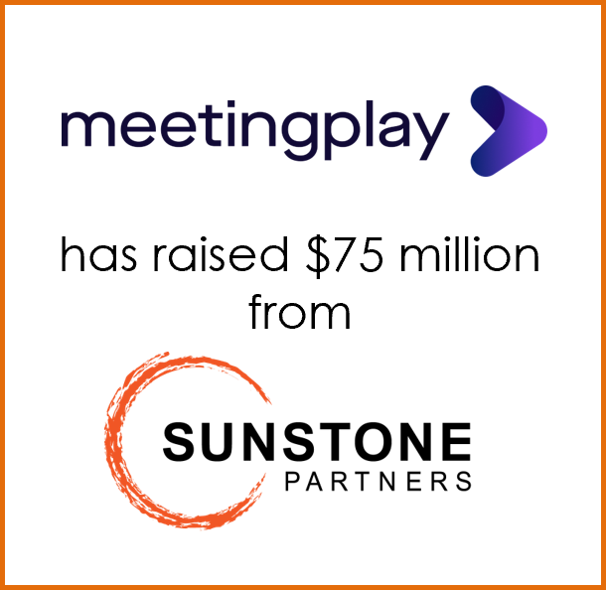
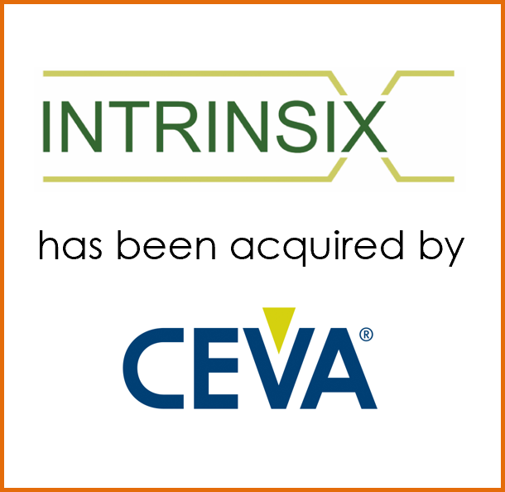
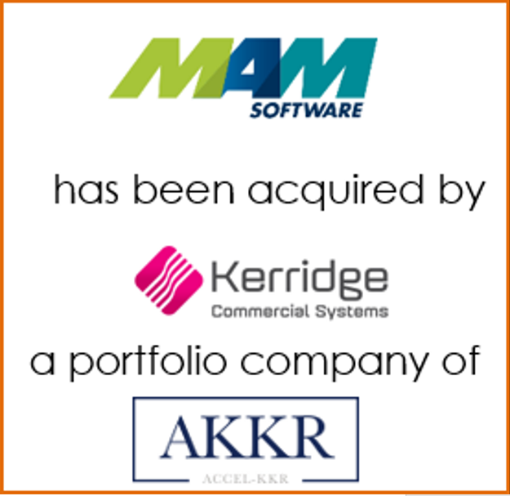
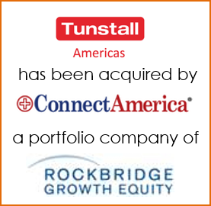


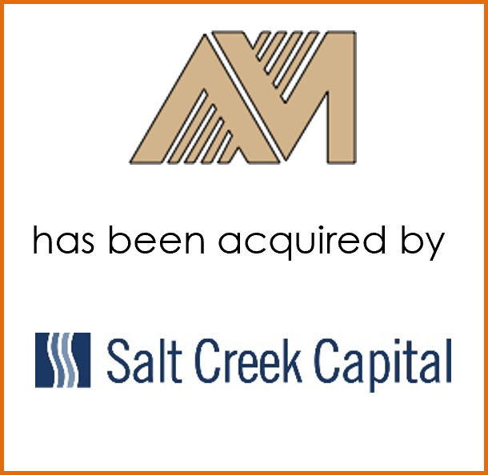
Recent transactions
Mirus works in a variety of industries with a range of sellers (founders, families, closely-held, corporate, public)

Slide 5
How does the M&A process work and where do attorneys add value?
(an investment banker’s perspective)

Slide 6
Big picture
What is client looking for in a transaction? What can be done with the business before beginning a process?
Help clients avoid “unforced errors”
  There are almost always “honest mistakes” by the client that the seller’s team catches
  Expect everything to be checked in diligence
Help client prepare and understand what’s going to happen
  You’ve got perspective on what’s “market” and what’s unreasonable
  Advisors can help clients avoid becoming wedded to an untenable deal strategy
  Start getting ready before engaging investment banker
Develop a good working relationship with the ibanker and other advisors
  Try to keep the business owner at “30,000 ft.” or else the deal details will exhaust him/her
  Keep things moving along
Help clients negotiate a favorable deal

Slide 7

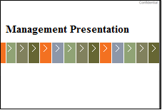

The investment banking sell-side process
Driving value through preparation, competition and negotiation
Prepare for offering process
Create a market for the client’s company
Prepare management for bidder interaction
Manage competitive bidding process through close
secure, online
dataroom
contact prospective
buyers / investors
manage NDAs, initial diligence
drive value,
negotiate & close the deal
meet with select parties

Slide 8
Typical sell-side M&A timeline
Transaction timeline from investment banker engagement to closing
Preparation
Offers
Completion
Engagement and kickoff;
Accounting diligence;
Marketing strategy;
Document preparation;
Build virtual data room;
Shareholder planning
One month
Receive initial indications of interest;
Management meetings with selected
prospective acquirers;
Provide additional requested information;
Receive updated offers;
Move forward with one or more bidders
Two months
Closing of transaction
Marketing
Diligence
Contact prospective acquirers;
Execute NDAs;
Provide CIM and VDR access
Two months
Due diligence;
Finalize transaction legal documents
Two – three months

Slide 9
Preparing for a private company M&A process
Add value: Explore personal and business objectives of sellers
Objectives | What are the key objectives of a transaction (personal liquidity, restructuring of ownership structure, access to resources, etc.)?
Timing | Why a transaction now? What are the key drivers for overall process timing?
Post-deal roles | To what extent does ownership want to stay involved with the business? Is there management staying with the business?
Risk / return | How much appetite is there for a “second bite of the apple” (equity stake, earn-out)?
Priorities | What are the priorities beyond “hard issues” (price, deal structure)? What are the sellers’ key “soft issues” (employees, culture, brand, continuity)?
Helpful to have some of this as background as you’re helping the client to select an investment banker

Slide 10
High level checklist for diligence
Partial checklist – typically customized to the client’s business
A | Company background
B | Products and Services
C | Sales and Marketing
D | Intellectual Property / Licenses / Technology & Infrastructure
E | Reimbursement
F | Regulatory / Clinical
G | Employees and organization
H | Facilities
I | Litigation
J | Finance
K | Grants
L | Contracts, agreements and corporate documents
Each category has a sub-list of requests
Some information can be provided later in the process
Don’t want surprises in diligence
Some diligence deficiencies are easily addressed, others are tougher
Toughest ones typically involve employees, former employees, former shareholders, other third parties

Slide 11
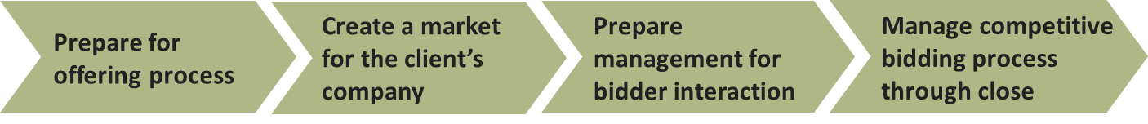
Stages where attorneys can really add value
Prior to process
  Clean-up corporate issues. Common problem areas include: S-Corp election validity; taxes, including state and local; compensation issues; employee non-competes; intellectual property protection; cap table; status of stock option agreements.
  Contracts – customers, vendors, etc. Do they say what the client thinks they say?
  Shareholder planning. Gifting.
  Customer concentration, “small business” designation, other risk areas
  Compliance, IT security (CCMC, SOC 2)
Early in process
  Selection of investment banker. Relevant industry / transaction experience. Fit with the client.
  Help client understand what’s going on.
Pre-LOI
  Review NDAs and offering materials. Advise on structure – sale of asset or stock, which entities if multiple corporations involved, real estate issues and tax structure
  Review dataroom materials
LOI
  Assist in evaluating proposed terms, manage mark-ups, help client focus on key elements
  Keep things “market” and know when you’re out of market (good or bad)
  Tax / elections 338(h)(10), F-Reorg topics
  Employment expectations, on-going involvement of the sellers
P&S
  Disclosure schedules
  Manage negotiations with counterparty counsel
Closing

Slide 12
What’s going on in M&A (November 2022)
One banker’s observations
2021 was an extremely good year for M&A
Current deal activity down ~ 30-40% Q3 2022 y-o-y
Lower middle market (sub $200 million) somewhat insulated from the broader market
  PE firms continue to pursue add-ons and buyers remain committed to their M&A strategies
  Capital generally very available, albeit with a higher cost of debt
  “Story” deals are tougher in 2022
  Good companies continue to receive strong attention from bidders
Federal and state tax policies remain a risk to M&A activity
It’s very hard to predict economic downturns and to encourage clients to take advantage of favorable markets, which can turn faster than owners and companies can react
  Being prepared for a deal at anytime is a good approach, but is hard to pull off
Preparation is more important that ever. Buyers will invest in good businesses, but the overall risk appetite has shifted. Don’t create risk unnecessarily by being unprepared.

Slide 13
Contact information
www.merger.com
Mirus Capital Advisors
Alan Fullerton
fullerton@merger.com
200 Summit Drive, Burlington MA 01803
781 418 5900

