Slide 1
Massachusetts Specialty Courts & Behavioral Health Initiatives

Slide 2
specialty court noun
\ˈspe-shəl-tē ˈkȯrt\
plural specialty courts
Definition of specialty court
A specialized docket within the criminal justice system that seeks to address underlying mental health or substance use disorders that contribute to the commission of certain criminal offenses in many cases, often providing treatment rather than punishment
The most common types of specialty courts are drug treatment, mental health and veterans treatment courts
The model can also be applied to families involved with the child welfare system

Slide 3
Specialty Courts ̶̶ Specialized Court Sessions:
Target High Risk/High Need Probationers with mental health and/or substance use disorders
Utilize evidence-based assessment and screening tools to determine eligibility
Utilize a team approach:
Judges
Prosecution & Defense Counsel
Probation Officer(s) & OCC representatives
Specialty Court Coordinator
Specialty Court Clinician
Local law enforcement, Sheriff’s Department
Treatment providers & Recovery coaches

Slide 4
Types of Specialty Courts in Massachusetts
Drug
Mental Health
Veterans Treatment
Family Treatment
Homeless
May also be referred to as “Recovery Courts”

Slide 5
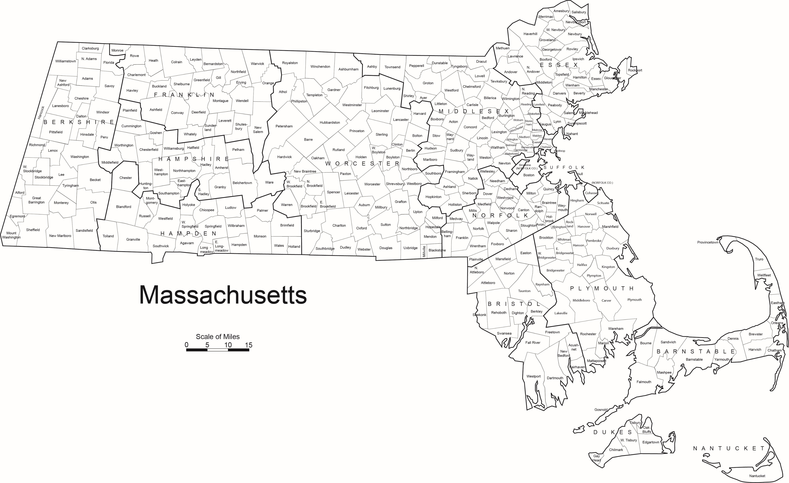
Specialty Court Locations

Slide 6
Specialty Court Team
Coordinator
Prosecutor
Defense Attorney
Probation
Clinician
Treatment Providers
Mentor/
Peer Support
Judge

Slide 7
Growth of Massachusetts Specialty Courts

Slide 8
Fatal Overdoses in Massachusetts

Slide 10
Distribution of Specialty Courts

Slide 11
Specialty Court Funding: Line Item

Slide 12
What is funded?
Master’s level clinicians in every specialty court ($3.6M)
Specialty Courts Administrator, Deputy SCA, Finance Manager & Fiscal Specialist
Specialty Court Coordinators in over 30 specialty courts
Drug Testing ($800,000 - $1 million/year)
Training, training, training – (Judges, POs, Teams – national & local)
Center of Excellence for Specialty Courts ($1.7M over 3 years)
Adding Transportation Coordinator
Need Administrative Coordinator!

Slide 13
Federal Grant Support for Specialty Courts and Behavioral Health Programs
Federal Funder` | Grant Name | Award Amount
SAMHSA | MISSION HOPE | $2,125,000
SAMHSA | MISSION CAPE II | $2,000,000
SAMHSA | MISSION MILL CITIES | $2,000,000
SAMHSA | MISSION SPRINGFIELD | $2,000,000`
SAMHSA | B.O.A.T. | $4,000,000
COSSAP | PROJECT NORTH | $6,000,000
BJA | DRUG COURTS & CCCs | $1,200,000
COAP | NE RJOI | $1,500,000
OVW | DEE KENNEDY PROJECT | $550,000
OJJDP | UPSTREAM/PATHS | $1,500,000
CURRENT GRANT TOTAL | 10 | $22,875,000

Slide 14
Specialty Court Expansion
Family Treatment Courts: $1.5 Million Grant from OJJDP to expand Family Treatment Courts in the Juvenile Court Department
Hampden County Juvenile Court will open session in late Spring in Springfield;
Additional sessions to be opened in Essex, Middlesex, Suffolk and other counties TBD.
Mental Health Court Expansion: 3 additional mental health court sessions in development in District Court Department

Slide 15
Project N RTH Navigation, Outreach, Recovery, Treatment, and Hope

Slide 16
Project NORTH
3 year grant from the Department of Justice
COSSAP: Comprehensive Opioid Stimulant and Substance Abuse Site-based Program
$6 million
Trial Court retains $800,000
1 of 11 states to receive the award
Sole state court
First Navigator started in December 2021
Notes:
We are a pretty new project. Our first Navigator came on board last December and we have added Navigators all year. We are at 11 right now and will be at 13 in the coming months.

Slide 17
Target Population: Court-involved persons with indications
of substance use disorders
Goals
Decrease risk of justice system involvement
Objectives
Increase access to care coordination
Decrease barriers to treatment retention
Increase treatment engagement and retention
Increase access to evidence-based treatment
Decrease risk of overdose
Increase recovery support and recovery capital
Increase access to overdose prevention education and naloxone

Slide 18
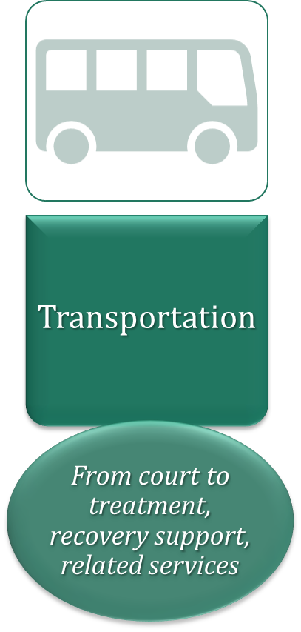
Strategies
Recovery Support Navigation
13 court locations
Data Collection and Evaluation

Slide 19
Tom Ambrosino
Court Administrator
Jeffrey Locke
Chief Justice
Edward Dolan
Probation Commissioner
Tom Simard
Chief Financial Officer
Sheila Casey
Specialty Court Administrator
Jessica Fix
Senior Grant Manager
Marisa Hebble
Project Co-Director
Michael Coelho
Project Co-Director
Tess Jurgensen
Administrative Coordinator
Jill Forbes
Manager of Reentry Services
Michelle Martino
Administrative Coordinator
Positions below the line are funded by the grant
Judy Bazinet
Project Manager
Recovery Support
Navigator
Recovery Support
Navigator
Beth Duffy
Grant Coordinator
Sober Housing
Trial Court
Employee
Recovery Support
Navigator
Recovery Support
Navigator
Contracted
Agency
Recovery Support
Navigator
Recovery Support
Navigator
Advisory Board
Court Administration • Judges • Probation
Executive Office of Health and Human Services
DPH: Bureau of Substance Addiction Services
Department of Mental Health • MassHealth
Massachusetts Alliance for Sober Housing
Committee for Public Counsel Services
Community Justice Support Centers
UMass Medical: Center of Excellence for Specialty Courts
Recovery Support
Navigator
Recovery Support
Navigator
Recovery Support
Navigator
Recovery Support
Navigator
Recovery Support
Navigator
Recovery Support
Navigator

Slide 20
Eligibility for Project NORTH
Project NORTH services are free, confidential, and voluntary
Available to court users and their family members
involved with any court department
Court User
Current case with the court or within the past year, in a Project NORTH location
Currently under supervision or completed supervision within the past year, in a Project NORTH location

Slide 21
Recovery Support Navigation (RSN)
Navigators will assist with:
Navigators will not:
Testify
Report back to the court without a release
Influence cases
Identifying and facilitating access to evaluation, treatment, and recovery support resources in the community
Assistance with health insurance enrollment and adjustment
Short term care coordination and connections to comprehensive care management
Referrals to overdose prevention and naloxone distribution
On-site resource for court staff, partners, and court users
State Medicaid alignment for sustainability planning

Slide 22
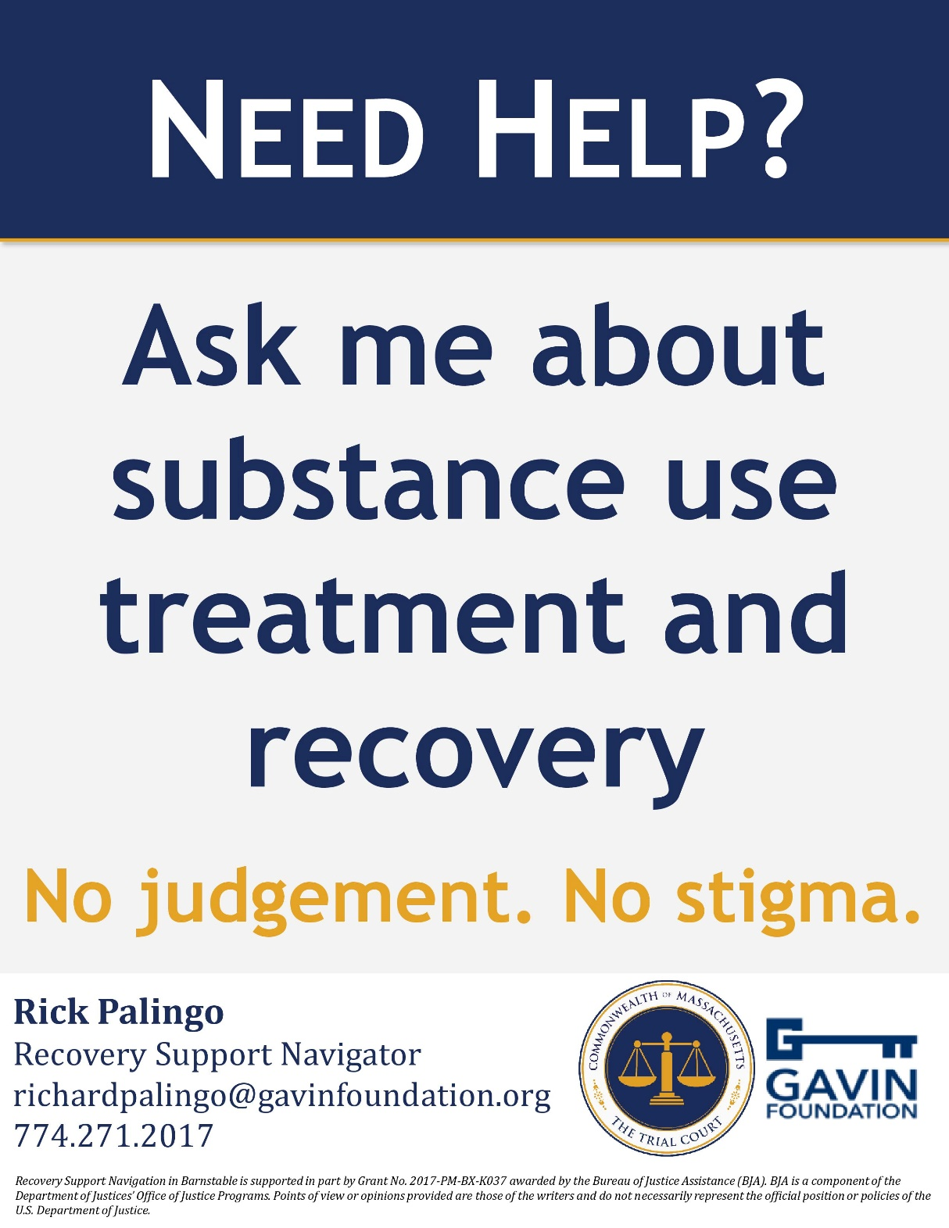
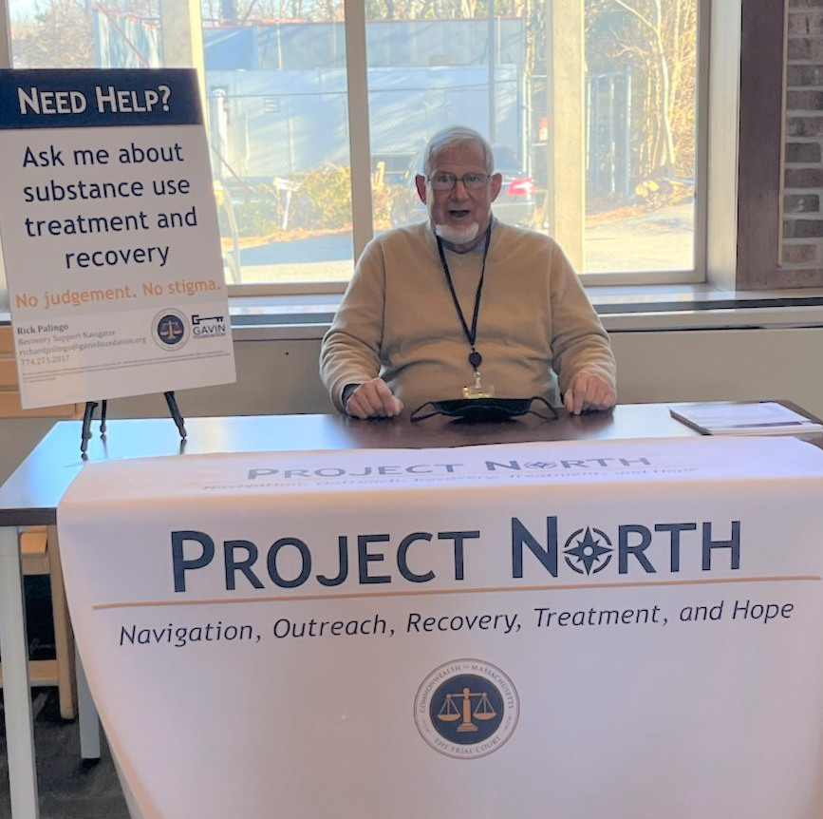

Slide 23
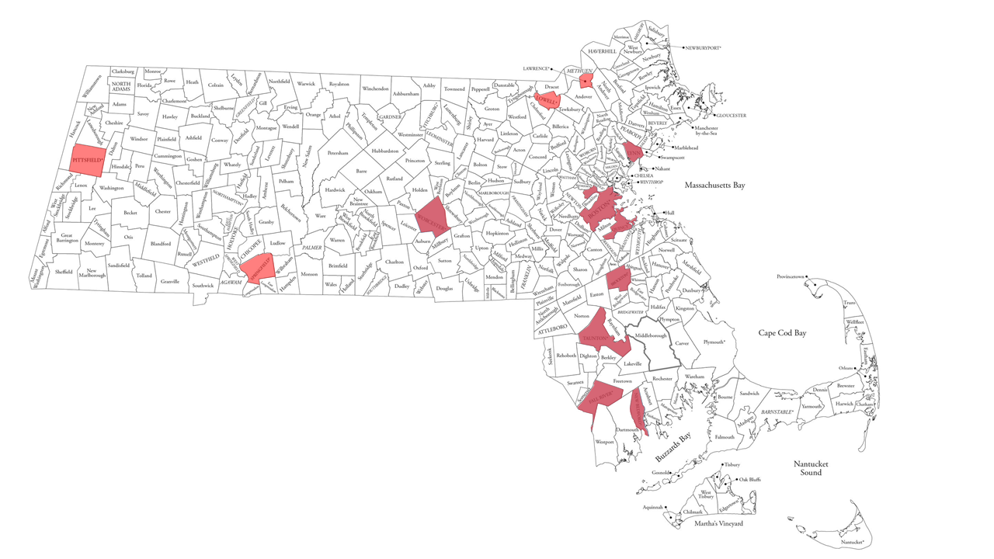
Navigation Locations
Lawrence
Pittsfield
Lowell
Lynn
Boston
Quincy
Brockton
Springfield
Worcester
Taunton
Fall River
Barnstable
*funded by another project
New Bedford

Slide 24
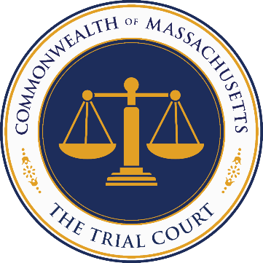
Supreme Judicial Court
1 Chief Justice • 6 Associate Justices
Appeals Court
1 Chief Justice
24 Associate Justices
Executive Office of the Trial Court
1 Chief Justice • 1 Court Administrator
Office of the Jury Commissioner
Commissioner
Massachusetts Probation Service
1 Chief Justice
29 Associate Justices
8 Divisions
Boston Municipal Court
Housing Court
1 Chief Justice
14 Associate Justices
6 Divisions
1 Chief Justice
157 Associate Justices
62 Divisions
District Court
Probate and Family Court
1 Chief Justice
50 Associate Justices
14 Divisions
1 Chief Justice
81 Associate Justices
14 Counties
Superior Court
Land Court
1 Chief Justice
6 Associate Justices
1 Chief Justice
41 Associate Justices
11 Divisions
Juvenile Court
Office of Court Management
Department Directors

Slide 25
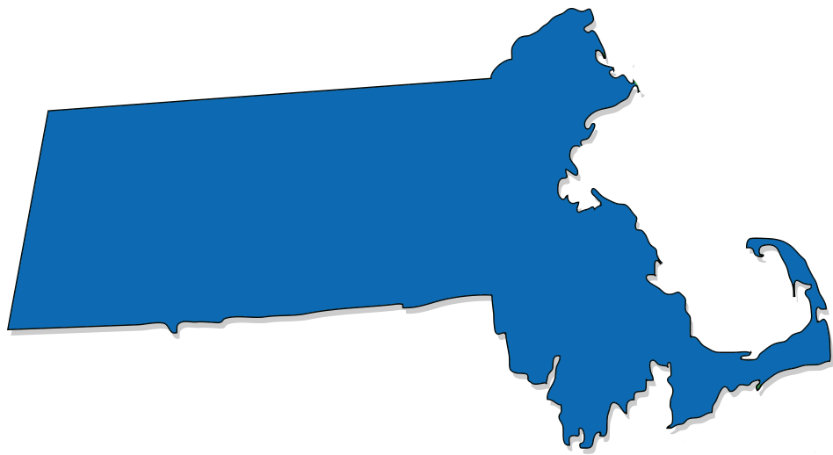
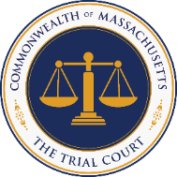
Questions?
Comments?
Feedback?
Comments?
Judy Bazinet, LICSW • Project Manager Executive Office of the Trial Court
judy.bazinet@jud.state.ma.us
Beth Duffy • Grant Coordinator
Executive Office of the Trial Court
elizabeth.duffy@jud.state.ma.us
Marisa Hebble, MPH • Project Co-Director Executive Office of the Trial Court
marisa.hebble@jud.state.ma.us
Deputy Commissioner Mike Coelho • Project Co-Director Massachusetts Probation Service michael.coelho@jud.state.ma.us

Slide 26
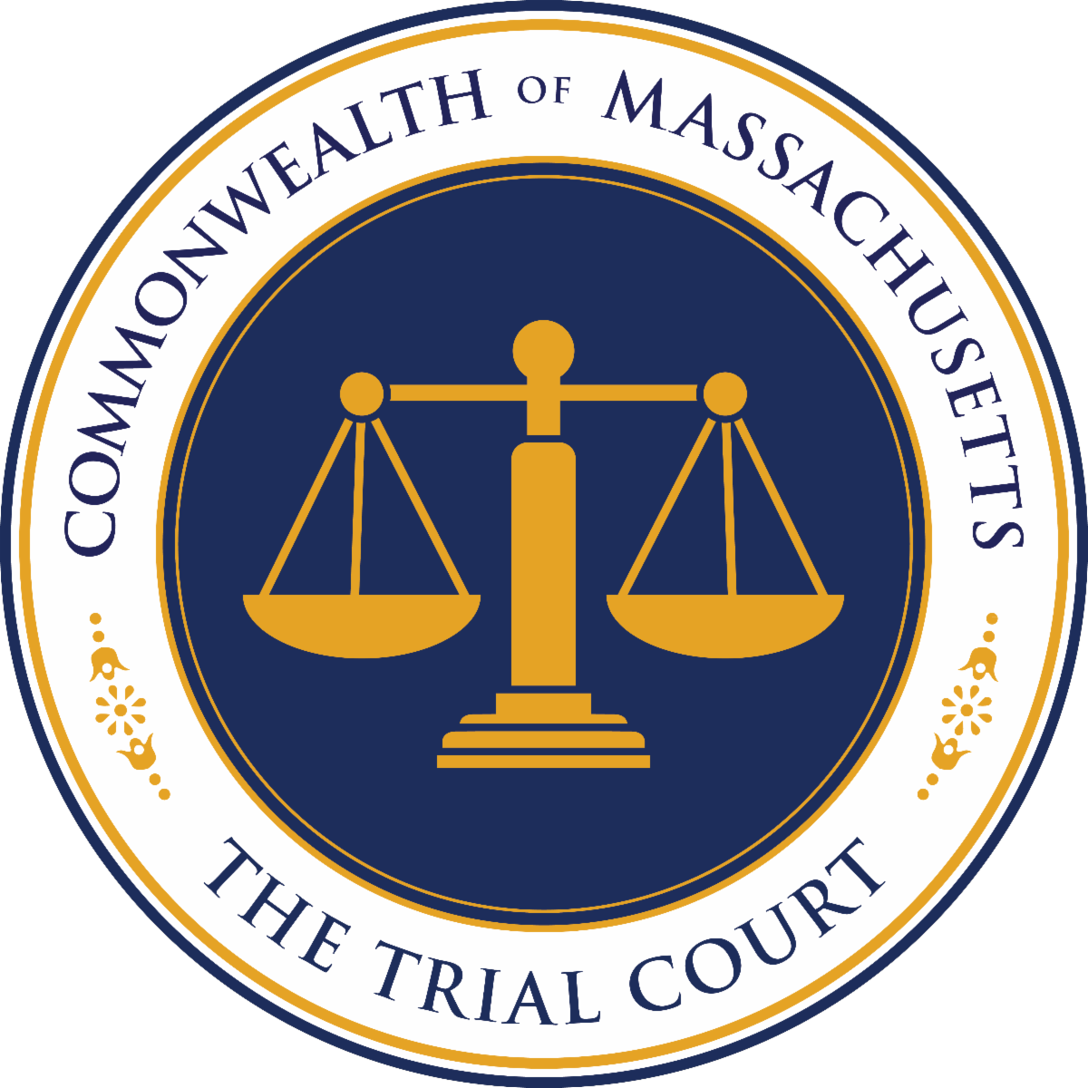
Sheila Casey, Esq.
Executive Office of the Trial Court
sheila.casey@jud.state.ma.us
mass.gov/massachusetts-community-justice-project

