Slide 1
SaaS Agreements Demystified
Steve Winslow, Boston Technology Law, PLLC
Kevin J. Angle, Holland and Knight LLP
Stas Zakharenko, GTC Law Group, PC & Affiliates
September 27, 2024

Slide 2
Welcome and Agenda
Overview of SaaS and Related Offerings
Comparing SaaS Agreements and Traditional License and Service Contracts
Negotiating Key Provisions of SaaS Agreements
Break
Special Topics:
  Data Privacy and Cybersecurity
  Open Source and Source-Available Licenses in SaaS
  Data as Intellectual Property
  AI and Use of Customer and Personal Data
Q&A Session and Wrap Up

Slide 3
Overview of SaaS and Related Offerings

Slide 4
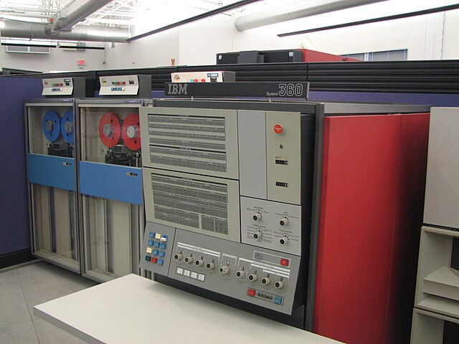
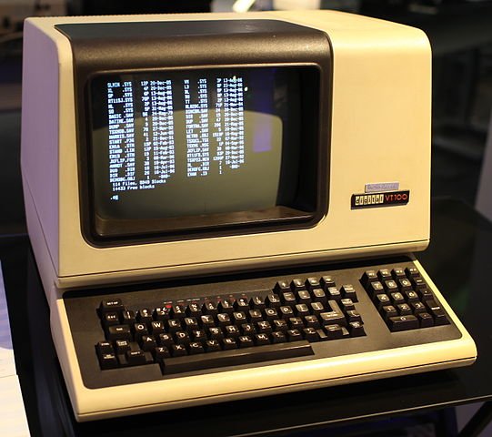
What is SaaS?
Early computing:
Terminals connected to
mainframe computers
Photo credit: Jason Scott, used under CC-BY-2.0,
https://en.wikipedia.org/wiki/File:DEC_VT100_terminal.jpg
Photo credit: Erik Pitti, used under CC-BY-2.0,
https://commons.wikimedia.org/wiki/File:IBM_System360_Mainframe.jpg

Slide 5
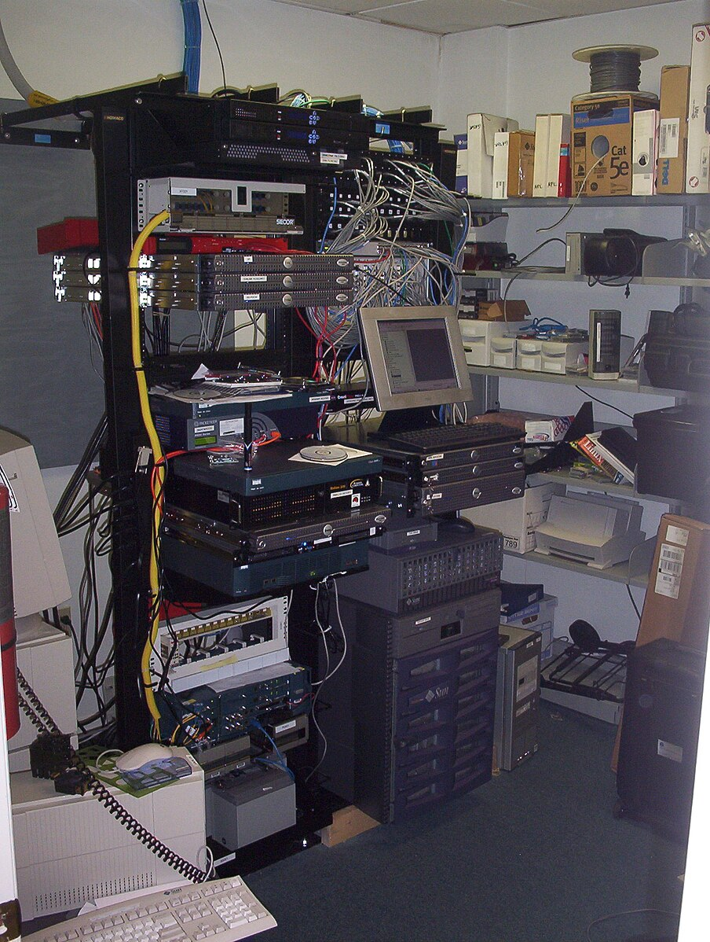
What is SaaS?
Business IT evolution:
Server rooms on-premises
Photo credit: sylvar, used under CC-BY-2.0,
https://commons.wikimedia.org/wiki/File:Server_room_-_Flickr_-_sylvar.jpg

Slide 6

What is SaaS?
External co-location:
Third party multi-tenant
data centers
Photo credit: used under CC-BY-4.0, https://commons.wikimedia.org/wiki/File:Regional_data_and_international
_commutation_centers_in_Baku.jpg

Slide 7
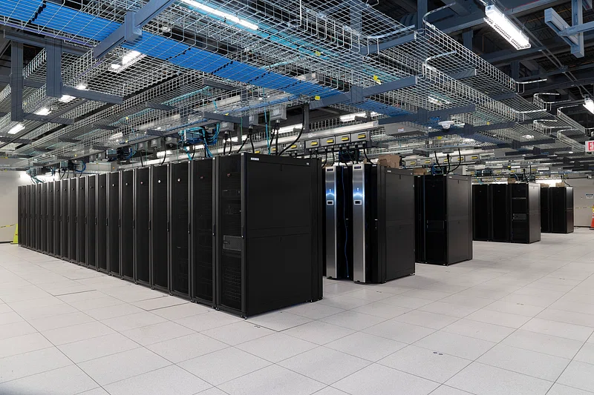
What is SaaS?
Cloud Computing:
Provider-owned facilities
and infrastructure, accessed
on-demand
Photo credit: used under CC0-1.0, https://www.rawpixel.com/image/9648108/photo-image-person-public-domain-computer

Slide 8
What is SaaS?
Key elements of cloud computing:
Provider-owned, multi-tenant infrastructure
Accessed remotely over the Internet
Data is received, stored, and processed by provider
Software is (mostly) not distributed to users
Instead, provider performs the “service” of managing the infrastructure, hosting the software, and providing access to users
Pricing may be subscription-based or on-demand
Can enable better growth and scaling than large capital asset purchases

Slide 9
Cloud Computing Types and Responsibilities
No bright lines between these types, but useful as concepts:
Infrastructre as a Service (IaaS):
  Cloud provider makes available infrastructure building blocks, for you to construct your own Internet-connected systems
Platform as a Service (PaaS):
  Cloud provider makes available “middleware” elements, managing lower-level infrastructure, enabling you to build business logic on top of it
Software as a Service (SaaS):
  Cloud provider makes available a full business “solution” for you to use

Slide 10
Cloud Computing Types and Responsibilities
Data
Application Software
Platform (Middleware)
Operating System
Virtualization
Networking
Physical Hardware (CPUs, Storage, etc.)
Power and HVAC
Physical Security
 | Cloud Provider Manages | Customer Manages
On-Premises |  | Everything!
Infrastructure as a Service (IaaS) | Physical Security; Power and HVAC; Physical Hardware; Networking; Virtualization | Operating System; Platform; Application Software; Data
Platform as a Service (PaaS) | IaaS, plus Operating System and Platform | Application Software; Data
Software as a Service (SaaS) | Everything!

Slide 11
Cloud Computing Types and Responsibilities
We’ll generally use “SaaS” as a catch-all for all of these types
As counsel negotiating a SaaS (or IaaS, or PaaS…) agreement:
Helpful to understand scope of provider’s responsibilities
Helpful to understand how it fits into your provider’s business
Important for your client’s procurement, engineering, and risk teams to be aligned on who is responsible for what!

Slide 12
Comparing SaaS Agreements and Traditional License and Service Contracts

Slide 13
Key differences between Software License and SaaS Licenses
Software License | SaaS License
Software code is provided by Provider to Customer, and is installed by Customer in its own operating environment (local or hosted servers) | Provider operates the software in its own environment, and provides access to the software to Customer via web-based interface, APIs or customer integration
License grant includes the right to install and use, may also include the right to modify, create derivative works, incorporate into other software | License grant provides the right to access and use the software
License term may be perpetual or limited | License is term limited, typically subscription based
Support, updates and maintenance may be included, or offered separately for an extra fee | Support, updates and maintenance, particularly in multi-tenant offerings are typically included in subscription fee

Slide 14
Key differences between Software License and SaaS Licenses (continued)
Software License | SaaS License
Resolving bugs, security issue and similar issues is typically part of warranty or support agreement | Availability of software is typically subject to a Service Level Agreement
Data stays under the control of Customer | Data needed to use the software is transferred to Provider’s servers
Customer is able to continue using the software during the licensed term even if the Provider ceases doing business, may include source code escrow provisions for self-help support | Customer is reliant on Provider to continue doing business and providing the hosting services. Source code escrow provisions are rare. May include transition provisions.
Open Source Software in the code may require making Customer’s modifications or proprietary code public | Open Source Software license obligations remain the responsibility of Provider, but may still be covered in reps & warranties

Slide 15
Negotiating Key Provisions of SaaS Agreements

Slide 16
Negotiating Key Provisions of SaaS Agreements
We’ll be focusing on topics that are specific or unique to SaaS agreements.
Many typical technology license provisions also apply in some form.
After the break we’ll cover several special topics, including e.g. data privacy and security; service provider’s use of customer content.

Slide 17
Negotiating Key Provisions of SaaS Agreements
Things we’ll focus on:
Customer right to access and use
Restrictions on use (Acceptable use policies)
Service provider’s modification or cessation of the services
Service Level Agreements (SLAs)
Technical commitments (e.g. high availability / disaster recovery)
Subcontractors and service providers
Other SaaS-specific considerations

Slide 18
1. Customer Access and Use
  Processing / CPU time
  User seats
Key concepts:
Pricing generally tied to resource usage, such as:
  Data storage
  API calls
May be “all you can eat”
May be subject to purchased limits with overage fees
Pricing formulas can be extremely complex and unpredictable

Slide 19
1. Customer Access and Use
Sample clauses:
Customer:
  Customer may from time to time transfer User Licenses among Customer’s employees and contractors. Provider shall promptly notify Customer upon Customer using 90% of the purchased User Licenses during the Term.
Provider:
  User Licenses may not be transferred to any other user during the Term. If Customer exceeds the number of purchased User Licenses at any time, such number shall be deemed increased for the remainder of the Term and Customer shall promptly pay Provider for all corresponding fees at Provider’s then-current rates.
Negotiated:
  Customer may transfer User Licenses to another Customer employee or contractor upon an Authorized User leaving Customer’s employment or having permanently reassigned job duties where access to the Services are no longer required. If Customer exceeds the purchased User Licenses, Customer shall promptly purchase additional User Licenses or else Provider may disable excess User Licenses.

Slide 20
2. Restrictions on Use
Key concepts:
Typical restrictions on not copying, reverse engineering, …
Additionally: “Acceptable Use Policy” or similar
  Often on provider’s website, incorporated by reference
  Providers will rarely, if ever, agree to AUP changes
    Might agree to “Notwithstanding the AUP, …” clarification edits
  Providers will usually want flexibility to modify their AUP in their sole discretion
Review for issues specific to customer’s use case (e.g. “no competitive use”), and discuss with relevant business team as needed

Slide 21
2. Restrictions on Use
Sample clauses:
Customer:
  Provider shall not modify the AUP during the Term.
Provider:
  Provider may modify the AUP from time to time in its sole discretion. Changes to the AUP shall be effective upon posting on Provider’s website.
Negotiated:
  Provider may modify the AUP from time to time in its sole discretion; provided, that any changes shall only become effective upon the commencement of the next Renewal Term.

Slide 22
3. Modification or Discontinuation
Key Concepts:
Control: What changes can the Provider make to the Software without Customer’s consent?
Reduction in Functionality: What if the change materially reduces the functionality of the Software? What if the change is non-material overall but is material to the Customer?
Discontinuation: What notice is required if the Service Provider discontinues the service during the term?
Remedies: Can Customer terminate and receive a refund in case of reduction of functionality or discontinuation?

Slide 23
3. Modification or Discontinuation
Sample clauses:
Customer:
  Provider may not modify the software in any way that materially reduces its functionality.
Provider:
  Provider may modify or discontinue the Software with or without notice.
Negotiated:
  Provider may update or modify the software at any time, subject to a 90 day prior written notice to Customer if the functionality materially reduces any existing functionality. Provider may discontinue provision of the Software during the term with at least 180 days’ prior written notice to Customer. In either case, Customer may terminate this Agreement upon written notice to Provider and Provider will issue a pro-rata refund to Customer of any pre-paid and unused licensing fees.

Slide 24
4. Service Level Agreements (SLAs)
Key concepts:
Availability: What % (or other metrics) “uptime” commitments are made for the SaaS system?
Exclusions: What events are excluded from uptime calculations?
Remedies: If the SLA is breached, what does the customer get?
Remember:
An SLA is a contractual commitment, not a technical panacea!

Slide 25
4. Service Level Agreements (SLAs)
Availability:
Customer:
  Provider shall make the Services Available X% of each calendar month during the Term, excluding Excused Downtime.
  “Available” means that the Services are available for Customer’s use and functioning correctly in all material respects.
Provider:
  Provider shall use commercially reasonable efforts to make the Services Available X% of each calendar month during the Term, excluding Excused Downtime.
  “Available” means that the Services are powered on and responding to network pings, as measured by Provider using its standard system health checks.

Slide 26
4. Service Level Agreements (SLAs)
Exclusions:
Customer: ”Excused Downtime” means failure of Availability due to:
    (1) emergency maintenance due to Force Majeure, not to exceed X hours / month; or
    (2) scheduled maintenance, not to exceed X hours / month, occurring only between the hours of 3-5AM Eastern Time, and with at least 72 hours advance written notice.
Provider: ”Excused Downtime” means failure of Availability due to:
    (1) emergency or scheduled maintenance;
    (2) failure of the Internet, utilities, or service providers;
    (3) acts or omissions of third parties;
    (4) lack of Availability resulting from acts or omissions of Customer; or
    (5) any other circumstances beyond the reasonable control of Provider.

Slide 27
4. Service Level Agreements (SLAs)
Remedies:
Customer:
  If Provider fails to achieve the SLA Commitment in any calendar month, Provider shall promptly refund X% of Customer’s monthly fees.
  If Provider fails to achieve the SLA Commitment either (a) by more than X% in any calendar month, or (b) Y or more times in any Z-month period, then upon written notice Customer may terminate the Agreement.

Slide 28
4. Service Level Agreements (SLAs)
Remedies:
Provider:
  If Provider fails to achieve the SLA Commitment in any calendar month, Customer may receive a service credit in the amount of X% of monthly fees for Availability between Y% and Z%; …
  The foregoing service credits are subject to (1) Customer notifying Provider no later than X days after the occurrence of the downtime event; and (2) Provider’s confirmation of the absence of Availability during such event.
  Service credits may be applied against fees due for future invoices, but shall not be issued to Customer as a refund.
  The foregoing service credits are Customer’s sole and exclusive remedy, and Provider’s sole liability, regarding any unavailability of the Services.

Slide 29
5. Technical commitments
Key concepts:
Will necessarily be specific to the nature of the SaaS service
Customer can often reasonably expect commitments for:
  high availability and redundancy / multi-region deployments
  backups
  disaster recovery
  status notification site
  technical support
BUT: Unless Customer is paying enough, Provider will not agree to implement unique technical commitments.

Slide 30
6. Subcontractors and Service Providers
Key Concepts:
Visibility: Does the Provider have to disclose which subcontractor it utilizes to provide the SaaS (e.g. a third party hosting provider)
Control: Does the customer have the ability to approve sub-contractors that the Provider is using to deliver the services?
Responsibility: Is the Provider responsible for breaches or damages caused by third party sub-contractors/service providers?
Additional Terms: Do any additional terms apply when the Provider uses a third party sub-contractor or service as part of its offering?

Slide 31
6. Subcontractors and Service Providers
Sample Clauses:
Customer:
  Provider may only use subcontractors approved by Customer in writing to perform any material aspect of the services. Provider is fully responsible for all damages resulting from acts or omissions of any sub-contractor.
Provider
  Provider may utilize third parties and third party products and services to perform its obligations under this Agreement, which may be subject to separate terms and conditions as may be posted on the Provider’s website. Customers use of the Service constitutes acceptance of such third party terms and conditions. Provider is not liable to Customer for the services provided by Third Parties.

Slide 32
6. Subcontractors and Service Providers
Sample Clauses:
Negotiated:
  Provider may utilize third parties and third party products and services to perform its obligations under this Agreement, however Provider remains responsible for providing the Services, and the use of third party or third party products and services does not relieve Provider from its obligations under this Agreement.

Slide 33
7. Other SaaS-specific considerations
No acceptance provisions
  SaaS agreements typically do not include acceptance/rejection of deliverables provisions, except if specific integration/professional services are purchased separately. There may be an evaluation or trial period offered instead.
  SLAs may be tied to specified minimum functionality, which would provide remedies in case the software is not meeting the requirements.
Source Code Escrow
  Given that the software is engineered to be a SaaS offering, it is unlikely to be a helpful remedy to a Customer and is less common in SaaS Agreement, but may still be used where the Customer is a large entity and the SaaS service is business critical.
Change of Control
  Change of control to a competitor of Customer is a greater concern since the SaaS provider has ongoing access to Customer’s data, and a business interest conflict is more likely to have an impact than in case of a Software license.

Slide 34
Break

Slide 35
Data Privacy and Cybersecurity

Slide 36
Data Processing Agreements (DPAs)
If a contract involves the processing of personal data, the parties likely need to enter into a DPA. In many cases, the law expressly requires it. If one party is processing personal data on behalf of another party, there likely needs to be a DPA under the express terms of the GDPR, CCPA and other US state privacy laws. Some disclosures of personal data to third parties are also subject to express requirements, such as under the CCPA. Even if there is not an express requirement, privacy and cybersecurity terms are essential to ensuring legal compliance and protecting the parties to the contract.
Key Terms
Personal Data (Personal Information): Information relating to and identified or identifiable naturl person.
Processing: Any operation or set of operations which is performed on personal data, such as collection, structuring, storage, retrieval, use, disclosure by transmission, dissemination or otherwise making available, alignment or combination, restriction, erasure or destruction.
Controller (Business): Entity that determines the purposes and means of processing personal data.
Processor (Service Provider): Entity that processes personal data on behalf of controller.

Slide 37
DPAs: Express Legal Requirements
Laws like the GDPR, HIPAA, CCPA and other US state privacy laws expressly require contractual protections in some cases
  GDPR Article 28: “Processing by a processor shall be governed by a contract or other legal act under Union or Member State law, that is binding on the processor with regard to the controller and that sets out the subject-matter and duration of the processing, the nature and purpose of the processing, the type of personal data and categories of data subjects and the obligations and rights of the controller.”
  CCPA 1798.100(d): “A business that collects a consumer’s personal information and that sells that personal information to, or shares it with, a third party or that discloses it to a service provider or contractor for a business purpose shall enter into an agreement with such third party, service provider, or contractor” that includes specified terms.
  HIPAA Business Associates: Covered entities disclosing PHI to service providers required to have business associate agreement with specified protections.

Slide 38
CCPA “Service Providers”
Prohibit from “selling” or “sharing” personal information received under the contract
Identify specific purposes for processing personal information under contract
  Cannot use generic terms such as referencing contract generally
Prohibit service provider from retaining, using or disclosing other than for purposes specified in contact, except as otherwise provided by CCPA
  Exception can include internal uses for product improvement but not on behalf of a third party
Prohibit from retaining, using or disclosing outside of the direct business relationship with the business
Provide same level of privacy protection as applicable to business under CCPA
Right to take reasonable steps to ensure compliance
Notify in the event service provider can no longer comply
Right to take reasonable steps to stop and remediate unauthorized uses
Consumer rights requests

Slide 39
DPAs: Addressing Other Requirements
Contracts are a tool to comply with other legal requirements and protect a client’s rights. Some examples include:
Assisting controller in reponding to data subject rights or regulatory inquiries
  Often a service provider is in possession of data at issue or may have direct relationship with data subjects
Assisting controller in meeting other privacy requirements, e.g., data protection impact assessments
  Understanding controls in place to protect data may be key in meeting requirements
Notifying controller in the event of a data breach
  As the “owner” of personal information transferred through services agreement, controller is generally required to send data breach notices, but relies on service provider for information about the breach
Ensuring the security of regulated data
  In some cases, laws like the NY SHIELD Act include contractual protections and the ability to conduct oversight as elements of a reasonable security program

Slide 40
Beyond Express Legal Requirements….
Privacy and cybersecurity terms of agreement help companies to assert their rights and protect the value of the deal
Examples:
  User data is valuable—restricting others from using it helps to protect that value
  Cybersecurity and data breach terms help to ensure that data is not authorized without authorization and, if it is, allow client to know if asset in the hands of third parties
    Especially valuable if data is PI or other sensitive or proprietary information
  Audit terms allow companies to monitor compliance with restrictions described above

Slide 41
Cybersecurity
Not just about personal data!
Consider other proprietary data, IP, service up-times, etc.
Typical provisions included:
  General security requirements, i.e., “reasonable security, including administrative, technical and physical safeguards.”
  Specific security requirements, often an annex to agreement
  Breach notification
  Indemnification
  Insurance

Slide 42
General Security
Provider will implement and maintain reasonable security procedures and practices including administrative, technical and physical safeguard that are appropriate to the nature of any Customer Data and the Services and that are consistent with best practices in the industry. Without limiting the generality of the foregoing, Provider’s security procedures and practices shall include the security measures set out in Annex A.
BUT: Well established Providers likely to have specific security annexes and are unlikely to deviate from those terms.
Other terms might include:
  Access controls
  Audits and testing, including availability of security reports
  Sub-processors
  Business continuity and disaster recovery

Slide 43
Data Breach
Provider will notify Customer promptly of unauthorized access to or loss of Customer Data (a “Security Incident”) promptly and in any event no less than [72 hours] after first discovery of such Security Incident. Such notice shall summarize in reasonable detail, where available, the nature of the Security Incident, the impact on Customer Data, and the corrective action taken or proposed to be taken by Provider.
  Consider:
    Timing and scope of notification?
    Responsive actions—what cooperation do you require?
    Who controls external communications?
    Costs associated with response and remediation, e.g., forensic investigation, legal fees, notification, credit monitoring, damage to equipment
    Other harms associated with breach, e.g., third-party claims, regulatory investigations, reputation, loss of business—indemnification and limitations of liability

Slide 44
Open Source and Source-Available Licenses in SaaS

Slide 45
Open Source Licenses
30-second overview – software which meets ALL of the following:
publicly available in source code form
license permits use for ANY purposes
license is subject to very limited set of conditions, not restrictions:
  “permissive”: retain copyright and license notices
  “copyleft”: apply this same license to (certain of) your own software
Many companies have some form of Open Source Program Office (OSPO) to manage license compliance across business functions

Slide 46
Open Source Licenses and SaaS
OSS compliance generally easier for SaaS services:
For most OSS licenses, distribution is the trigger for conditions
For most SaaS services, the provider’s software is not distributed

Slide 47
Open Source Licenses and SaaS
But, there are non-trivial caveats:
For some OSS licenses, “external deployments” or making the software accessible over a network can trigger compliance requirements
And even for other licenses, SaaS services often involve distributing some software!

Slide 48
Source Available Licenses and SaaS
“Source Available” licenses are NOT open source:
Source code is available
…but, some uses are prohibited
…or, some (effectively impossible) restrictions are imposed
Several were specifically drafted to target SaaS use cases
Developers may not appreciate the difference between source available and open source!

Slide 49
Open Source / Source Available: Providers
Aligns with open source / license compliance practices generally:
Know what software you’re using
Determine which licenses apply
Understand the rights and obligations for each license
Evaluate the use cases, focused on distribution and deployment
Establish a process to meet those requirements

Slide 50
Open Source / Source Available: Customers
Ask for reasonable things:
Commitment that use of the SaaS services will not e.g. impose any copyleft obligations on Customer’s content and SaaS outputs
Don’t ask for unreasonable things:
Commitment that no open source will be used
Commitment that no copyleft open source will be used
Commitment that all open source will be listed on an exhibit

Slide 51
Data as Intellectual Property

Slide 52
Which Types of IP apply to “Data”?
Copyright?
  May apply to certain “content”, but in the US not to “data” generally
  May apply to a limited extent to sufficiently creative structure of data
  May differ in other jurisdictions! Note EU sui generis database rights
Patents?
  Maybe to the SaaS system itself, but not to the data / content
Trademarks?
  Maybe embodied in certain content, depending on nature of the SaaS service
Confidentiality / Trade Secrets?
  Often doing most of the work for what the parties care about

Slide 53
“Ownership” of data
May not work as expected from a “business” perspective…
As with other contracts, be precise if using ownership language
  “Provider hereby assigns” vs. “Provider shall assign” vs. “Customer owns”
But “assigns” or “owns” language may lack clarity or effectiveness, especially where few or no underlying IP rights exist
Particularly for outputs automatically generated by the SaaS system

Slide 54
Practical approach to rights in data
What are the parties contractually committing that the Customer can, and can’t, do with the content / data?
What are the parties contractually committing that the Provider can, and can’t, do with the content / data?
Include assignment and license grant language where applicable

Slide 55
AI and Use of Customer and Personal Data

Slide 56
Artificial Intelligence as SaaS
Top Generative AI services (OpenAI, Azure, AWS, Google Cloud) are all SaaS
Incremental provisions that may be included:
  Restriction on retention and use of Licensee’s data to improve Licensor’s services or train AI models
  Ownership and right to use of outputs generated by AI
  Quality requirements (or disclaimers) on outputs of AI
  Transparency, explainability, bias mitigation and compliance with emerging laws
  Liability for infringement by the training data, model or outputs

Slide 57
Q&A

Slide 58
Wrap Up

Slide 59
Thank you!
Contact us:
Steve Winslow
Boston Technology Law, PLLC
swinslow@bostontechlaw.com
Kevin J. Angle
Holland and Knight LLP
kevin.angle@hklaw.com
Stas Zakharenko
GTC Law Group, PC & Affiliates
szakharenko@gtclawgroup.com

