Slide 1
MCLE’S
MUPC & MUTC Update 2025
February 28, 2025
Heirs at law
priority for appointment
time limits for filing
Jamie L. Jordan, Esq., Assistant Register
Middlesex Probate and Family Court
Jamie.Jordan@jud.state.ma.us

Slide 2

The “MUPC HUB”
https://www.mass.gov/estate-administration-resources-mupc-hub
Go-to for instructions and resource materials related to estate administration, trusts, and the MUPC

Slide 3

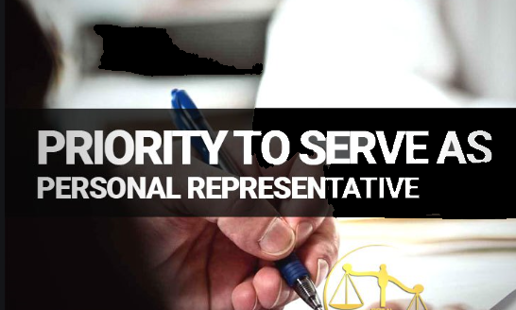

Understanding the Basics Before you Begin

Slide 4
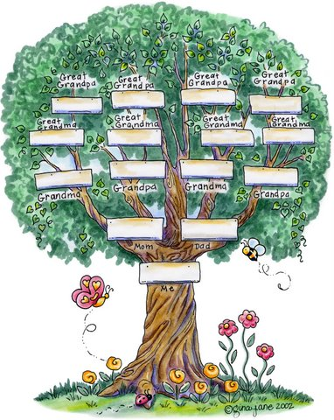
Identifying Heirs at Law

Slide 5
Identifying Heirs at Law
Heirs at law are those persons who inherit a Decedent’s property under the applicable statute when the Decedent died intestate (without a will).
Heirs at law are identified as of the Decedent’s date of death
    For deaths that occur on or after 3/31/2012, the MUPC (Chapter 190B) at § 2-101, et seq. should be consulted.
    For deaths that occurred prior to 3/31/2012, the law in effect at time of death controls (See generally, G. L. c. 190, since repealed)

Slide 6
Identifying Heirs at Law
MUPC at § 2-101, et seq.
It is critical to correctly identify the Decedent’s heirs at law under the MUPC for various reasons:
NOTICE: Heirs at law must be notified in both informal and formal proceedings to open an estate.
PRIORITY FOR APPOINTMENT AS PR: Heirs at law have priority for appointment in intestate estates and may also have priority for appointment in testate estates.
LEGAL STANDING: Heirs at law have legal standing to challenge the probate of any will.
PROPER ADJUDICATION: Heirs at law are judicially determined in formal proceedings to open an estate.

Slide 7
Identifying Heirs at Law
MUPC at § 2-101, et seq.
Pattern of intestate succession in Massachusetts
in order of priority is as follows:
1. Decedent’s Spouse
2. Decedent’s Descendants (Decedent’s children and/or grandchildren, etc. if there are any predeceased children)
3. Parents
4. Parents’ Descendants (Decedent’s brothers/sisters and/or nieces/nephews, etc. if there are any predeceased siblings)
5. “Next of kin”
6. Commonwealth of Massachusetts or Soldiers’ Home (if there is no taker)

Slide 8
Identifying Heirs at Law
MUPC at § 2-101, et seq.
Kindred of Half Blood
Relatives of the half blood inherit the same share they would inherit if they were of the whole blood. MUPC at § 2-107.
Parent and Child Relationship
An adopted individual is the child of his adopting parent or parents and not of his natural parents, but adoption of a child by the spouse of either natural parent has no effect on the right of the child or a descendant of the child to inherit from or through either natural parent. MUPC at § 2-114(b).
In July 2022, § 2-114 amended to add (c) – an individual adopted by a blood relative loses their right to inherit from a natural parent or kindred
Afterborn Heirs
An individual in gestation at a particular time is treated as living at that time if the individual lives 120 hours or more after birth. MUPC at § 2-108.

Slide 9

Heirs at Law under the MUPC – on or after 3/31/2012
Individual dies married with no descendants (children, grandchildren, etc.)
Survived by no parents?
Survived by parent(s)?
Surviving Spouse is the Sole Heir at Law
Surviving Spouse and Surviving Parent(s) are the Heirs at Law

Slide 10
Heirs at Law under the MUPC – on or after 3/31/2012
Individual dies married with descendants that are all from current marriage and….
The Surviving Spouse does not have any descendants outside of this relationship
Surviving Spouse is the Sole Heir at Law

Slide 11

Heirs at Law under the MUPC – on or after 3/31/2012
Individual dies married with descendants that are all from current marriage and….
The Surviving Spouse has descendants outside of this relationship
Surviving Spouse and the Decedent’s Surviving Descendants are the Heirs at Law

Slide 12
Heirs at Law under the MUPC – on or after 3/31/2012
Individual dies married with descendants outside of the current marriage
Surviving Spouse and the Decedent’s Surviving Descendants are the Heirs at Law

Slide 13
Heirs at Law under the MUPC – on or after 3/31/2012
Individual dies single or widowed
Survived by no Descendants or Parent(s),
but Siblings*
*Note: Descendants of a predeceased person that would otherwise be an heir take their parent’s share.
Survived by Descendants * Survived by no Descendants, but Parent(s)
Decedent’s Surviving Descendants are the Heirs at Law
Surviving
Parent(s) are the Heirs at Law
Decedent’s Siblings are the Heirs at Law

Slide 14

Heirs at Law under the MUPC – on or after 3/31/2012
Individual dies single or widowed
Survived by no Descendants, Parent(s), or
Siblings,
but other relatives
(See Degrees of Kinship Chart for closest living relative)
If no taker, the intestate estate passes to the Commonwealth of Massachusetts unless the decedent was a veteran who died while a member of the Soldier’s Home in MA or the Soldier’s Home in Holyoke.

Slide 15
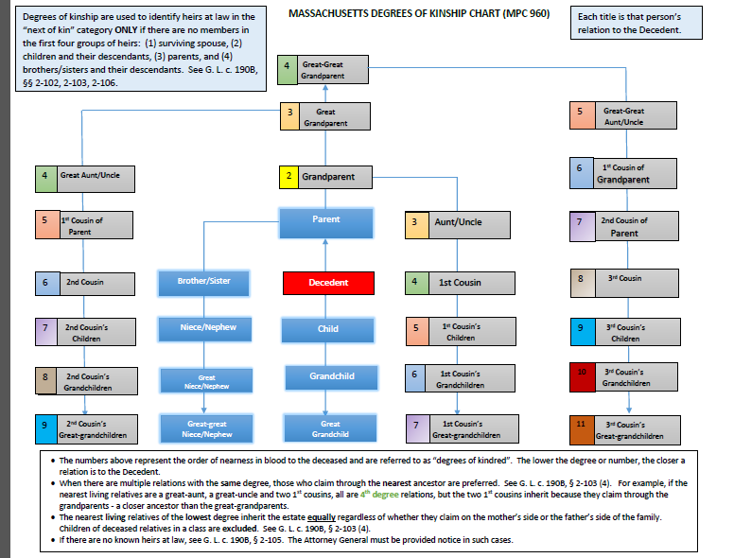
Identifying Heirs at Law
Degrees of Kinship

Slide 16
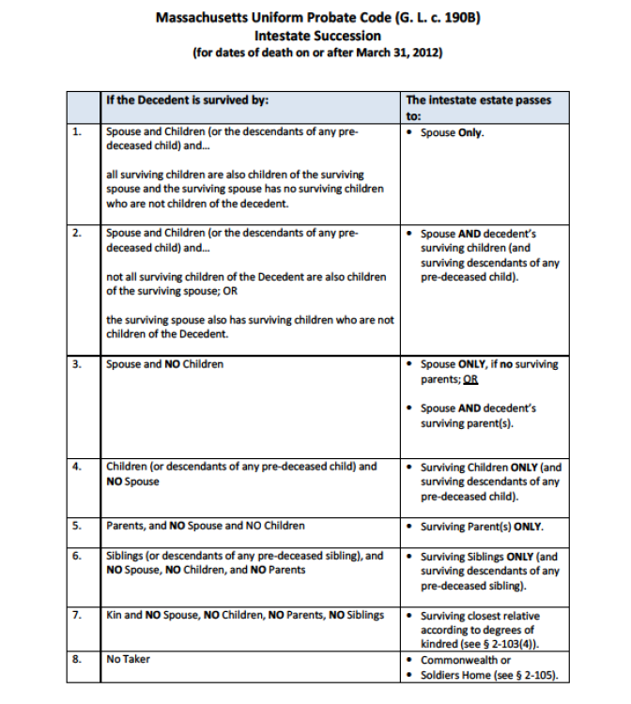
Identifying Heirs at Law
MUPC at § 2-101, et seq.

Slide 17
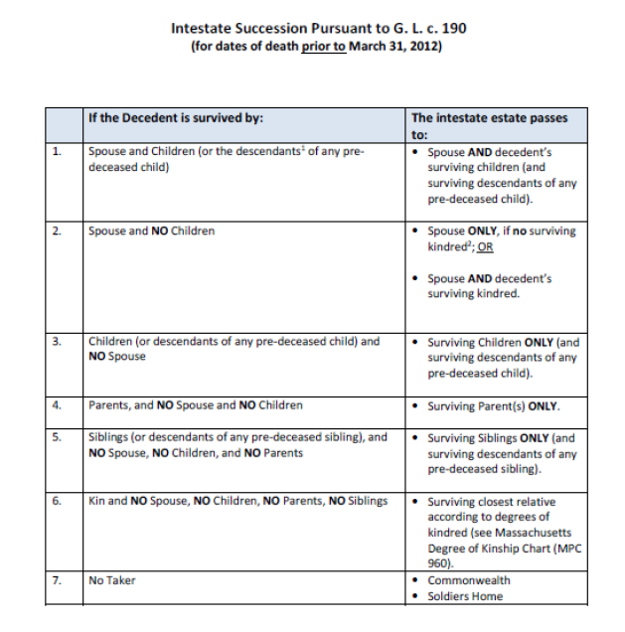
Identifying Heirs at Law
Basic Rules Pre-MUPC (c. 190, since repealed)

Slide 18
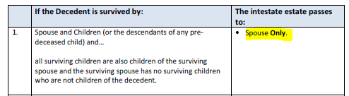
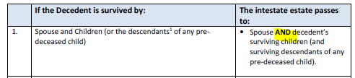
MUPC v. Pre MUPC: Key Differences
Surviving Spouse
MUPC
Pre MUPC

Slide 19
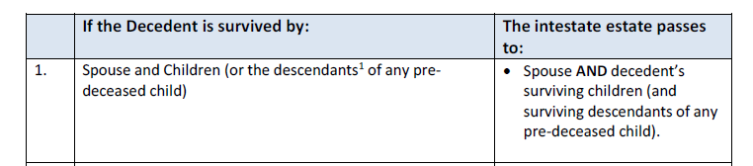
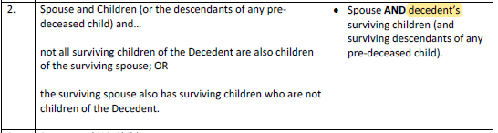

MUPC v. Pre MUPC: Key Differences
Surviving Spouse
MUPC
Pre MUPC

Slide 20
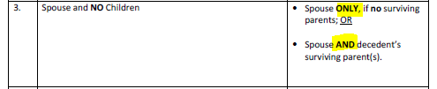
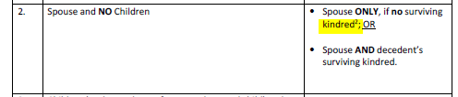
MUPC vs. Pre MUPC: Key Differences
Surviving Spouse
MUPC
Pre MUPC

Slide 21
Remember. . .
A decedent by will may expressly exclude or limit the right of an individual or class to succeed to property of the decedent passing by intestate succession.
MUPC at § 2-101(b).

Slide 22

Pop Quiz Time!
QUESTION:
Joseph died on March 31, 2012. What law controls for purposes of identifying Joseph’s heirs at law?

Slide 23
Pop Quiz Time!
ANSWER:
The MUPC – G.L. c. 190B – for deaths ON or after 3/31/12

Slide 24
Pop Quiz Time!
QUESTION:
Kathy died on August 31, 2020, leaving a spouse, Dean, and two children of the marriage – Blake and Austin. Neither Kathy nor Dean have children from any other relationship. Who are the heirs at law of Kathy’s estate?

Slide 25
Pop Quiz Time!
ANSWER:
Dean (surviving spouse)
MUPC death with intact family =
Surviving spouse is sole heir

Slide 26
Pop Quiz Time!
QUESTION:
Kathy died on August 31, 2011 leaving a spouse, Dean, and two children of the marriage – Blake and Austin. Neither Kathy nor Dean have children from any other relationship. Who are the heirs at law of Kathy’s estate?

Slide 27
Pop Quiz Time!
ANSWER:
Kathy’s spouse and children – Dean, Blake, and Austin
Pre-MUPC death =
spouse and descendants are heirs

Slide 28
Pop Quiz Time!
QUESTION:
Kevin died on January 1, 2018 leaving a spouse, Maureen, and one child of the marriage - Melissa. Maureen has no other children from any other relationship. Kevin, however, had two other children from prior relationships. Who are the heirs at law of Kevin’s estate?

Slide 29
Pop Quiz Time!
ANSWER:
Maureen (surviving spouse), Melissa (child of the marriage), and Kevin’s 2 other children outside of the marriage

Slide 30
Pop Quiz Time!
QUESTION:
Megan died on September 1, 2020 leaving a spouse, Jared, and two children of the marriage – Ben and Zoe. Megan has no other children from any prior relationship. Jared has one child from a prior relationship, Jackson. Who are the heirs at law of Megan’s estate?

Slide 31
Pop Quiz Time!
ANSWER:
Jared (surviving spouse) and Megan’s children, Ben and Zoe
Stepchild is not an heir of Megan

Slide 32
Pop Quiz Time!
QUESTION:
Adam died on December 1, 2023 leaving a spouse, Allison, and two children of the marriage –Alex and Adrian. Adam has one child from a prior relationship, Isabelle. Who are the heirs at law of Adam’s estate?

Slide 33
Pop Quiz Time!
ANSWER:
Allison (surviving spouse) and all of Adam’s children – Alex, Adrian and Isabelle

Slide 34
Pop Quiz Time!
QUESTION:
Judy dies unmarried leaving two children, Anna and Emily. Her third child, Amy, predeceased her. Amy left a son, Cameron. Who are the heirs at law of Judy’s estate?

Slide 35
Pop Quiz Time!
ANSWER:
Anna and Emily (children)
AND
Cameron (grandchild/child of predeceased child)

Slide 36
Pop Quiz Time!
QUESTION:
Karen is the spouse of David. Karen dies on December 1, 2018. David dies one day later on December 2, 2018. Attorney Smart files an informal petition to probate David’s estate. On the Surviving Spouse, Children, Heirs at Law form (MPC 162), Attorney Smart does not list Karen as a surviving spouse. Is this correct?

Slide 37
Pop Quiz Time!
ANSWER:
YES! Heirs are determined as of Decedent’s date of death. A person must survive the death of the Decedent to “qualify” as an heir

Slide 38
Pop Quiz Time!
QUESTION:
Billy is the spouse of Aaron. Aaron dies on September 1, 2018. Billy dies on September 15, 2018. Attorney Smart files a formal petition on October 31, 2019 to probate Aaron’s estate. On the Surviving Spouse, Children, Heirs at Law form (MPC 162), Attorney Smart does not list Billy. Is this correct?

Slide 39
Pop Quiz Time!
ANSWER:
NO! Heirs are determined as of Decedent’s date of death. NOT date of filing.

Slide 40
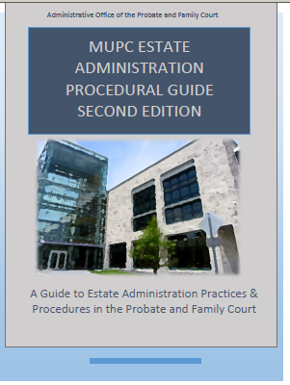
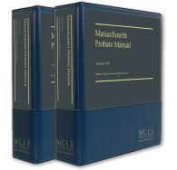

Identifying Heirs at Law
There are many resources to help you correctly identify the heirs at law of an estate:
The law!
Form MPC 162 (Surviving Spouse, Children, Heirs at Law form) and the Instructions/Charts available on the MUPC HUB
  MUPC Estate Administration Procedural Guide, Second Edition ()
  Includes charts for MUPC deaths, pre-MUPC deaths and Degrees of Kinship
The MCLE Probate Manual

Slide 41
Priority for Appointment

Slide 42
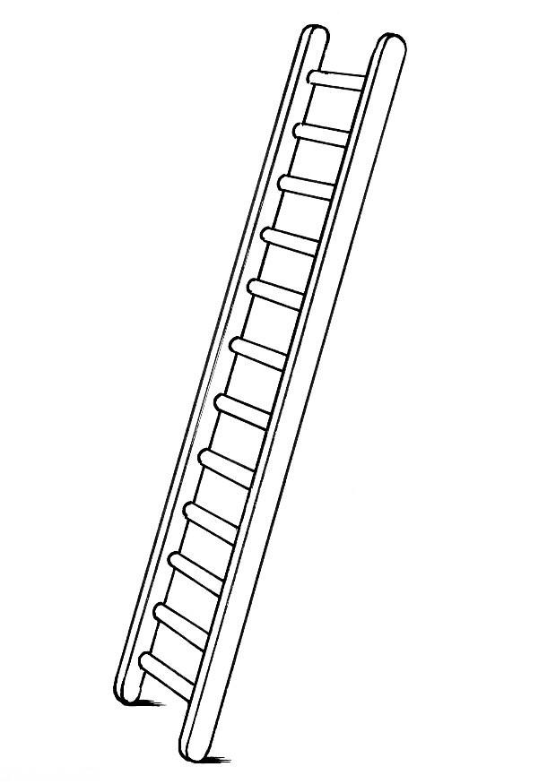
Priority for Appointment
Priority for Appointment is a way of determining the ranking of person(s) who may be appointed as PR in both an informal and formal proceeding.
Referred to as the:
“Priority Ladder”

Slide 43
Who has priority for appointment?
MUPC at § 3-203
the person with priority as determined by a probated will including a person nominated by a power conferred in a probated will;
(2) the surviving spouse of the decedent who is also a devisee in the will;
(3) other devisees in the will;
(4) the surviving spouse of the decedent;
(5) other heirs of the decedent;
(6) if there is no known spouse or next of kin, a public administrator.
See MUPC at § 3-203; see also Chapter 1 of the MUPC 2nd Edition Procedure Guide

Slide 44
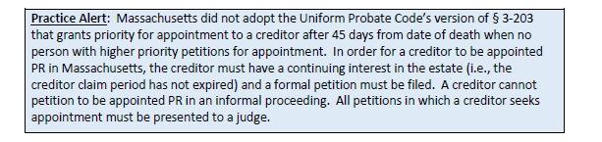
Who has priority for appointment?
MUPC at § 3-203

Slide 45
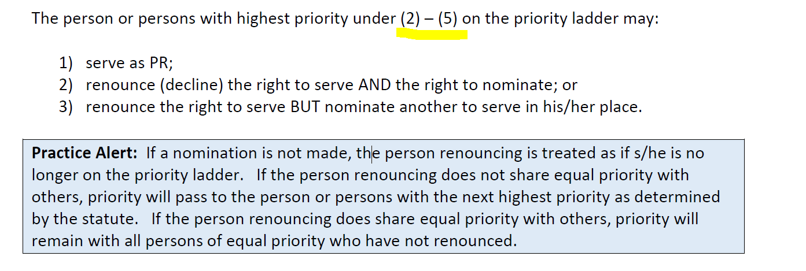
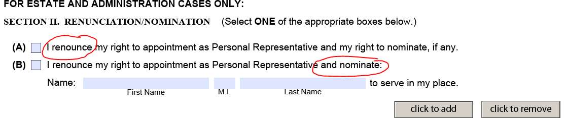
Options for the person(s) with highest priority
See form (MPC 455), section II (A) and (B); see also the Instructions (MPC 941)

Slide 46
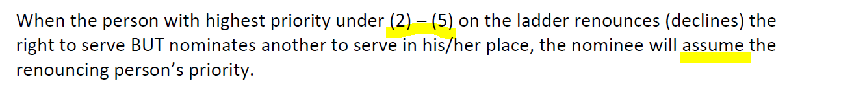
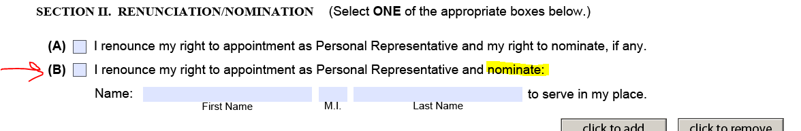
Nomination when one person has priority
See form (MPC 455), section II(B); see also, the Instructions (MPC 941),
Chapter 3 (Informal Proceedings) and Chapter 4 (Formal Proceedings) in the Procedural Guide

Slide 47
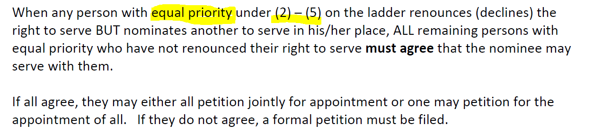
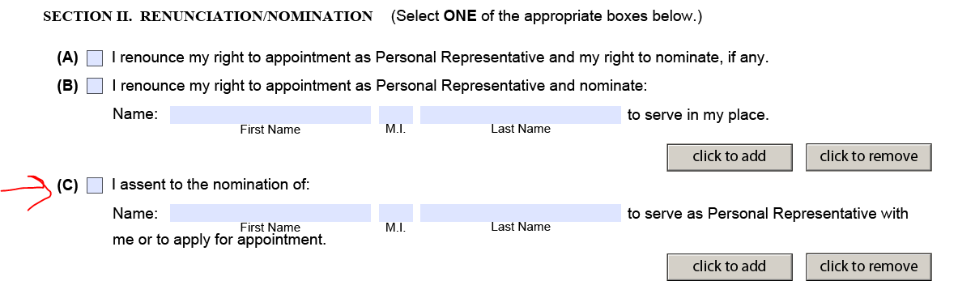
Nomination when more than one person has priority
See form (MPC 455), section II(C); see also, the Instructions (MPC 941),
Chapter 3 (Informal Proceedings) and Chapter 4 (Formal Proceedings) in the Procedural Guide

Slide 48
Special rules for wills
If a will nominates a PR and the nominee does not want to serve, the nominee may renounce (decline) the right to serve; AND
1) If the will contains language which gives the nominee the right to nominate someone else, the nominee can:
a) renounce (decline) the right to nominate; OR
b) nominate anyone else to serve (who need not have statutory priority but who assumes the renouncing person’s priority as set forth above).
2) If the will does not contain language which gives the nominee the right to nominate someone else, that person may not nominate someone else and either priority remains with the other persons who shared priority with the person renouncing (i.e., named co-PRs) or, if the nominee was the only person with priority, priority passes to the next named person in the will or if none, the next person with highest priority as determined by the statute.
See form (MPC 455), section II(A) and (B); see also, the Instructions (MPC 941),
Chapter 3 (Informal Proceedings) and Chapter 4 (Formal Proceedings) in the Procedural Guide

Slide 49
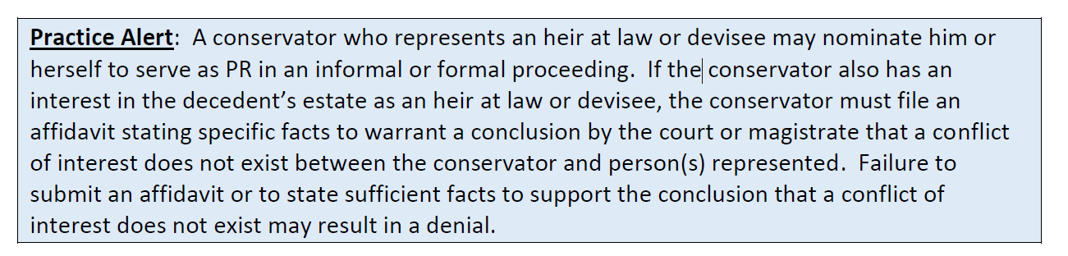
Minor, IP or PP with highest priority
A conservator of the estate of a protected person, or if there is no conservator, a guardian, may exercise the same right to nominate, to object to another’s appointment, or to participate in determining the preference of a majority in interest of the heirs at law and devisees that the protected person or minor would have if qualified for appointment. MUPC at § 3-203(d).

Slide 50
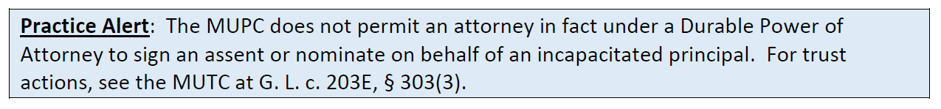
Incapacity of the Appointed PR
If a successor PR is necessary because of the incapacity of the appointed PR, the conservator or if none, the guardian of the appointed PR assumes the priority that the appointed PR had, if any. If the incapacitated /protected PR had no priority, then his guardian/conservator has no priority to petition informally for the appointment of a successor PR. The guardian/conservator of an incapacitated /protected PR who had no priority may petition formally for the appointment of a successor PR or for the appointment of a SPR.

Slide 51
Priority of the domiciliary PR
A PR appointed by a court of the decedent’s domicile has priority over all other persons for appointment in Massachusetts except where the decedent’s will nominates a different person to be the PR in Massachusetts than in the state of domicile. If the decedent’s will does not nominate a different person, the domiciliary PR may nominate another, who shall have the same priority as the domiciliary PR.
MUPC at § 3-203(g). See also Chapter 11 of the MUPC Procedural Guide.

Slide 52
Disqualification from Serving
Regardless of his or her priority, no person is qualified to serve as a PR if:
the nominee is under the age of 18 or under guardianship or conservatorship. MUPC at § 3-203(f)(1).
the court finds in a formal proceeding that the appointment would be contrary to the best interests of the estate. MUPC at § 3-203(f)(2).
the nominee has feloniously and intentionally killed the decedent.
MUPC at § 2-803(c)(1)(iii).
the nominee is a former spouse of the decedent and/or a relative of
decedent’s former spouse, even if nominated in decedent’s will unless the
express terms of the will state otherwise. MUPC at § 2-804(b).
Note: Spouses who are separated, but not divorced, retain rights under the MUPC. MUPC at § 2-802.

Slide 53
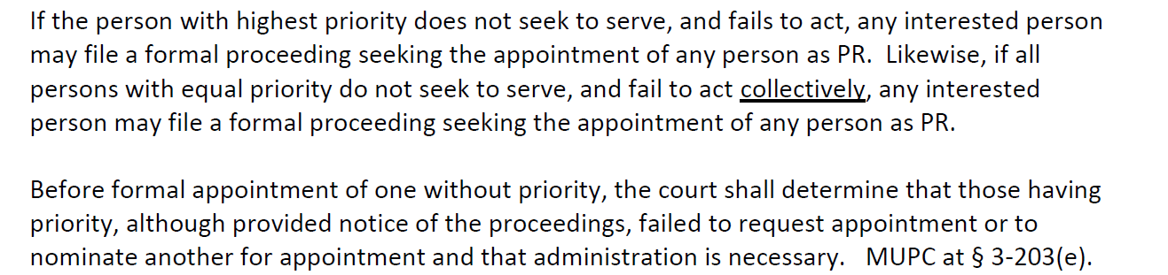
Failure of person(s) with highest priority to act

Slide 54
Pop Quiz Time!
QUESTION:
Adam, Jamie, and Brian are the heirs at law of Kevin’s intestate estate. Brian renounces his right to appointment because he has young children and wants to spend any free time he has playing golf. Who has priority for appointment?

Slide 55
Pop Quiz Time!
ANSWER:
Adam and Jamie
(Brian renounced = off the priority ladder)

Slide 56
Pop Quiz Time!
QUESTION:
Same facts - Adam, Jamie, and Brian are heirs of Kevin’s intestate estate and Brian has renounced.
Now Jamie also wants to renounce her right to appointment because her calendar is already too full. However, she wants to nominate her best friend Meredith to serve in her place. What must Jamie do?

Slide 57
Pop Quiz Time!
ANSWER:
Jamie must complete Section II-B of form MPC 455 to renounce the right to serve and nominate her best friend Meredith to serve in her place

Slide 58
Pop Quiz Time!
QUESTION:
Same facts - Adam, Jamie, and Brian are heirs of Kevin’s intestate estate. Brian and Jamie have renounced and Jamie has nominated her best friend Meredith to serve in her place.
Adam agrees that Meredith can serve with him. What must Adam do?

Slide 59
Pop Quiz Time!
ANSWER:
Adam must complete Section II-C of form MPC 455 to assent to Meredith’s nomination to serve with him

Slide 60
TIME LIMITS FOR FILING

Slide 61
TIME LIMITS FOR FILING UNDER THE MUPC
MUPC at § 3-108, as amended
The general rule is that testacy and appointment proceedings must be commenced (i.e. “filed”) within 3 years of a decedent’s death.
This time limit does not apply to bar the following proceedings, which may be filed at any time:
        Voluntary Administrations
        Actions to Construe a Probated Will
        Actions to Determine Heirs
        Actions by Foreign Fiduciaries
        Actions to Appoint a Successor PR

Slide 62
TIME LIMITS FOR FILING UNDER THE MUPC
MUPC at § 3-108, as amended
This time limit does not apply to Pre- MUPC Deaths.
Prior law controls (50 year time limit. See
G. L. c. 193, § 4)

Slide 63
EXCEPTIONS…..
Doubt About Death Exception
Missing Person Exception
Twelve Month Will Exception
Late and Limited Exception (§ 3-108(4))
    In/testate: Formal only
Power of Appointment Exception
    Formal only

Slide 64
EXCEPTIONS….
Twelve Month Exception:
A formal proceeding to contest an informally probated will and to secure appointment of
the person with legal priority for appointment may be brought within the later of 12 months
from the informal allowance of the will/appointment of a PR or 3 years from the date of
death.
MUPC at § 3-108 (3).

Slide 65
The Effect of § 3-108 (3)
When a decedent dies testate and the will is informally probated, if there are no formal testacy proceedings instituted within the later of 3 years of death or one year after the date of informal probate, devisees under the probated will are provided conclusive proof of their title regardless whether there is administration of the estate.
Their titles are not only conclusive as against the decedent’s heirs, but also as against the decedent’s devisees under unprobated wills.

Slide 66
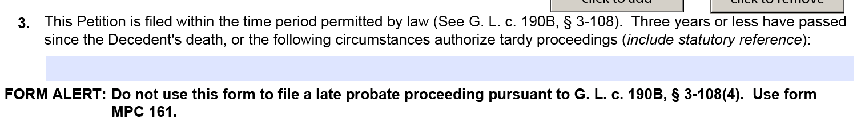
TIME LIMITS FOR FILING UNDER THE MUPC
MUPC at § 3-108, as amended
See # 3 on both the Informal Petition (MPC 150) and the Formal Petition (MPC 160)

Slide 67
The “Late and Limited” Exception
“Late and Limited” 3-108(4) Exception:
Applies to MUPC deaths only (deaths on or after 3/31/2012)
No proceedings have been filed within 3 years of death
Any PR appointed has LIMITED authority
Intestate estate: PR may be appointed
Testate estate: Will may be probated with or without the appointment of a PR
MUPC at § 3-108 (4) (as amended).

Slide 68
The Effect of § 3-108 (4)
Prior to the “Late and Limited” exception, if NO proceedings were filed within 3 years of date of death, there was a presumption of intestacy which was FINAL. Now, the § 3-108(4) exception changes that presumption because a will may be admitted to probate at any time (if no prior proceedings were filed within 3 years of death).

Slide 69
Case Law Update
In the Matter of the Estate of Patricia Ann Slavin, 492 Mass. 551 (2023)
SJC held that “…the position of voluntary personal representative under G.L. c. 190B, § 3-1201, is an appointment, falling within the exception to the three-year time limit in § 3-108 for ‘appointment proceedings relating to an estate in which there has been a prior appointment.’”
Consequently, if there were a prior VPR, the VPR or any other interested person as defined in MUPC § 1-201(24) may file appointment proceedings outside the three-year time limit.
A VPR may file an Informal Petition (MPC 150) or Formal Petition (MPC 160) for their appointment as Personal Representative, with or without a request for a determination of heirs, following the established procedure for each respective type of Petition.

Slide 70
Pop Quiz Time!
QUESTION:
Travis died on June 15, 2003. Does the 3-year time limit to probate his estate apply?

Slide 71
Pop Quiz Time!
ANSWER:
NO. Travis died pre-MUPC. Prior time limits control to administer his estate

Slide 72
Pop Quiz Time!
QUESTION:
Elizabeth died on August 31, 2020. Her surviving spouse, Lucas, thought there was no need to file any estate proceeding because he believed all assets and accounts of Elizabeth were held jointly with him. On October 31, 2023, Lucas is doing some fall cleaning and finds bank statements for an account with $50,000 solely in Elizabeth’s name. May Lucas file an informal petition to gain access to this account?

Slide 73
Pop Quiz Time!
ANSWER:
NO. Lucas may only file a formal Late and Limited Petition because it has been over 3 years since Elizabeth’s date of death.

Slide 74
QUICK RECAP
Make the MUPC Hub your “go-to” place
Correctly identify the Decedent’s heirs before filing and do so based on the Decedent’s date of death (pre-MUPC vs. MUPC)
Correctly identify who has priority to serve as PR and how to handle when those with priority do not want to serve or are not coming forward, or when those who share priority disagree on who should serve
Pay attention to the pre-MUPC and MUPC time limits so that the correct pleadings are prepared for filing.

