Slide 1



Probate Real Estate MCLE’s MUPC/MUTC Update February 28, 2025
Evelyn J. Patsos, Esq.
Administrative Office of the Probate and Family Court
evelyn.patsos@jud.state.ma.us

Slide 2

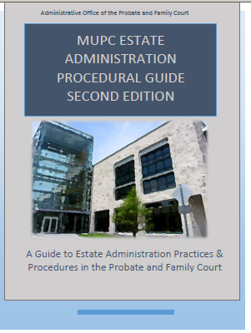
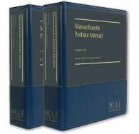
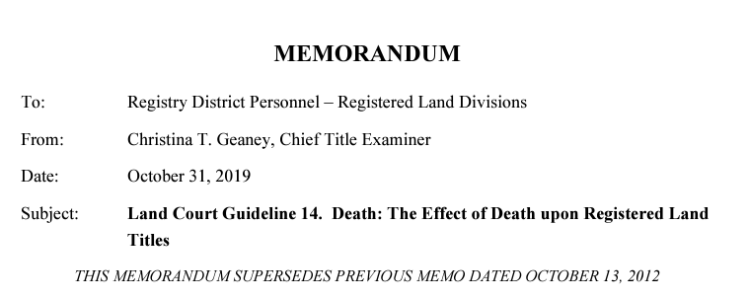
Resources
https://wwwˌmassˌgov/estate-administration-resources-mupc-hub
Chapter 11
wwwˌmassˌgov/doc/land-court-chief-title-examiner-memorandum-re-land-court-guideline-14-death-the-effect-of-death/download

Slide 3

Probate Property Requires a Probate Proceeding
A probate proceeding is necessary when the deceased owner was:
The sole owner of real property
A tenant in common with other owners

Slide 4

MUPC at § 3-101: Passage of Title Upon Death
“. . . Upon the death of a person, the decedent's real and personal property devolves to the persons to whom it is devised by the decedent's last will or to those indicated as substitutes for them in cases involving lapse, renunciation, or other circumstances affecting the devolution of testate estate, or in the absence of testamentary disposition, to the decedent's heirs, or to those indicated as substitutes for them in cases involving renunciation or other circumstances affecting devolution of intestate estates, subject to allowances and exempt property, to rights of creditors, elective share of the surviving spouse, and to administration.”
MUPC at § 3-101 (emphasis added).

Slide 5
MUPC at § 3-709: PR’s Right to Possession or Control
“(a) Except as otherwise provided by a decedent's will, every personal representative has a right to, and shall take possession or control of, the decedent's property, except that any real property or tangible personal property may be left with or surrendered to the person presumptively entitled thereto unless or until, in the judgment of the personal representative, possession of the property will be necessary for purposes of administration. The request by a personal representative for delivery of any property possessed by an heir or devisee is conclusive evidence, in any action against the heir or devisee for possession thereof, that the possession of the property by the personal representative is necessary for purposes of administration. The personal representative shall pay taxes on, and take all steps reasonably necessary for the management, protection and preservation of, the estate in the personal representative's possession. The personal representative may maintain an action to recover possession of property or to determine the title thereto.”
NOTE: The PR does NOT hold title to the property because title vests in the heirs or devisees (or both) subject to administration. MUPC at § 3-101.

Slide 6
MUPC at § 3-901: Successors’ Rights if No Administration
“In the absence of administration, the heirs and devisees are entitled to the estate in accordance with the terms of a probated will or the laws of intestate succession.
Devisees may establish title by the probated will to devised property.
Persons entitled to property by family allowance, exemption or intestacy may establish title thereto by proof of the decedent's ownership, his death, and their relationship to the decedent. Successors take subject to all charges incident to administration, including the claims of creditors and allowances of surviving spouse and dependent children, and subject to the rights of others resulting from abatement, retainer, advancement, and ademption.”
MUPC at § 3-901 (emphasis added).

Slide 7

MUPC at § 3-102: Wills Must be Probated
“Except as provided in section 3-1201, to be effective to prove the transfer of any property or to nominate an executor, a will shall be declared to be valid by an order of informal probate by a magistrate or an adjudication of probate by the court. . . “
MUPC at § 3-102 (emphasis added).

Slide 8

§ 3-108 Time Limits to Probate a Will
For MUPC deaths (on or after 3/31/2012), unless an exception applies, the general rule is that an informal or a formal proceeding to probate a will must be commenced (“filed”) within 3 years of date of death.
The purpose of this section under the UPC was to establish a basic limitation period of 3 years within which it may be determined whether a decedent left a will and to secure administration. If no will was probated within 3 years of death, the section had the effect of making the assumption of intestacy final.

Slide 9

§ 3-108 (3) Exception to Contest an Informally Probated Will
When a will is informally probated, § 3-108 (3) grants persons interested in the estate the ability to contest the informally probated will within the later of 12 months from the informal probate or 3 years from date of death.
The purpose of this exception is to assure that heirs will have at least one year after an informal probate to initiate a contest and to secure administration of the estate as intestate.

Slide 10

The Effect of § 3-108 (3)
If there are no formal testacy proceedings instituted within the later of 12 months from the informal probate or 3 years from date of death, devisees under the informally probated will are provided conclusive proof of their title regardless of whether there is administration of the estate. Their titles are not only conclusive as against the decedent’s heirs, but also as against the decedent’s devisees under unprobated wills.
Once the § 3-108 contest/challenge period runs, testacy status is final.

Slide 11

§ 3-108 Time Limits and Formal Proceedings to Probate a Will
A formal proceeding that adjudicates the validity of the will shortens the time limits within which such issues can be litigated under § 3-108.
A formal proceeding includes both an action to open an estate (Petitions for Formal) or to close an estate (Petition for Complete Settlement).
Once a formal decree issues, testacy status is final (subject only to appeal, Rule 60, and to being vacated for a limited period of time and for limited reasons under §§ 412, 413).

Slide 12
§ 3-108 (4) “Late and Limited” Exception to Probate a Will
Section 3-108 provides an exception to the basic 3 year rule to probate a will. Under § 3-108(4), a will may be admitted to probate at any time if no proceedings were commenced within 3 years of date of death.
However, any PR appointed under this exception (if any) has very limited authority. The PR may only confirm title in successors to the estate and pay expenses of administration, if any. The PR cannot take possession or control estate assets as provided for in § 3-709. For MUPC deaths, a Late and Limited PR may not sell real estate.
If a PR is not necessary, think twice before requesting their appointment.

Slide 13
The effect of § 3-108 (4)
Three years after the death of a MUPC decedent, if there is no record of any probate proceeding with respect to the decedent, title can no longer rest with the heirs. The presumption of intestacy has gone out the window. Testacy status must now be determined by formal decree in a Late and Limited proceeding. Filing a Formal Petition requesting just a determination of heirs is likely not enough.

Slide 14
§ 3-108 Time Limits and Intestate Estates
For MUPC deaths (on or after 3/31/2012), unless an exception applies, the general rule is that an informal or a formal proceeding to appoint a PR in an intestate estate must be commenced (“filed”) within 3 years of date of death.
In an informal intestate proceeding appointing a PR, the question of whether the decedent died leaving a valid will was not considered, therefore such a will could still be probated within the 3 years from death limitation under § 3-108.

Slide 15

The effect of § 3-108 on Intestate Estates
After an informal appointment, if there are no formal proceedings instituted within 3 years from date of death to probate a will, any later-discovered will cannot be probated.
Once the § 3-108 time limits run, testacy status is final.

Slide 16
§ 3-108 Time Limits Formal Proceedings Intestate Estates
A formal proceeding that adjudicates the testacy status of the estate as intestate, shortens the time limits within which such issues can be litigated under § 3-108.
A formal proceeding includes both an action to open an estate (Petitions for Formal) or to close an estate (Petition for Complete Settlement).
Once a formal decree issues, testacy status is final (subject only to appeal, Rule 60, and to being vacated for a limited period of time and for limited reasons under §§ 412, 413).

Slide 17


Petition for Order of Complete Settlement:
The formal proceeding to close an estate
Remember: In addition to requesting the approval of a final account or to determine and approve a proposed distribution or to construe a probated will, a Petition for Order of Complete Settlement may request that the court:
Adjudicate in/testacy, if not previously formally determined and within the time limits of § 3-108;
Adjudicate the identity of the heirs at law, if not previously formally determined.
What you don’t get on an informal opening, you may get on a formal closing!

Slide 18

SALE OF REAL ESTATE BY THE PERSONAL REPRESENTATIVE

Slide 19
Power of Sale in the Will
If the Will gives the PR the power to sell real estate, the PR may exercise that power once the Will has been admitted to probate (informal or formal), the PR is appointed, and their bond is approved. G. L. c. 190B, § 3-175 (23 ½)
A PR appointed in a Late & Limited formal has limited authority. G. L. c. 190B, § 3-108. Check with your title examiner!
See also REBA Title Standards 10, 40, and 78.

Slide 20

Bottom Line on Using the Power of Sale
The Will must be admitted to probate and expressly give the PR the power of sale
The sale must be to disinterested third parties (not to the PR!)
Need estate tax affidavit and/or release(s), as applicable, for 10 years from death
No requirement to close the estate to extinguish the power
Registered Land – See Land Court Memorandum

Slide 21
License to Sell
Obtain if:
• Sale out of Intestate Estate
• No Power of Sale in the Will
• Protecting PR in, e.g., sale to self, sale of partial interest with easement over rest, sale of whole interest, depending on circumstances
See G. L. c. 202 and REBA Title Standard 78

Slide 22
License to Sell
G.L. c. 202 has remained intact
Time limits on filing for a license:
Within 1 year after the date of the giving of the PR’s bond (or if a successor PR is appointed w/i this year, then within 6 months after the date of the giving of a bond by the successor PR) for general license (ex., heirs don’t want RE, instead want proceeds) (G. L. c. 202, § 19)
Any time to satisfy debts where the claim had been duly noticed within the one-year statute of limitations (G.L. c. 202, § 1)
Within 6 years from the date of the PR giving bond to sell for expenses or charges of administration (G. L. c. 202, § 20A)

Slide 23
License to Sell
Forms Required
Timely Petition signed by fiduciary
Attach property description with docket number and case name
Co-Tenant Ownership - Sale price is for only decedent’s interest
Inventory
Additional Bond
Release of MA estate tax lien (G. L. c. 65C affidavit or commissioner’s release if taxable estate)
Military Affidavit (yes, unless all parties interested assent)
Proof of Publication on Informal? Yes
Proposed Decree MUST reflect “correct legal description”

Slide 24
License to Sell
• Notice must be given to “all persons interested” unless written assents – See Chapter 11
Generally speaking:
Intestate Estate: heirs
Testate Estate:
If PR appointed formally: to specific devisees or residuary takers if the real estate passes by the residue.
If PR appointed informally (and still within the challenge period) to:
Purported heirs and devisees
• Additional Interested Persons: see Probate Manual – examples include:
• AG
• Division of Medical Assistance
• Appointed fiduciary for deceased heir or devisee
• GAL if necessary for incapacitated person or minor

Slide 25

Sale of Real Estate by Heirs/Devisees
The focus of this discussion is on recorded land.
For specific requirements related to registered land, see Land Court Guideline 14. Death: The Effect of Death upon Registered Land Titles, dated October 31, 2019, found at:
wwwˌmassˌgov/doc/land-court-chief-title-examiner-memorandum-re-land-court-guideline-14-death-the-effect-of-death/download

Slide 26

Sale of Real Estate by Heirs/Devisees
You need to evaluate:
T- H- C

Slide 27
Sale of Real Estate by Heirs/Devisees
T = Testacy Status
Ask: Has the testacy status been finally determined? In other words, are you certain that the decedent died with or without a valid will?
Formal Decree: Did a formal decree (opening or closing) adjudicate the testacy status of the estate?
Operation of Law/Running of Time: Did an Informal Order issue and has the challenge/contest period under MUPC § 3-108 run?

Slide 28

Sale of Real Estate by Heirs/Devisees
H = Heirs at Law
Ask: In an intestate estate, have the heirs at law been adjudicated?
Formal Decree: Did a formal decree (opening or closing the estate) adjudicate their identity?
Title Standard 41: If no, (for Recorded Land only), is TS 41 (as amended) helpful?

Slide 29

Sale of Real Estate by Heirs/Devisees
C = Conclusion of Administration
Ask: If a PR was appointed, has their administration concluded?
In other words, is it certain that the PR may no longer seek a license to sell the real estate to pay costs of administration pursuant to G. L. c. 202 § 20A? Do any of the following apply:
(1) more than one year has passed since the filing of a Closing Statement (MPC 850); or
(2) a Decree and Order of Complete Settlement issued allowing the PR’s final account; or
(3) a period of six (6) years has passed from the date of approval of the PR’s bond; or
(4) the decedent’s Will was admitted to probate in a late and limited proceeding and devisees can rely on TS 40?
Note: In addition to administration issues above, both the Massachusetts and the Federal Estate Tax lien must be dealt with for decedents who died less than 10 years ago. See generally, Title Standard 3, 24 and 61.

Slide 30
Sale of Real Estate by Heirs/Devisees
C = Conclusion of Administration
Closing Statement (after one year from filing)
Decree and Order of Complete Settlement issued allowing the PR’s final account
Operation of Law/Running of Time (6 years from date of PR’s bond)
Late and Limited probate of a Will: TS 40

Slide 31
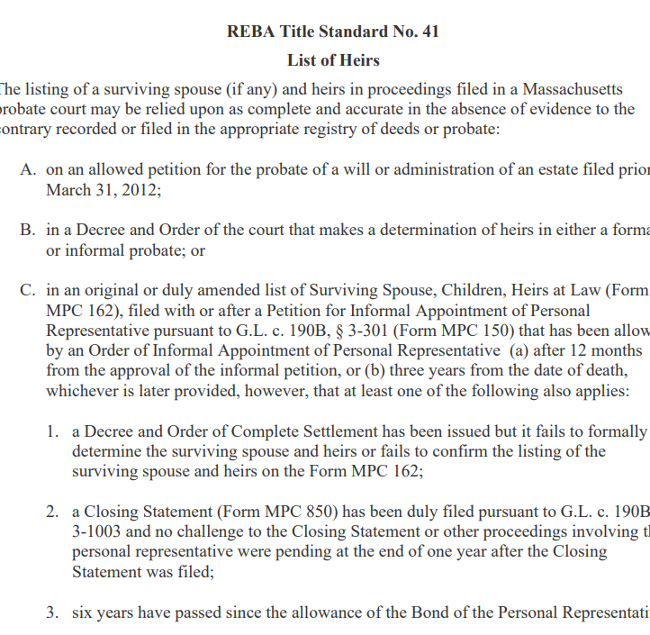
For Recorded Land ONLY Updated Title Standard 41:
In an intestate estate, after an informal appointment of a PR:
If you have T, and you have C, TS 41 will give you H ☺

Slide 32
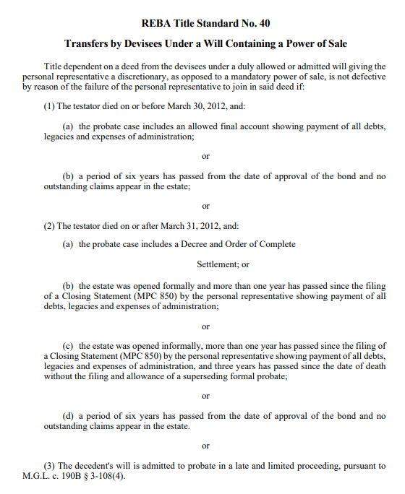
For Recorded Land ONLY Updated Title Standard 40:
The probate of a will in a Late & Limited proceeding will extinguish a discretionary power of sale
If you have T, TS 40 will give you C ☺

Slide 33
Takeaway #1
“T”
Testacy Status must be determined by formal decree (at the opening or at the closing) or by operation of law. In other words, the running of the “challenge period.”

Slide 34
Takeaway #2
“H”
Heirs at law must be formally determined in an intestate estate (at the opening or at the closing) or successors (heirs at law) must be able to rely on Title Standard 41 (for recorded land only).

Slide 35
Takeaway #3
“C”
The PR’s administration, if any, must be concluded.
(1) a Decree and Order of Complete Settlement issued allowing the PR’s final account; or
(2) more than one year has passed from the filing of a Closing Statement (MPC 850); or
(3) a period of six (6) years passed from the date of approval of the bond; or
(4) the decedent’s will is admitted to probate in a late and limited proceeding and devisees can rely on TS 40.
Note: In addition to administration issues above, both the Massachusetts and the Federal Estate Tax lien must be dealt with for decedents who died less than 10 years ago. See, generally, Title Standard 3, 24 and 61.

Slide 36
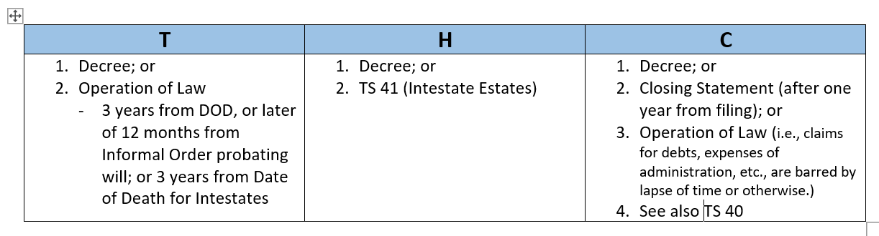
Key Takeaway... Summary of how to get T-H-C

Slide 37
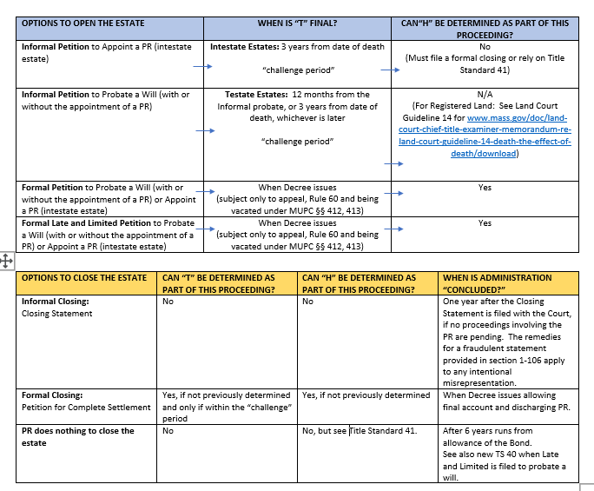

Slide 38
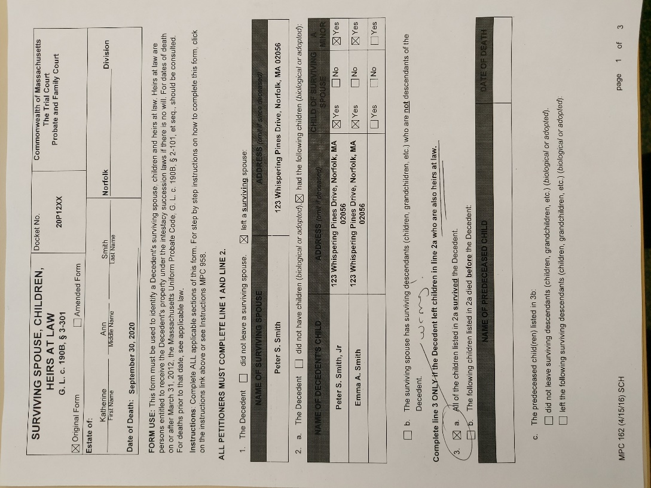
MPC 162: Surviving Spouse, Children, Heirs at Law Form
When children are NOT heirs at law, don’t say that they are at #3(a) on form MPC 162.

Slide 39
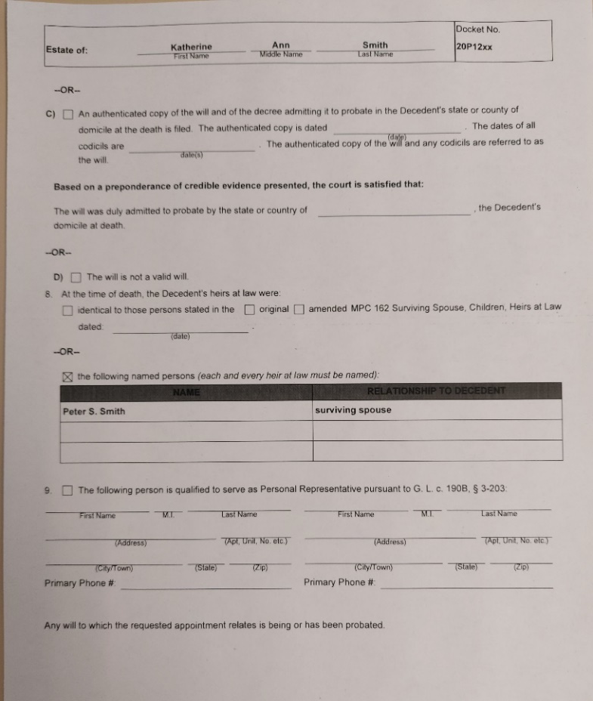
Formal Decree Determining Heirs- When Spouse is Sole Heir
When children are NOT heirs, don’t check off the box on the formal decree that states “heirs at law are as stated on form MPC 162.” Instead, write out the name of the surviving spouse on the decree to identify the correct heir at law.

Slide 40
Helpful REBA Forms
Form 32- Affidavit G. L. c. 65C, § 14 (a)
Form 32A- Affidavit Regarding Federal Estate Taxes
Form 58 – Deed of Distribution, G. L. c. 190B, § 3-907

Slide 41
Helpful REBA Title and Practice Standards
Title Standard 3 – Federal Estate Tax Liens
Title Standard 10 – Executor’s Power of Sale
Title Standard 14 – Missing Probates
Title Standard 24 – Massachusetts Estate Tax Liens
Title Standard 36 – Probate Inventories
Title Standard 40 – Transfers by Devisees
Title Standard 41 – List of Heirs
Title Standard 50 – Pretermitted Issue
Title Standard 71- Evidence of Death of Deceased Joint Owners and Life Tenants
Title Standard 78 – Personal Representative Conveyances per Power of Sale under Massachusetts Uniform Probate Code
Practice Standard 10 – Conveyances after Death: Recording of Documents

