Slide 1

Options to Close Estates and Allowance of Accounts

Slide 2
Options to Close an Estate:
Do Nothing
INFORMAL PROCEDURE:
Small Estate Closing Statement (§ 3-1204)
Closing Statement (§ 3-1003)
FORMAL PROCEDURE:
Petition for Order of Complete Settlement (§ 3-1001)
Must be filed for the allowance of a final account

Slide 3
Closing Statement Article III, § 3-1003
Form MPC 850
Closing Statement
An estate may be closed by filing Form MPC 850 if ALL of the following can be met:
The estate is not being administered by a Supervised PR;
There is no court order requiring a formal closing;
Six months have passed since date of appointment;
The time for creditor claims has expired (one year from date of death);
The PR has fully administered the estate by:
Distributing the estate
Making payment, settlement or other disposition of all claims presented, all expenses of administration, and estate inheritance and death taxes EXCEPT as may be specified in the Statement
The PR has furnished an account to distributees;
The PR sent a copy of the Statement to all distributees and to all creditors/claimants who have unbarred claims which have not been paid.

Slide 4
Allowance of Accounts
Inventory Form must be filed for allowance of accounts (MPC 854 & 854a)
PR Account Form (MPC 853 & 853a)
Petition for Allowance of Account (MPC 857) for non-final account
Petition for Order of Complete Settlement (MPC 855) for final account,
Decree (MPC 790)
Citation
Petition to Render Inventory/Account (MPC 856)

Slide 5
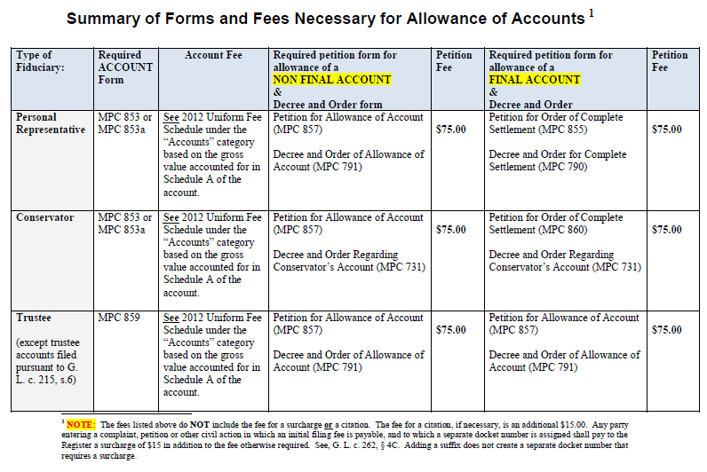
Allowance of Accounts

Slide 6
Petition for Order of Complete Settlement - Article III, § 3-1001
A Petition for Order of Complete Settlement filed to close the estate shall request approval of the final account and all of the following requirements must be met:
The final account has been filed;
The time for creditor’s claims has expired (one year from date of death);
One year has passed since the date of the original appointment of PR or the petitioner is the PR;
All interested persons have assented or been given notice; and
Any citation and military affidavit is filed with the court.

Slide 7
Petition for Order of Complete Settlement
Article III, § 3-1001
In addition to requesting the approval of a final account, a Petition for Order of Complete Settlement may request that the court:
Make a final determination of testacy, if not previously determined;
Make a final determination of the decedent’s heirs at law, if not previously determined;
Determine and approve a proposed distribution;
Construe a will as proposed.
Practice Alert: The request to determine testacy is subject to the time limits of § 3-108.

Slide 8
Petition for Order of Complete Settlement
Pre MUPC Cases
Intestate Estates:
You may request that the court formally determine the heirs at law
You may request that the court formally determine intestacy
Testate Estates:
You may request that the court formally determine the heirs at law
You may NOT request that the court formally re-determine testacy

Slide 9
Petition for Order of Complete Settlement Publication Requirements
Publication is ALWAYS required IF:
Rule 6 requires publication (i.e., an interested person’s whereabouts, address or identity is unknown); OR
You are requesting a determination of heirs; OR
You are requesting a determination of in/testacy.

Slide 10
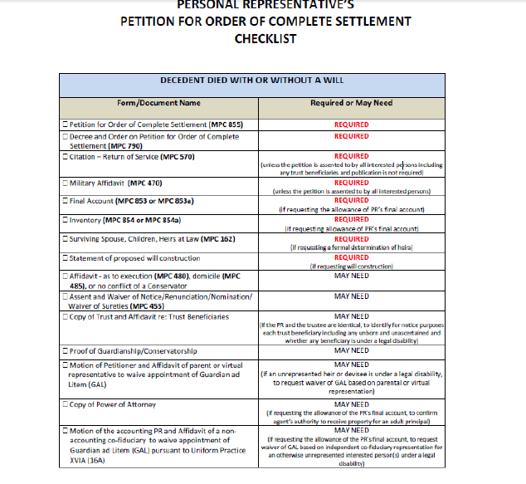
Petition for Order of Complete Settlement
Checklist
See Checklist
(MPC 972)
Handout

Slide 11
Petition for Order of Complete Settlement
Court Appointment of a GAL
A GAL must be appointed for a spouse, heir at law, or devisee who is an IP, PP or a minor UNLESS any of the following apply:
1. The spouse, heir at law, or devisee is represented by a
conservator;
2. The spouse, heir at law, or devisee is represented by a guardian who is not the petitioner;
3. The court has allowed a motion to waive the appointment of a GAL based on parental, virtual, or other representation as provided by § 1-403, § 3-915, or for any other reason.
MUPC at §§ 1-403, 1-404

Slide 12
Petition for Order of Complete Settlement
Statutory Waivers of Appointment Pursuant to § 1-403
To the extent there is no conflict of interest between them or among persons represented, the following fiduciaries may represent an heir at law or devisee who is an IP, PP, or a minor. NO motion to waive the appointment of a GAL is necessary.
1. Conservator. If an individual is a represented by a conservator, the conservator may represent and bind the person whose estate the conservator controls.
2. Guardian. If an individual is represented by a guardian, and no conservator has been appointed, the guardian may represent and bind the incapacitated person or minor.
3. Independent Trustee of Trust. An independent trustee of a trust may represent and bind the beneficiaries of the trust in a proceeding to probate a will establishing or adding to a trust, to review the acts or accounts of a prior fiduciary and in a proceeding involving creditors and other third parties.
4. Personal Representative. A personal representative of a decedent’s estate may represent and bind persons interested in the undistributed assets of a decedent’s estate.

Slide 13
Petition for Order of Complete Settlement
When the PR and Trustee are the same person:
Practice Alert: If there is a trust, notice shall be given to the trustee. The trustee represents the beneficiaries of the trust UNLESS the trustee and the PR are identical. MUPC at §§ 1- 201(10), 1-403. If the trustee and the PR are identical, notice also must be given to the trust beneficiaries, unless all beneficiaries have assented and waived notice. MUPC at §§ 1-201(24), 3-1001.
In that instance, the PR must provide a copy of the trust and an affidavit identifying each trust beneficiary and stating whether there are unborn or unascertained beneficiaries and whether any named beneficiary is under a legal disability. The trust and the affidavit shall be returned upon entry of the decree. Neither the trust nor the affidavit shall be entered on the docket or scanned unless otherwise ordered by the court.

Slide 14
Petition for Order of Complete Settlement
When heir at law or devisee is since deceased:
Practice Alert: In a proceeding for allowance of an account or a Petition for Order of Complete Settlement, if an heir at law or devisee is deceased at the time court proceedings are commenced, notice must be given to the PR of the since deceased person’s estate. MUPC at §§ 1-201(24), 3-1001.
If no PR has been appointed, publication is required. Assents of the presumptive heirs at law are NOT sufficient. In addition to notice by publication, the court may appoint a GAL or take other appropriate action.

Slide 15
Petition for Order of Complete Settlement
Permissive Waivers of Appointment Pursuant to § 1-403
The following persons may represent an heir at law or devisee who is an IP, PP, or a minor. A motion to waive the appointment of a GAL is REQUIRED.
Parent of a Minor. To the extent there is no conflict of interest, a parent may represent his/her minor child if a guardian or conservator has not been appointed and parental representation is pre-approved by the court.
Holder of a Power of Appointment. A holder of a non-testamentary general power of appointment or the holder of a broad special power of appointment may represent and bind all potential appointees.
Virtual Representative. A party who has a substantially identical interest may represent and bind an unborn or unascertained party who is not otherwise represented, if virtual representation is approved by the court.

Slide 16
Petition for Order of Complete Settlement
Permissive Waivers of Appointment Pursuant to § 1-403
Practice Alert: For a permissive waiver of the appointment of a GAL based on § 1-403, a motion must be filed and supported by an affidavit of the representative setting forth sufficient facts for consideration by the court.
An affidavit from counsel for the petitioner is not sufficient.
A motion to waive a GAL supported by an affidavit may be allowed without a hearing in the discretion of the court; provided, however, that the filer shall be given an opportunity to be heard before such motion is denied.
Note: Section 1-108 also permits the court, in its discretion, to waive the appointment of a GAL in a proceeding for allowance of an account where a person entitled to notice has a general power of appointment or the power to appoint among a class of appointees which is broader than the class of persons who would take in default of the exercise of the power.

Slide 17
Petition for Order of Complete Settlement
Permissive Waivers of Appointment Pursuant to § 3-915
Pursuant to § 3-915, a PR may distribute to an heir at law or devisee who is under a legal disability as follows provided there is no conflict of interest. A motion to waive the appointment of a GAL is REQUIRED.
1. Express Terms of Will. A PR may discharge his/her obligation to distribute to any person under legal disability by distributing in a manner expressly provided in the will.
2. Chapter 201A or Other Statute (UTMA). Unless contrary to the express provision in the will or if a conservator has been appointed or a proceeding to appoint a conservator is pending, a PR may discharge an obligation to distribute to a minor or person under disability as authorized by Chapter 201A or any other statute (e.g., G. L. c. 190B, § 5-102, G. L. c. 215, § 41A, G. L. c. 203B).
3. Agent under Power of Attorney. If an heir at law or devisee is under disability other than minority, a PR is authorized to distribute to an agent under a power of attorney who has authority to receive property for that party.
4. Spouse/Parent/Other Close Residential Relative. If an heir at law or devisee is under disability other than minority, a PR is authorized to distribute to a spouse, parent or other close relative with whom the party resides if the distribution is of amounts not exceeding $10,000 a year, or property not exceeding $10,000 in value, unless the court authorizes a larger amount or greater value.

Slide 18
Petition for Order of Complete Settlement
Permissive Waivers of Appointment Pursuant to § 3-915
Practice Alert: For a permissive waiver of the appointment of a GAL based on § 3-915, a motion to waive a GAL must be filed and supported by an affidavit of the representative. An affidavit from counsel for the petitioner is not sufficient.
A motion to waive a GAL supported by an affidavit may be allowed without a hearing in the discretion of the court; provided, however, that the filer shall be given an opportunity to be heard before such motion is denied.
Practice Alert: In a proceeding for approval of an account or a distribution, the court shall require a copy of any necessary document to confirm the identity of the representative and the power to distribute in accordance with that document. If requested, the document shall be returned upon entry of the decree. The document shall not be scanned unless otherwise ordered by the court.

Slide 19
Petition for Order of Complete Settlement
Permissive Waivers of Appointment Pursuant to UP XVIA
Pursuant to Uniform Practice XVIA (16A):
If a non-accounting co-fiduciary of an accountant, who has received or waived notice relating to the allowance of the account(s), currently represents the interests of a person or persons, the court may waive the appointment of a GAL for such person or persons upon motion of the accountant brought ex parte.
Such motion shall be accompanied by an affidavit of the co-fiduciary representing:
1. that such co-fiduciary has received or waived notice relating to the allowance of the pending account(s);
2. that such co-fiduciary is not aware of any conflict of interest which would prevent him/her from representing the person or persons whose interest would otherwise require appointment of a GAL;

Slide 20
Petition for Order of Complete Settlement
Permissive Waivers of Appointment Pursuant to UP XVIA
3. that such co-fiduciary has a duty to account in his/her capacity as a fiduciary;
4. that such co-fiduciary recognizes that he/she has a fiduciary duty to review such pending accounts with due care and has done so; and
5. that such fiduciary assents to the allowance of the pending account(s).
Such motion may be allowed without a hearing in the discretion of the court; provided, however, that the accountant shall be given an opportunity to be heard before such motion is denied.
Practice Alert: Failure to provide any of the requirements provided by Uniform Practice XVIA (16A) shall result in the appointment of a GAL or other appropriate action by the court.

Slide 21

Petition for Order of Complete Settlement
Notice Requirements
Unless the written assents and waivers of notice of all persons interested in the proceeding are filed, after the filing of a Petition for Order of Complete Settlement, the registry shall fix a return date and issue a citation.
Practice Alert: If the only relief requested in the Petition for Order of Complete Settlement is the allowance of the final account, Rule 72 of the Supplemental Rules of the Probate and Family Court applies and no citation need be issued if the written assents and waivers of notice of all persons interested in the account are filed. See Rule 72(b) of the Supplemental Rules of the Probate and Family Court and form MPC 455, Assent and Waiver of Notice/Renunciation/Waiver of Sureties.

Slide 22
Petition for Order of Complete Settlement
Persons Entitled to Notice
The petitioner shall provide notice to all interested persons. An interested person entitled to notice (or his/her attorney, if represented) including a GAL, conservator or other fiduciary, may waive the right to notice by filing a written assent and waiver of notice. A minor or an incapacitated or protected person may not waive notice.
Depending upon the particular relief requested, persons who may be interested in the Petition for Order of Complete Settlement may include the following:
1) heirs at law;
2) devisees (in the case of a devise to an trust, the trust or trustee is the devisee and the beneficiaries are not devisees;
3) persons having a property right in or claims against the estate of the decedent;
4) an attorney of record who has been designated by the client to receive notice;
5) any GAL appointed;
6) a fiduciary or other representative pursuant to § 1-403;
7) any representative pursuant to § 3-915 on behalf of a legally disabled person and the person represented regardless of age.

Slide 23
Petition for Order of Complete Settlement
Persons Entitled to Notice
If the proceeding affects a charitable interest or beneficiary, the petitioner must give notice to the charity and to the Attorney General of Massachusetts. The Attorney General must also be provided notice if there is no spouse or heir at law of the decedent. Uniform Practice XXXIV (34) of the Probate Court.
In certain circumstances, the Veterans Administration must be notified. See MUPC at § 2-105.
Practice Alert: In a proceeding for allowance of an account or a Petition for Order of Complete Settlement, if an heir at law or devisee is deceased at the time court proceedings are commenced, notice must be given to the PR of the since deceased person’s estate. MUPC at §§ 1-201(24), 3-1001. If no PR has been appointed, publication is required. Assents of the presumptive heirs at law are NOT sufficient. In addition to notice by publication, the court may appoint a GAL or take other appropriate action.

Slide 24
Petition for Order of Complete Settlement
Persons Entitled to Notice
Practice Alert: If there is a trust, notice shall be given to the trustee. The trustee represents the beneficiaries of the trust UNLESS the trustee and the PR are identical. If the trustee and the PR are identical, notice also must be given to the trust beneficiaries, unless all beneficiaries have assented and waived notice.

Slide 25
Petition for Order of Complete Settlement
How Notice is Given
The petitioner shall give notice of the proceeding as provided in the citation’s Order of Notice and in accordance with Rule 6 of the Supplemental Rules of the Probate and Family Court.
a. Service within Massachusetts
Service of a citation within Massachusetts shall be given by delivering in hand or by mailing by certified, registered or ordinary first class mail at least fourteen (14) days before the return date.
b. Service outside of Massachusetts
If it shall appear from the petition that there is anyone interested who is outside of Massachusetts in any part of the United States, its Commonwealths or territories, service of the citation shall be given by delivering in hand or by mailing by certified, registered or ordinary first class mail at least fourteen (14) days before the return day; if in other parts, one (1) month.

Slide 26
Petition for Order of Complete Settlement
How Notice is Given
c. Service when Whereabouts are Unknown
If it shall appear from the petition that a person is of parts unknown, service of the citation shall be given by delivery or mailing to the last known address at least one (1) month before the return day. See also Service by Publication below.
d. Service by Publication
In addition to the service requirements above, publication shall be required if a person’s whereabouts, address or identity is unknown. Publication shall also be required if a Petition for Order of Complete Settlement requests a formal determination of testacy or a formal determination of the decedent’s heirs at law. A copy of the citation shall be published once in a newspaper designated by the Register of Probate at least seven (7) days before the return day.

Slide 27
Petition for Order of Complete Settlement
Contesting the Allowance of an Account or a Petition for Order of Complete Settlement
File a Written Notice of Appearance and Objection (MPC 505a) by the Return Date – AND-
File a written affidavit of objections within 30 days of the return date.
Subject to being stricken by motion if not timely filed or if affidavit does not state specific facts and grounds.
MUPC at § 1-401

Slide 28
Petition for Order of Complete Settlement
Next Steps:
CONTESTED CASES:
In order to request a hearing date to appear before the court on a contested petition, the petitioner must file a Request for a Case Management Conference or other applicable form. The court’s judicial case manager may be consulted for further information regarding the scheduling of a hearing date.
Note: A contested petition shall be heard by a judge of the court and not a magistrate. A magistrate has no authority to hear a contested matter.
UNCONTESTED CASES:
If the petition is uncontested and a hearing is not required, the petitioner shall submit to the court, either in person at the registry or by mail, all necessary documents for allowance by the magistrate or court.
The court or the magistrate may enter appropriate orders after the return date on the strength of the pleadings if satisfied that all conditions are met or the court may conduct a hearing and require proof of the matters necessary to support the order sought.

Slide 29
Practical Tips
Practical Tips:
Review Instructions, if necessary
If requesting a determination of heirs, must include form MPC 162
Don’t check off every box in Petition – only what you need!
Submit a proposed Decree (MPC 790)
Provide Notice to proper parties (trustee/benes, AG)
Provide proper motion/affidavit if requesting waiver of GAL
Publish, if necessary (see Rule 6; request to determine heirs/testacy)
Submit correct filing fee

Slide 30
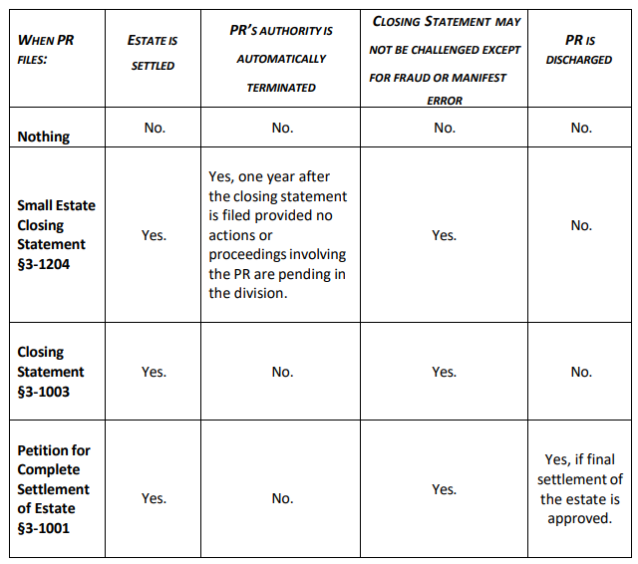
Closing Options Review:

Slide 31
Discovery of Additional Assets
If additional estate assets are discovered after the court enters a decree on a Petition for Complete Settlement discharging the PR and sureties from liability, the PR shall use the following procedure to administer the additional estate assets:
1. File an “Affidavit of Additional Assets” listing the value of the additional assets along with a Certificate of Service acknowledging that the Affidavit was sent to all persons interested in the estate, including the Division of Medical Assistance, Estate Recovery Unit and the Attorney General, if applicable.
2. File a subsequent bond (MPC 801) to cover the amount of the additional assets. Form MPC 455 may be filed for each person interested in the estate to waive sureties on the PR’s subsequent bond.

Slide 32
Discovery of Additional Assets
3. If requested, new Letters may be issued from the registry after the affidavit is filed and the bond has been approved.
Fee Alert: The fee to file a subsequent bond is $75.00. The fee for each Letter requested is $25.00.
4. A PR may close the estate as to the additional assets under any of the available MUPC options (e.g., Petition for Complete Settlement or Closing Statements).
Fee Alert: The filing fee for all accounts of additional assets filed shall be in accordance with the Uniform Fee Schedule based on the value listed in Schedule A and not the $75.00 fee for an “Amended/Substituted” Account.

